Slide 1
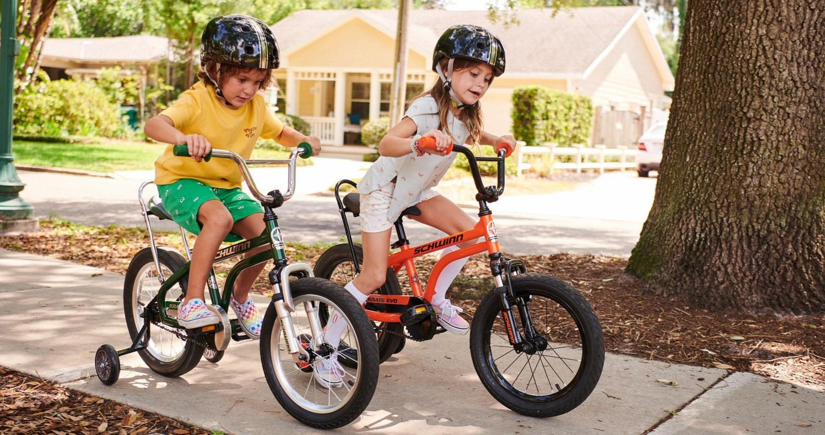

Slide 2
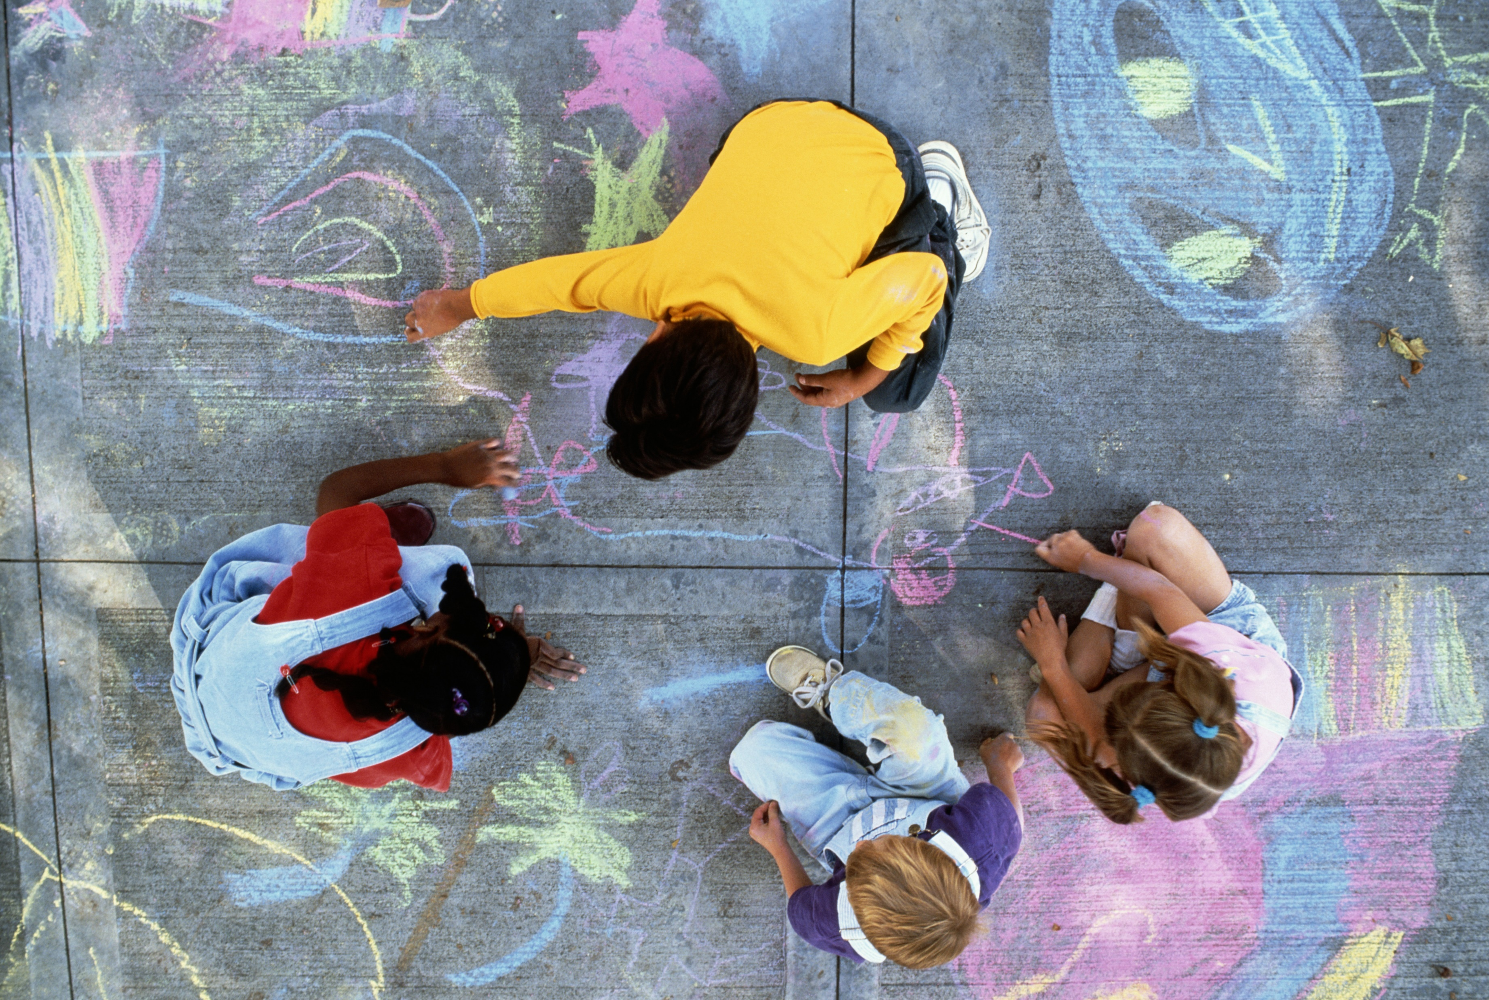

Slide 3


Slide 4
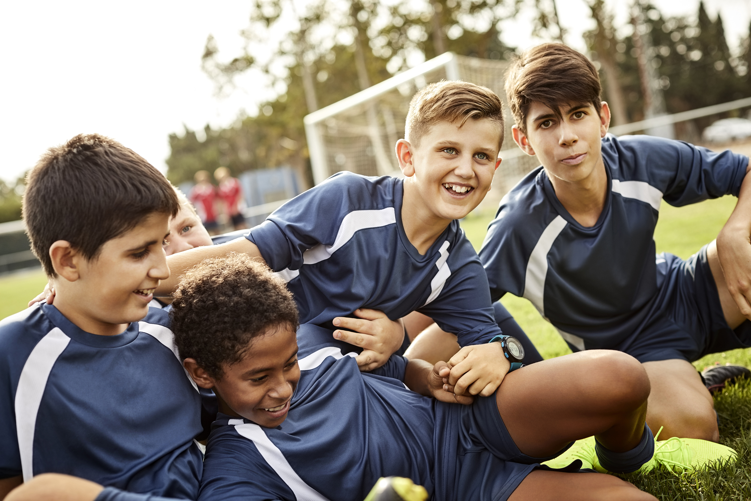

Slide 5


Slide 6
Time with friends

Slide 7


Slide 8
‘Do to others as you would have them do
to you.’
Luke 6.31

Slide 9
‘Carry each other's burdens.’
Galatians 6.2

Slide 10
‘A friend loves at all times, and a brother is born for a time of adversity.’
Proverbs 17.17

