Slide 1
Welcome

Slide 2
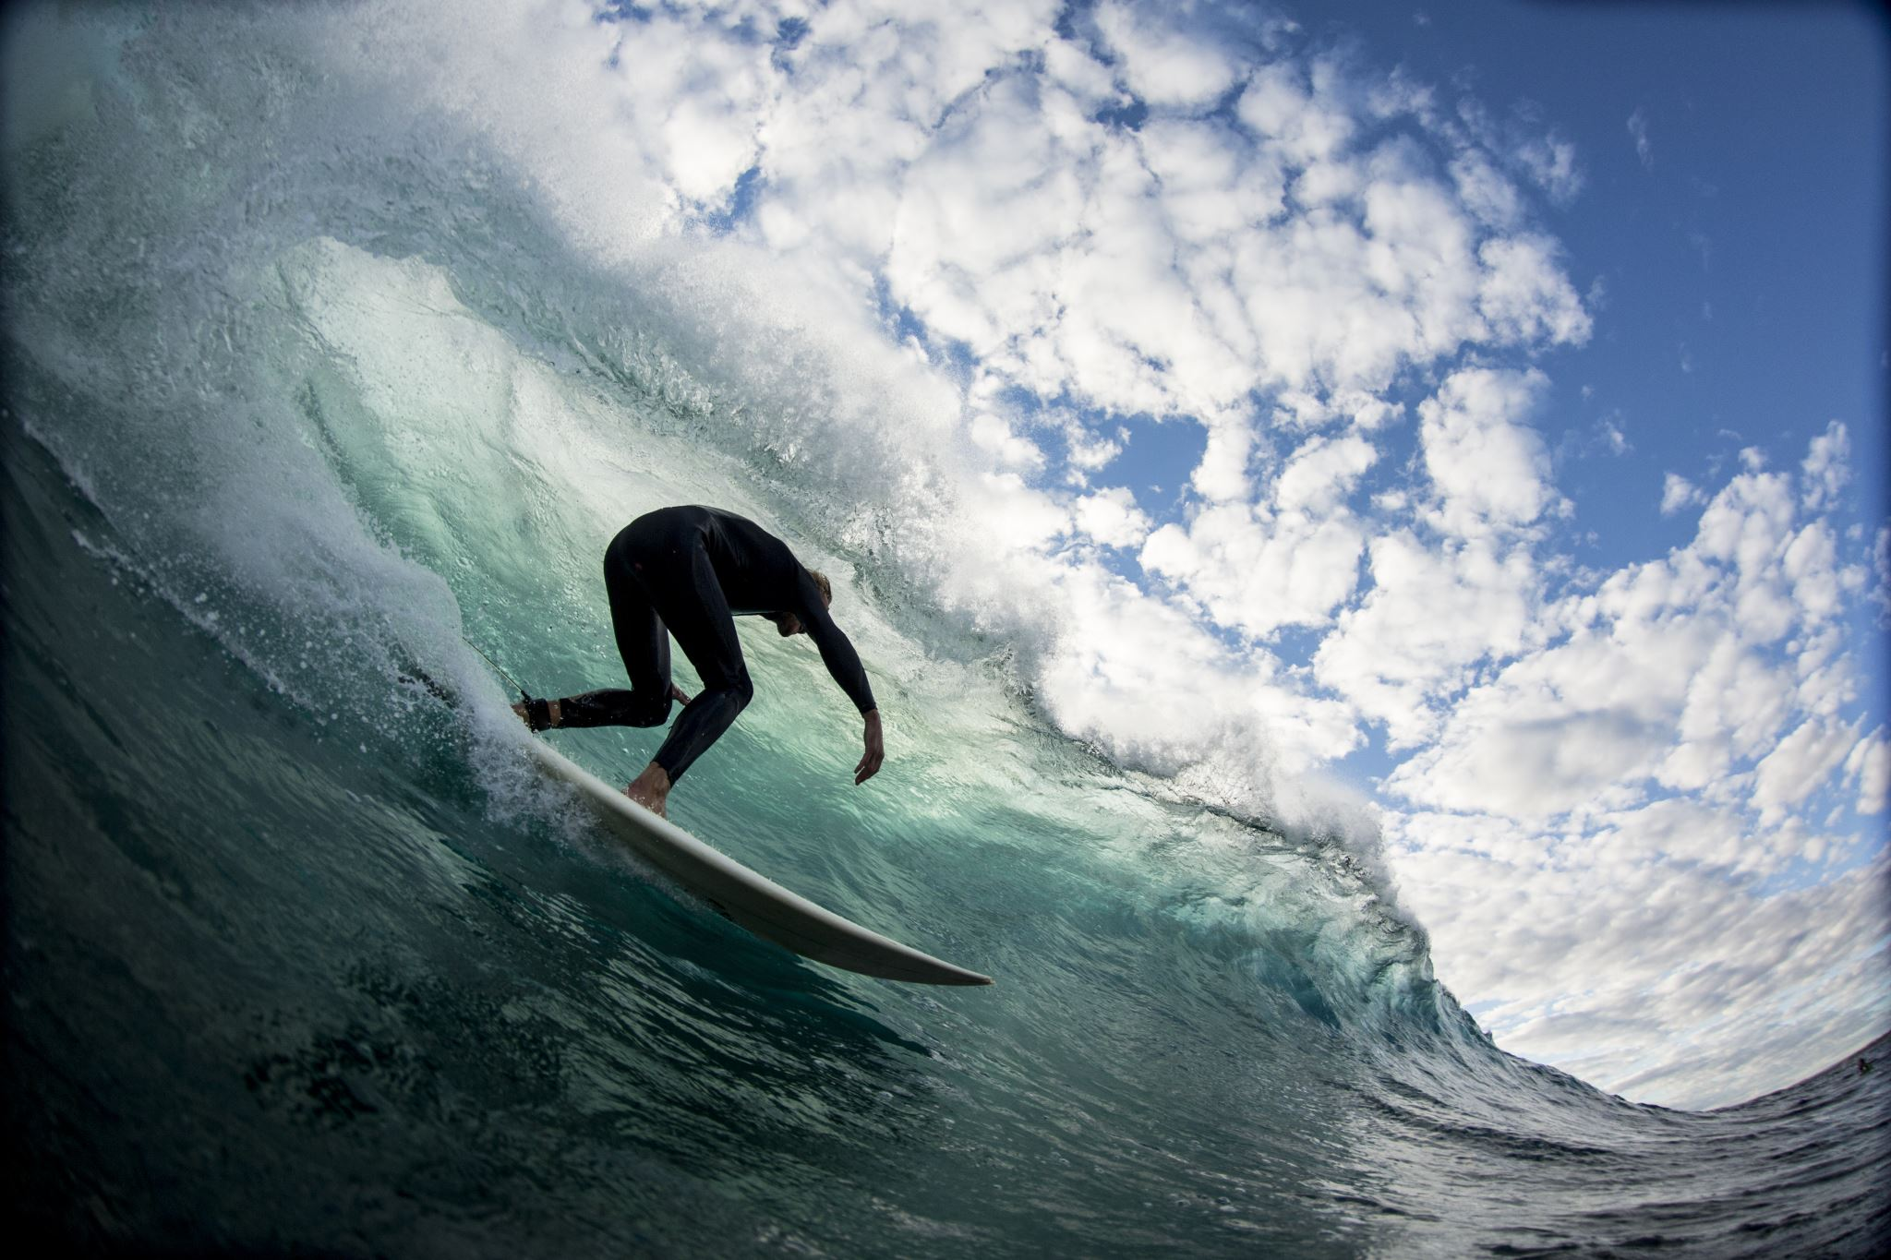
Welcome

Slide 3

Welcome

Slide 4

Welcome

Slide 5

Welcome

Slide 6
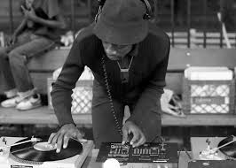



Slide 7

Welcome

