Slide 1

This Makes
No Sense!
Do we ever make mistakes at school?

Slide 2
This Makes
No Sense!
What sort of mistakes might we make?

Slide 3
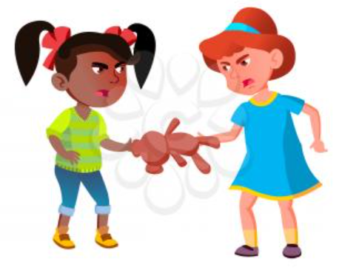
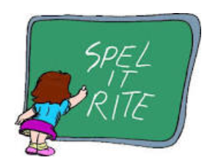

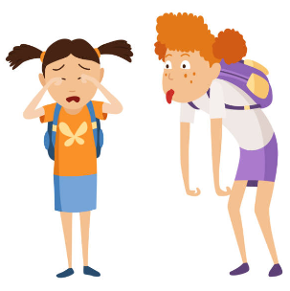

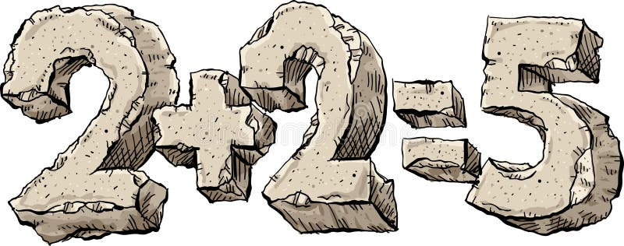
Falling out
with friends
Not spelling words correctly
This Makes
No Sense!
Not doing our homework
Upsetting
a friend
Losing our drinks bottle
Not adding numbers correctly

Slide 4
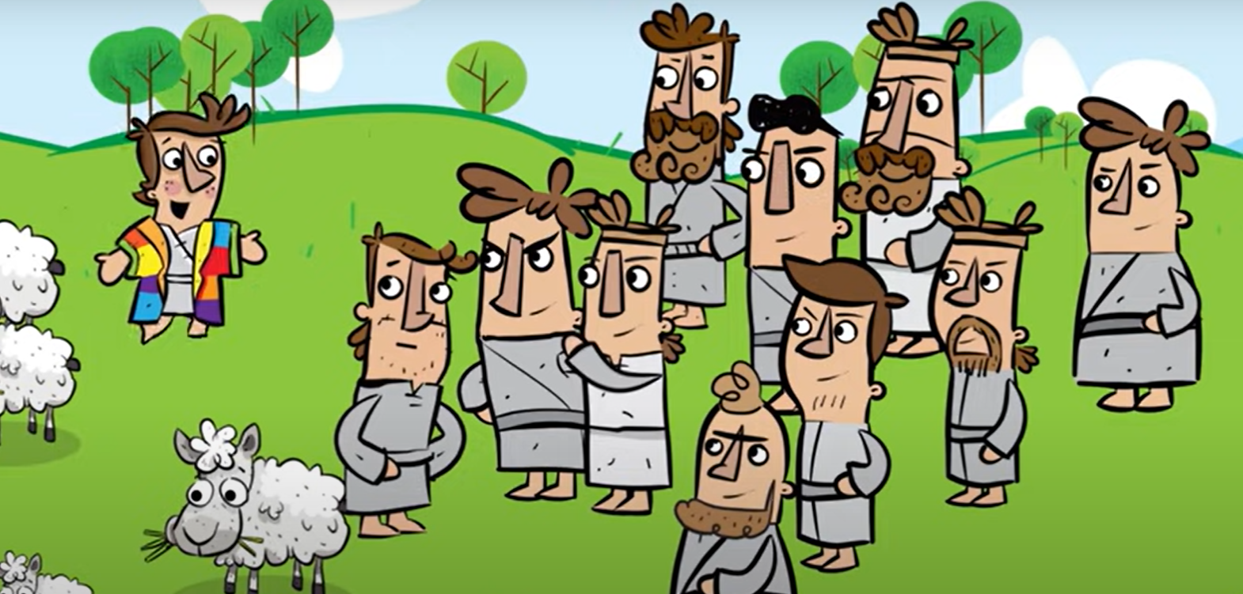
This Makes
No Sense!
Why is it a mistake to be boastful?

Slide 5
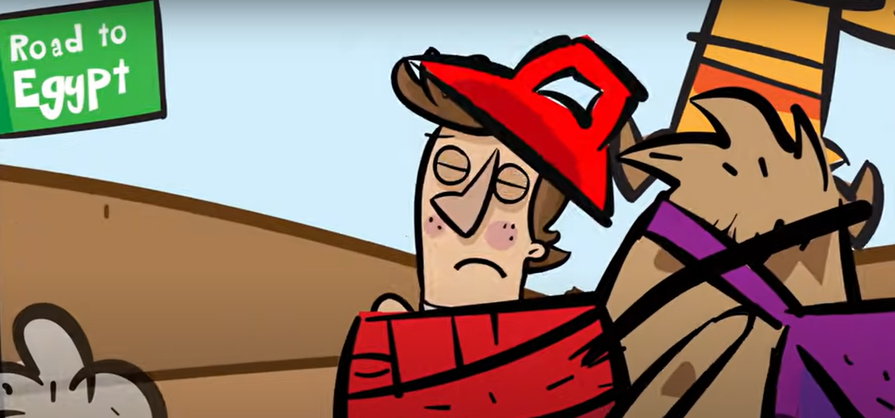
This Makes
No Sense!
How should Joseph's brothers have reacted?

Slide 6
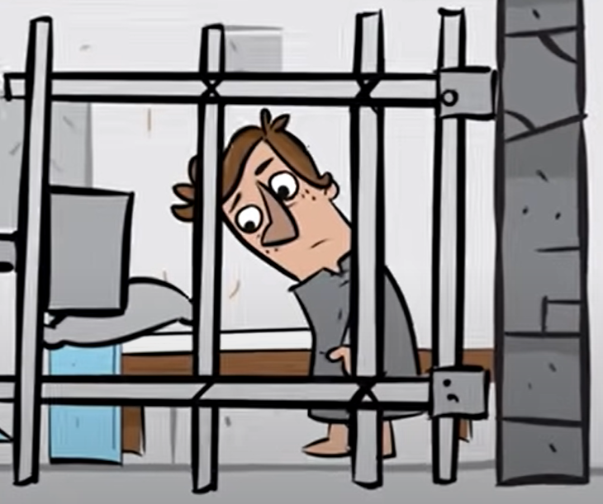
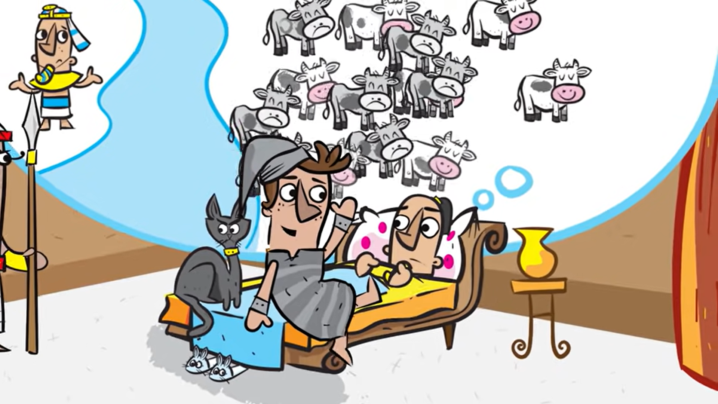
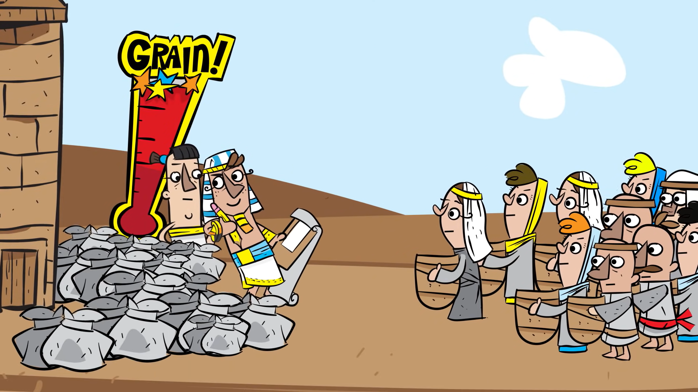
This Makes
No Sense!
How were the mistakes corrected?

Slide 7
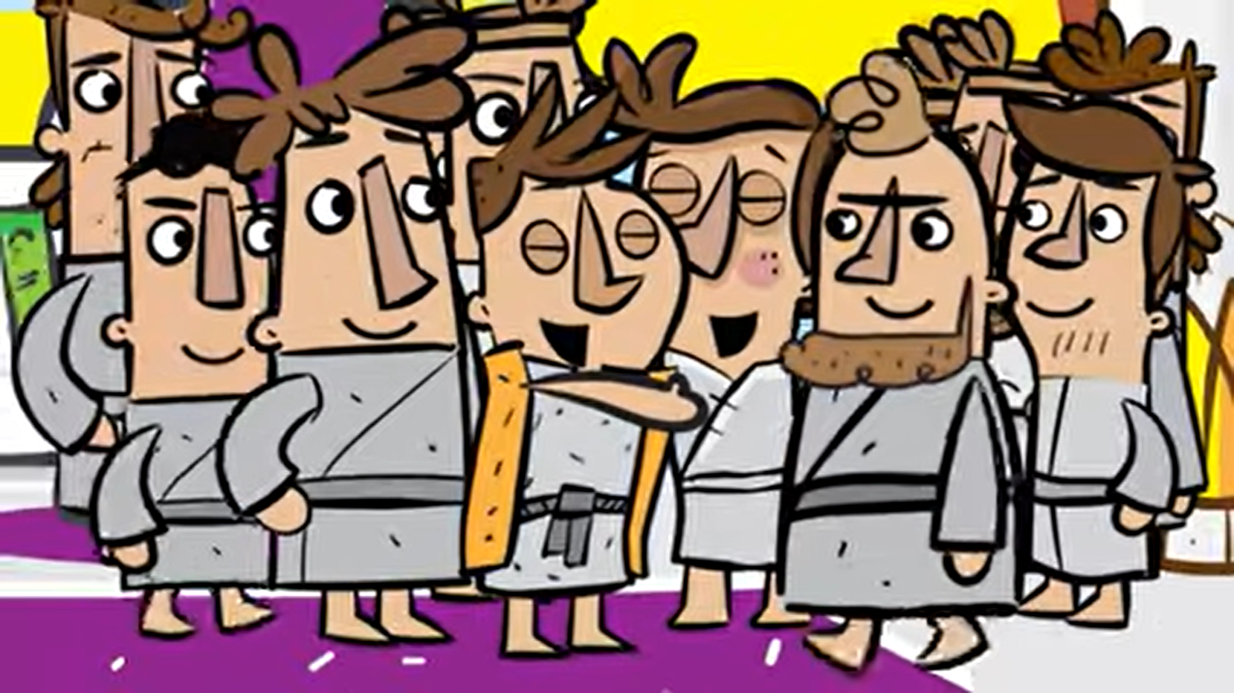
This Makes
No Sense!
Why did Joseph forgive his brothers?

Slide 8


This Makes
No Sense!

