Slide 1
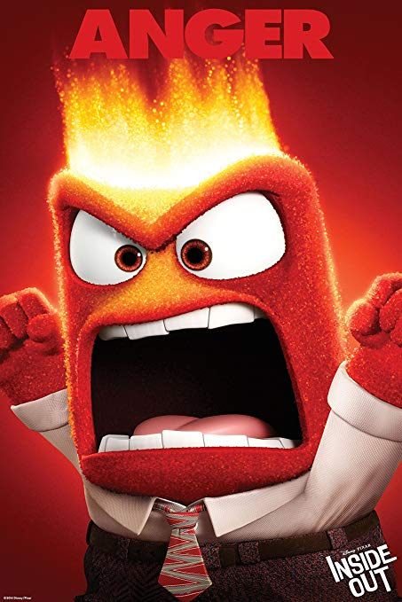



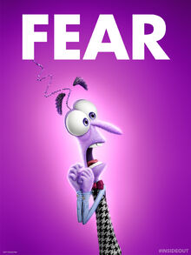
Joy Is Strong!
What are the names of the five emotions from the film Inside Out?

Slide 2


Joy Is Strong!

Slide 3
Joy Is Strong!
Why is joy a strong emotion?

Slide 4

Joy Is Strong!
Do the other emotions have their strengths?

Slide 5
Joy Is Strong!
What are the strengths of anger?

Slide 6
Joy Is Strong!
What are the strengths of fear?

Slide 7
Joy Is Strong!
What are the strengths of disgust?

Slide 8
Joy Is Strong!
What are the strengths of sadness?

Slide 9

Joy Is Strong!
What is the difference between joy and happiness?

Slide 10

Joy Is Strong!

