Slide 1


Slide 2


Slide 3


Slide 4
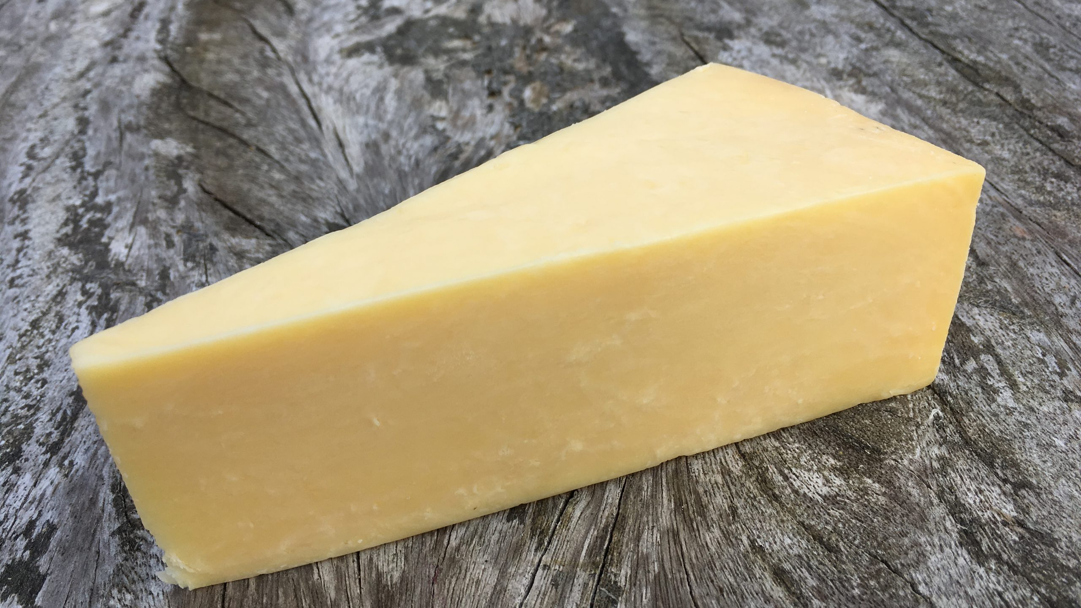

Slide 5
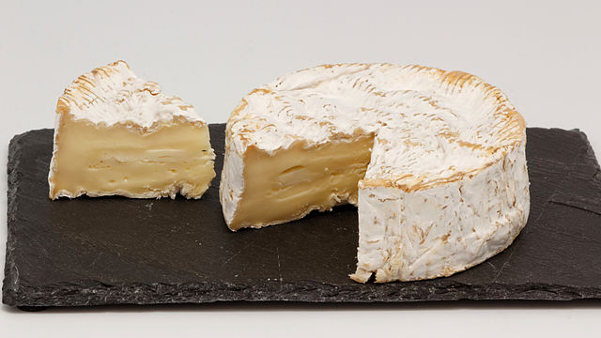

Slide 6
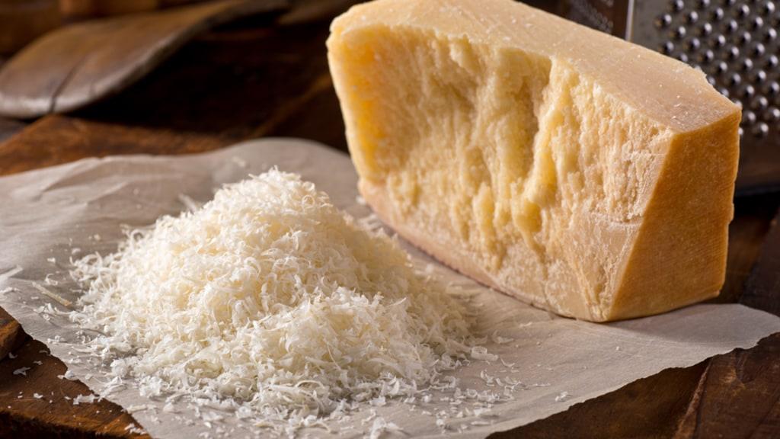

Slide 7
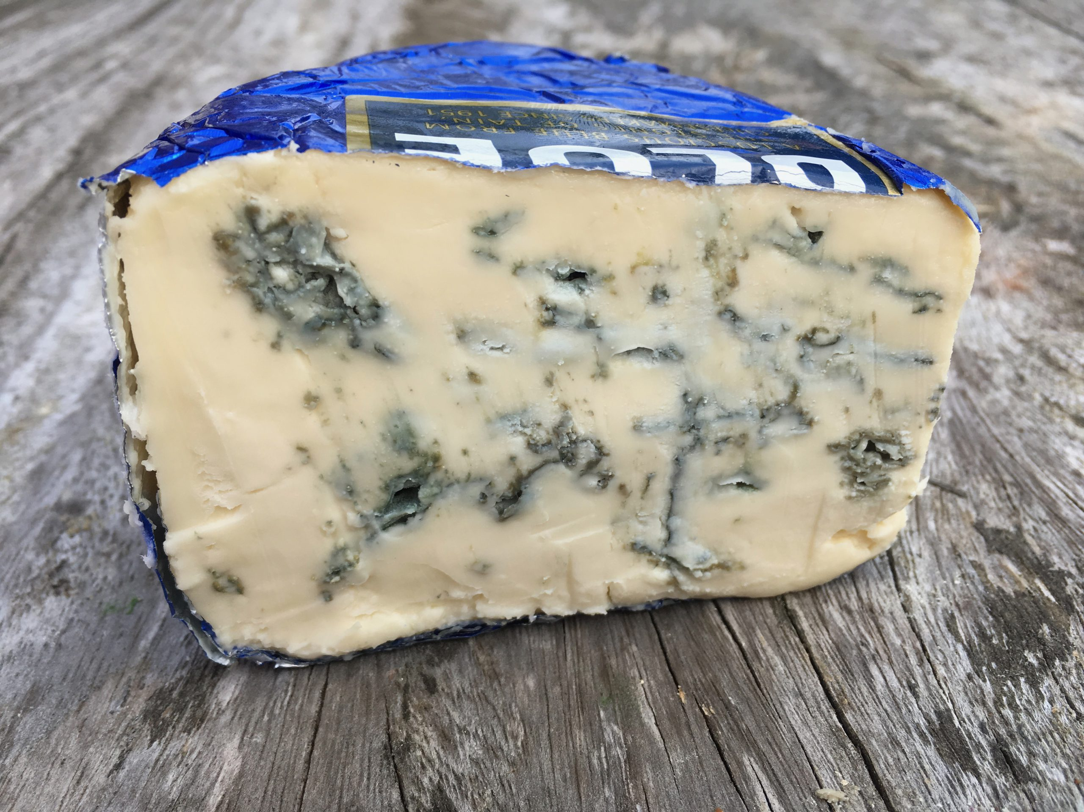

Slide 8
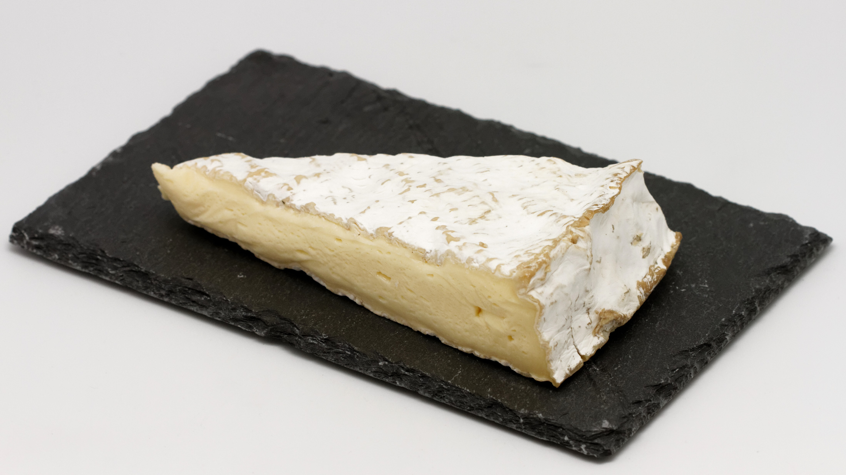

Slide 9
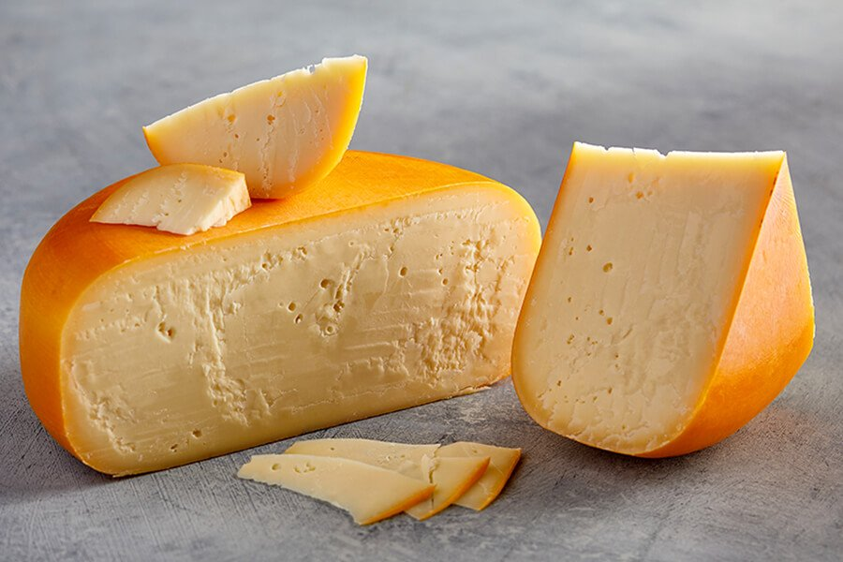

Slide 10
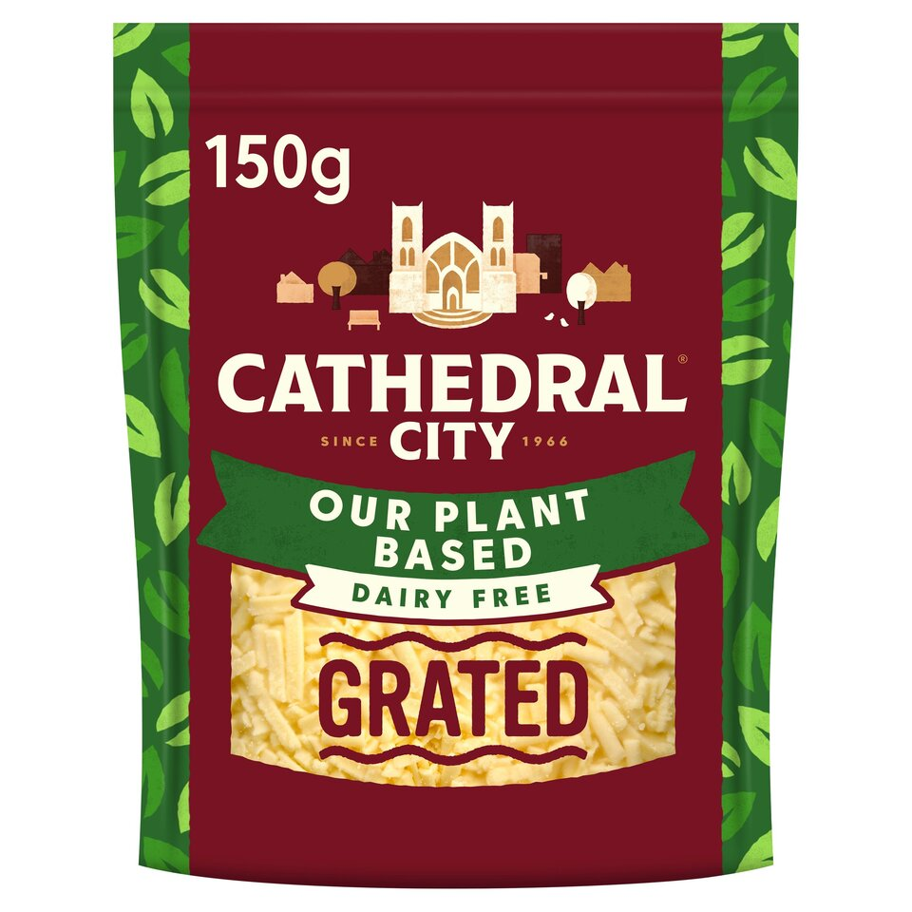

Slide 11
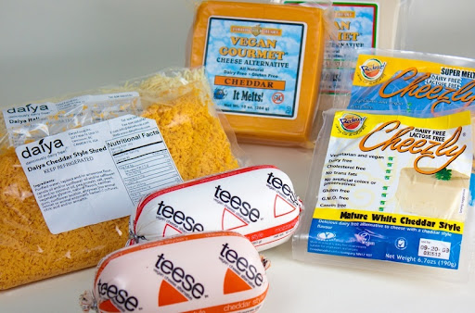

Slide 12
Glorious Cheese
Have you ever wondered why
cheese is yellow,
or orange or blue,
or simply why
some are mature and some are mellow?
You may never have considered how
black and white cows
who eat rich green grass
can turn this into pure white milk
and then into a solid yellow mass.

Slide 13
Today let’s celebrate all things cheesey
cheese crisps, cheese tarts,
toasties and even pizzas
delicious bowls of macaroni,
such a cheesey extravaganza!
So, which will you try today, I wonder?
A favourite cheddar, an alpine Emmental
French Camembert or Italian parmesan
Make sure to savour every bite
and thank God for the pure delight
of cheese.
Janice Ross

