Slide 1
What Makes Us Feel Hurt?
In what ways can we feel hurt?

Slide 2
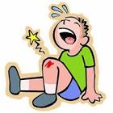
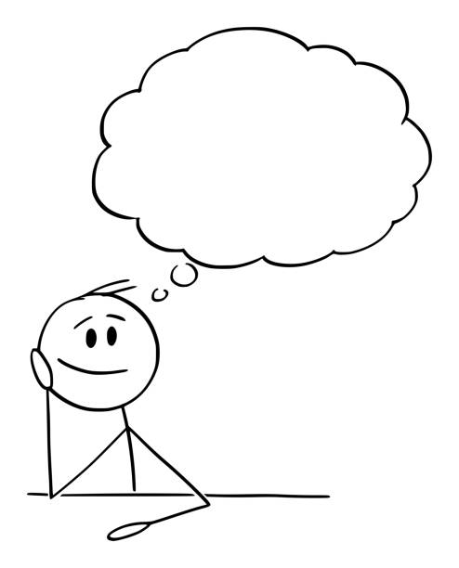
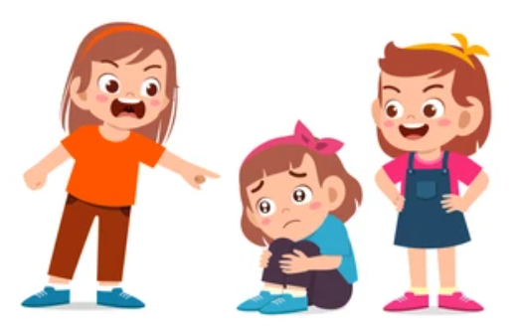

What Makes Us Feel Hurt?
Physically hurt
Mentally hurt
Emotionally hurt

Slide 3
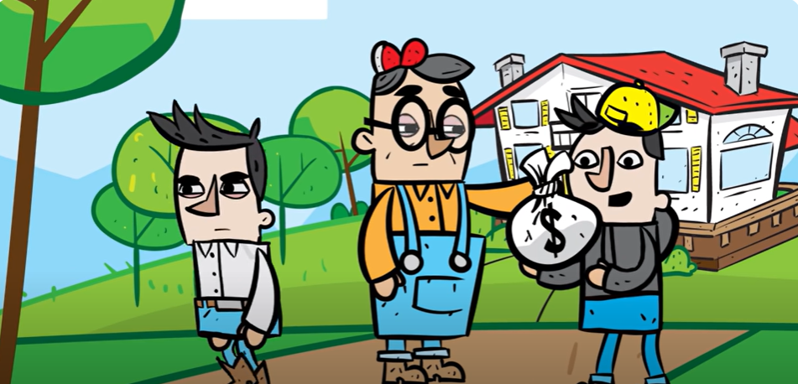
What Makes Us Feel Hurt?
Who was feeling hurt at the start of the story?

Slide 4
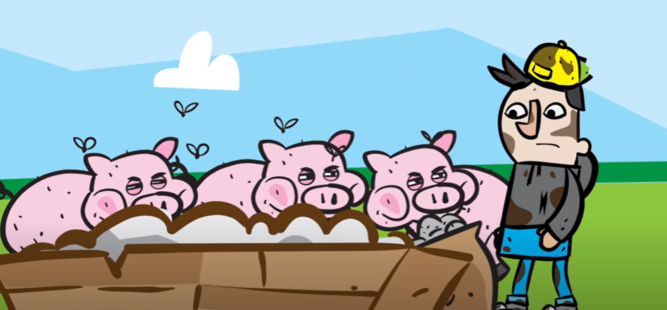
What Makes Us Feel Hurt?
Who was feeling hurt in the middle of the story?

Slide 5
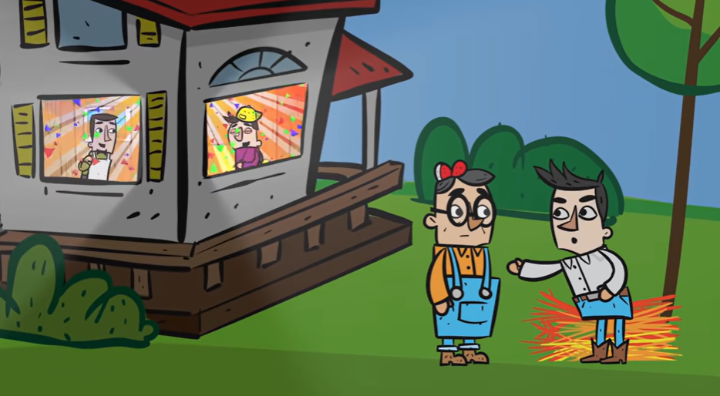
What Makes Us Feel Hurt?
Who was feeling hurt at the end of the story?

Slide 6

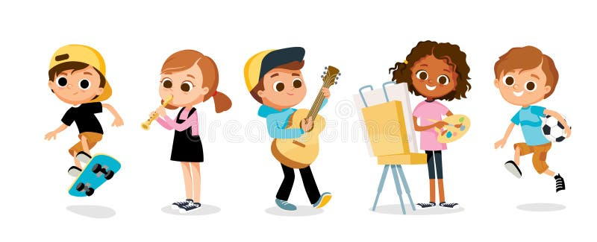

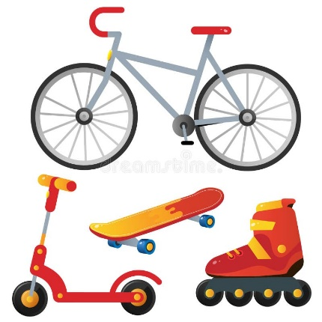
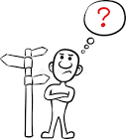
Motives Matter
What Makes Us Feel Hurt?
We might be hungry for . . .
Friendships
Hobbies and clubs
Feeling loved
New toys
Things going our way

Slide 7
What Makes Us Feel Hurt?
Tears fall for a reason
and they are your strength, not weakness
Charlie Mackesy

