Slide 1

Motives Matter
What motivates us?

Slide 2





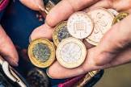
Motives Matter
Family and other adults
Friends
New skills and hobbies
Praise
Pocket money

Slide 3
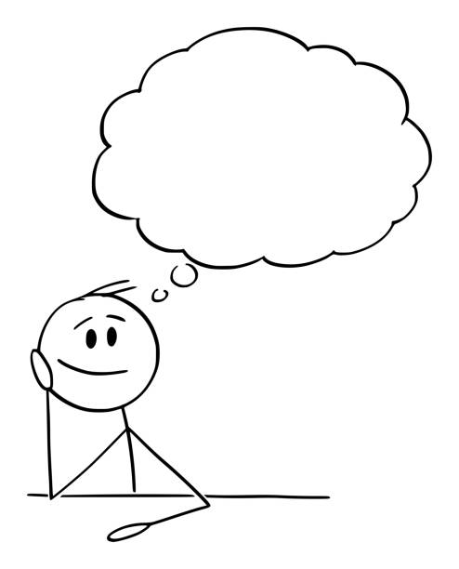


Motives Matter
Do our thoughts and emotions motivate us?

Slide 4
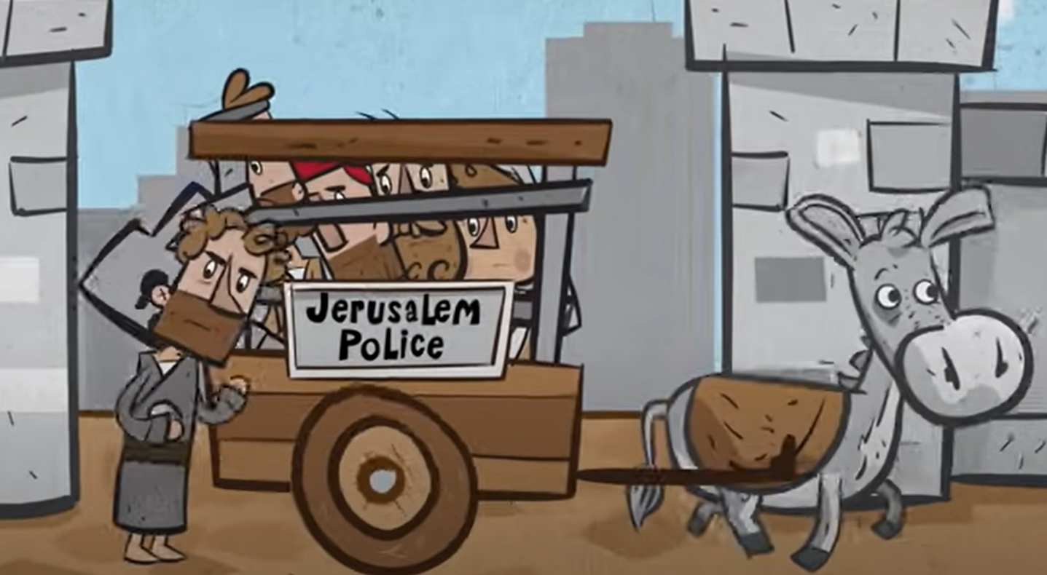
Motives Matter
Saul | Saul’s motives
Saul’s thoughts

Slide 5
Motives Matter
Saul | Saul’s motives
Saul’s thoughts | Harm Christians

Slide 6
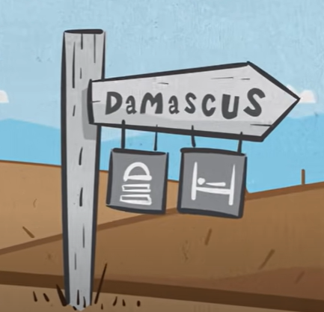
Motives Matter
Saul | Saul’s motives
Saul’s thoughts | Harm Christians
Saul’s idea

Slide 7
Motives Matter
Saul | Saul’s motives
Saul’s thoughts | Harm Christians
Saul’s idea | Go to Damascus and find more Christians

Slide 8
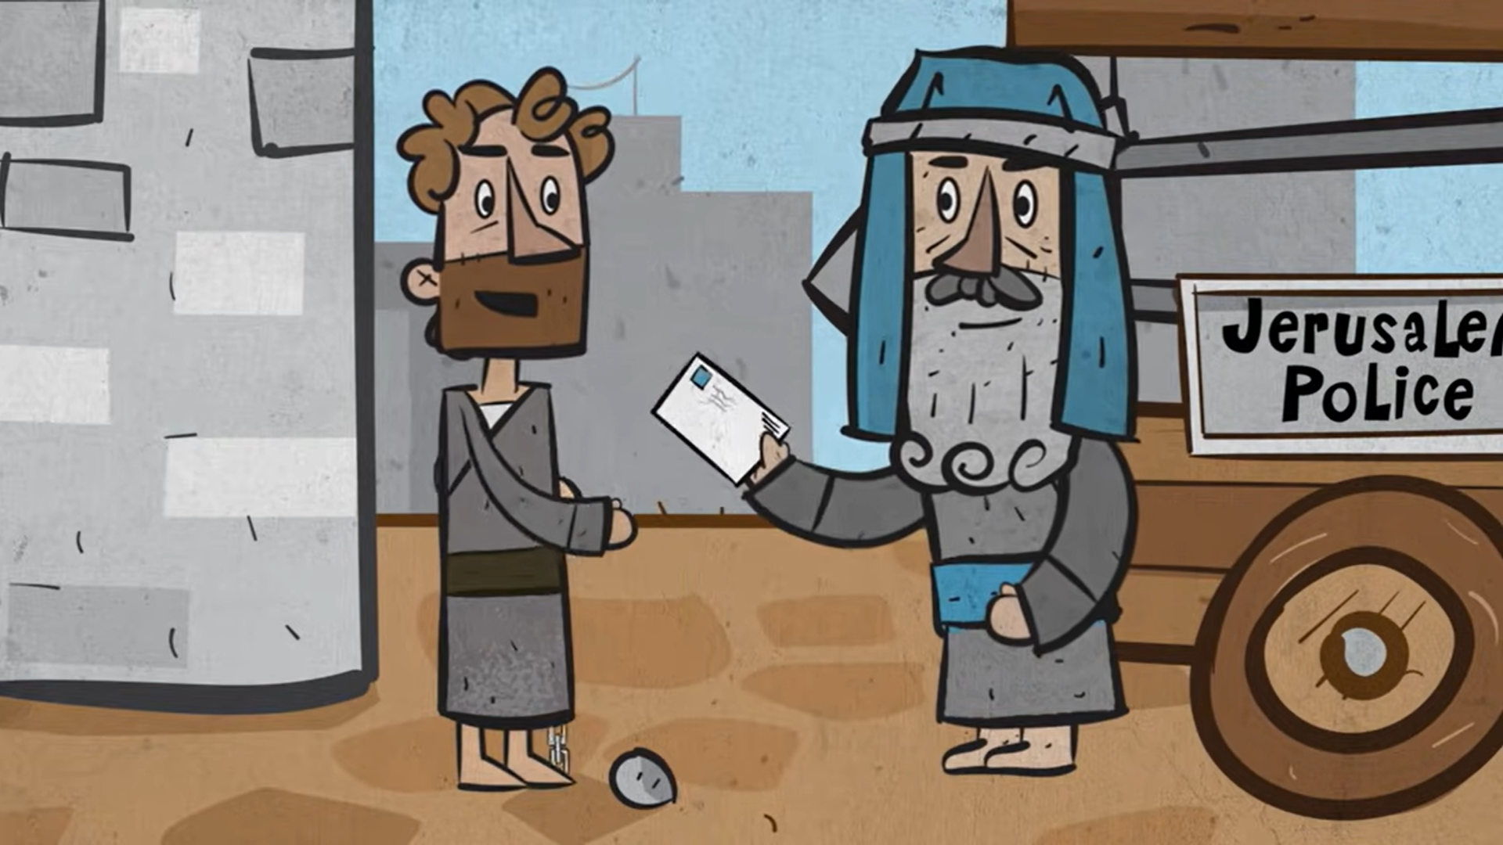
Motives Matter
Saul | Saul’s motives
Saul’s thoughts | Harm Christians
Saul’s idea | Go to Damascus and find more Christians
Saul’s supporters

Slide 9
Motives Matter
Saul | Saul’s motives
Saul’s thoughts | Harm Christians
Saul’s idea | Go to Damascus and find more Christians
Saul’s supporters | A Jewish high priest and some travelling companions

Slide 10

Motives Matter
Saul | Saul’s motives
Saul’s thoughts | Harm Christians
Saul’s idea | Go to Damascus and find more Christians
Saul’s supporters | A Jewish high priest and some travelling companions
Saul’s emotion

Slide 11
Motives Matter
Saul | Saul’s motives
Saul’s thoughts | Harm Christians
Saul’s idea | Go to Damascus and find more Christians
Saul’s supporters | A Jewish high priest and some travelling companions
Saul’s emotion | Driven by hate

Slide 12
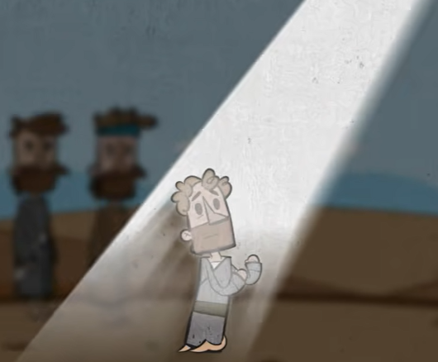
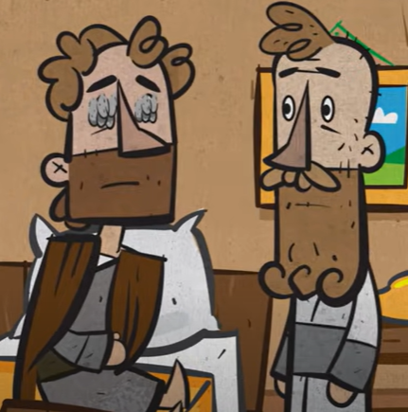
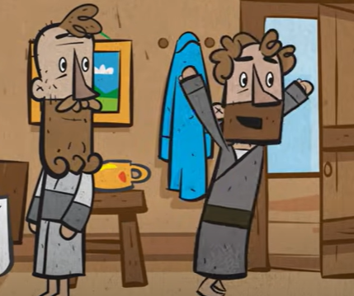
Motives Matter
Damascus moment . . .

Slide 13
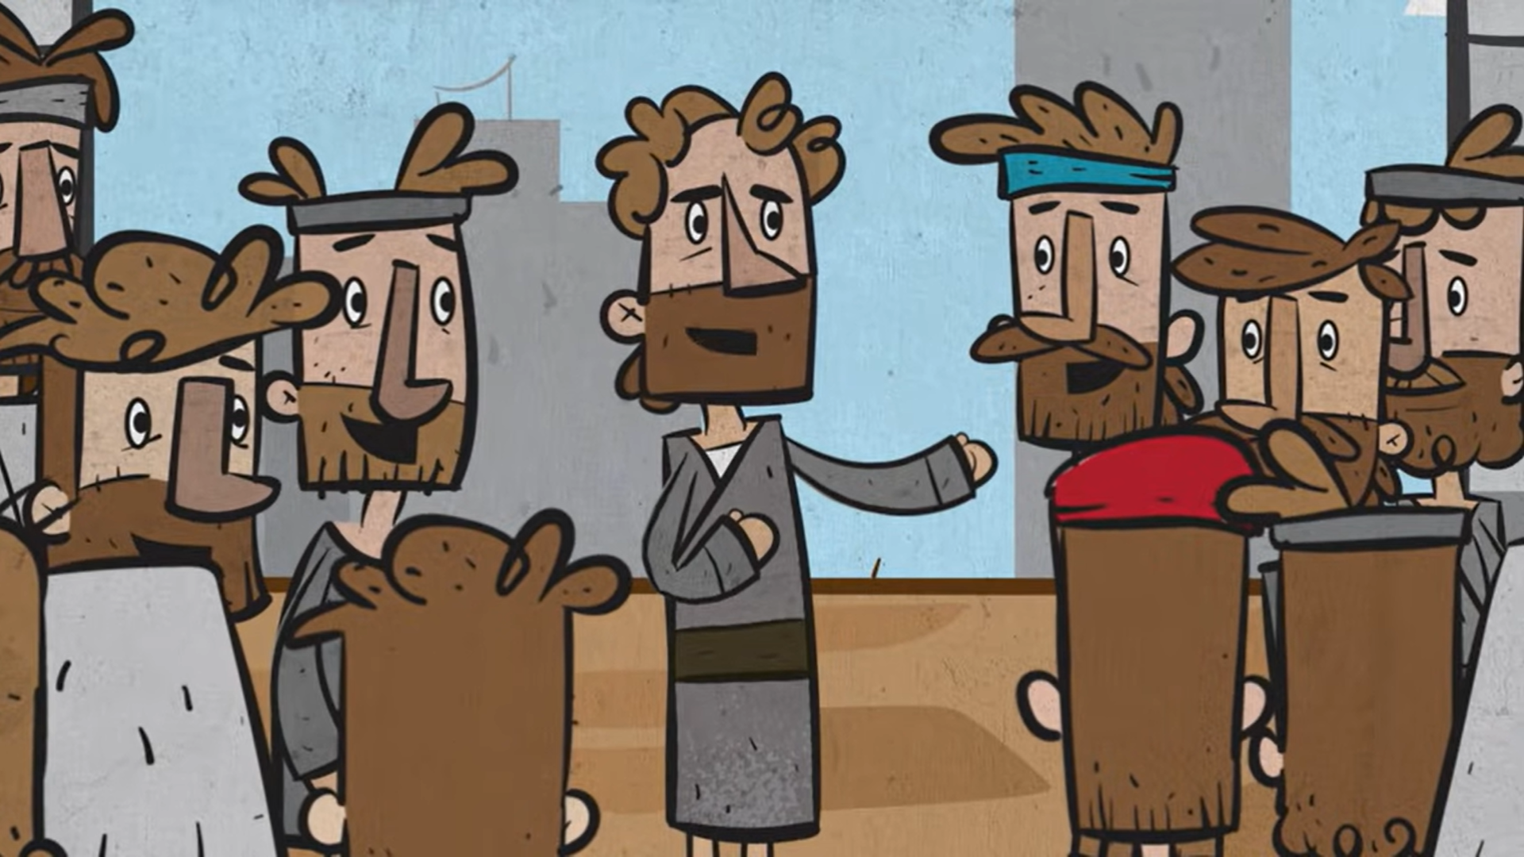
Motives Matter
Paul | Paul’s motives
Paul’s thoughts | Teach people about Jesus

Slide 14
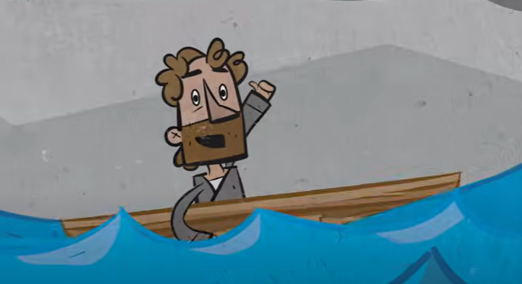
Motives Matter
Paul | Paul’s motives
Paul’s thoughts | Teach people about Jesus.
Paul’s idea | Travel around the Roman Empire

Slide 15
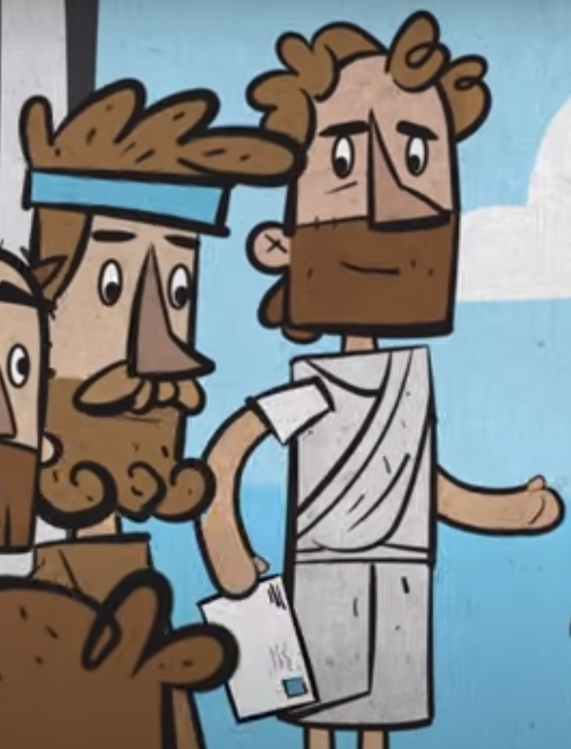
Motives Matter
Paul | Paul’s motives
Paul’s thoughts | Teach people about Jesus
Paul’s idea | Travel around the Roman Empire
Paul’s supporters | Paul had different helpers at different times: Barnabas, John Mark, Silas, Timothy, Aquila and Priscilla

Slide 16

Motives Matter
Paul | Paul’s motives
Paul’s thoughts | Teach people about Jesus
Paul’s idea | Travel around the Roman Empire
Paul’s supporters | Paul had different helpers at different times: Barnabas, John Mark, Silas, Timothy, Aquila and Priscilla
Paul’s emotion | Driven by love

Slide 17
Motives Matter
You | Your motives
Thoughts | What do you want to do? Learn to play a musical instrument
Ideas | Why do you want to do it? Play in a band or orchestra
Supporters | Who will help you? Music teacher and family
Emotions | How will you feel? Proud and excited
Which ones can we control?

Slide 18
Motives Matter
Three things will last forever – faith, hope and love - and the greatest of these is love.
1 Corinthians 13.13

