Slide 1
Daddy fell into the pond
by Alfred Noyes
Everyone grumbled. The sky was grey.
We had nothing to do and nothing to say.
We were nearing the end of a dismal day,
And there seemed to be nothing beyond,
THEN
Daddy fell into the pond!
And everyone’s face grew merry and bright,
And Timothy danced for sheer delight.
‘Give me the camera, quick, oh quick!
He’s crawling out of the duckweed.’
Click!

Slide 2
Continued . . .
Then the gardener suddenly slapped his knee,
And doubled up, shaking silently,
And the ducks all quacked as if they were daft
And it sounded as if the old drake laughed.
O, there wasn’t a thing that didn’t respond
WHEN
Daddy fell into the pond!

Slide 3
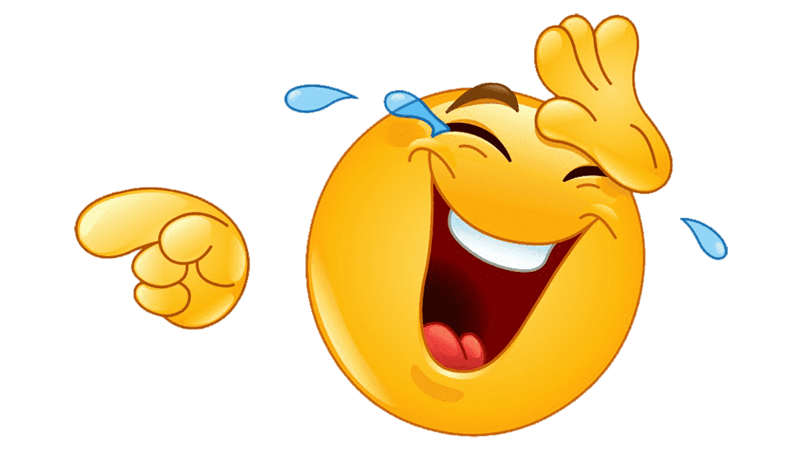
laugh
roar
cackle
chortle
snort
guffaw
crack up
chuckle
giggle
snigger

Slide 4
g
o
c
a
n
s
t
i
o
u

