Slide 1
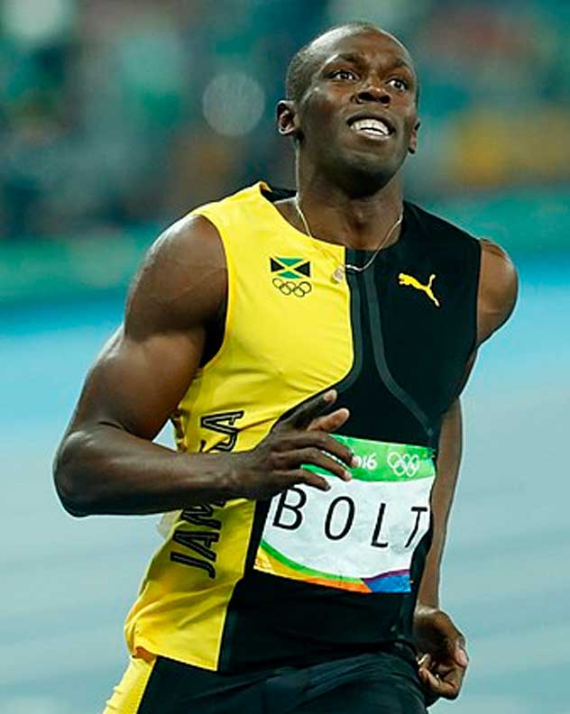
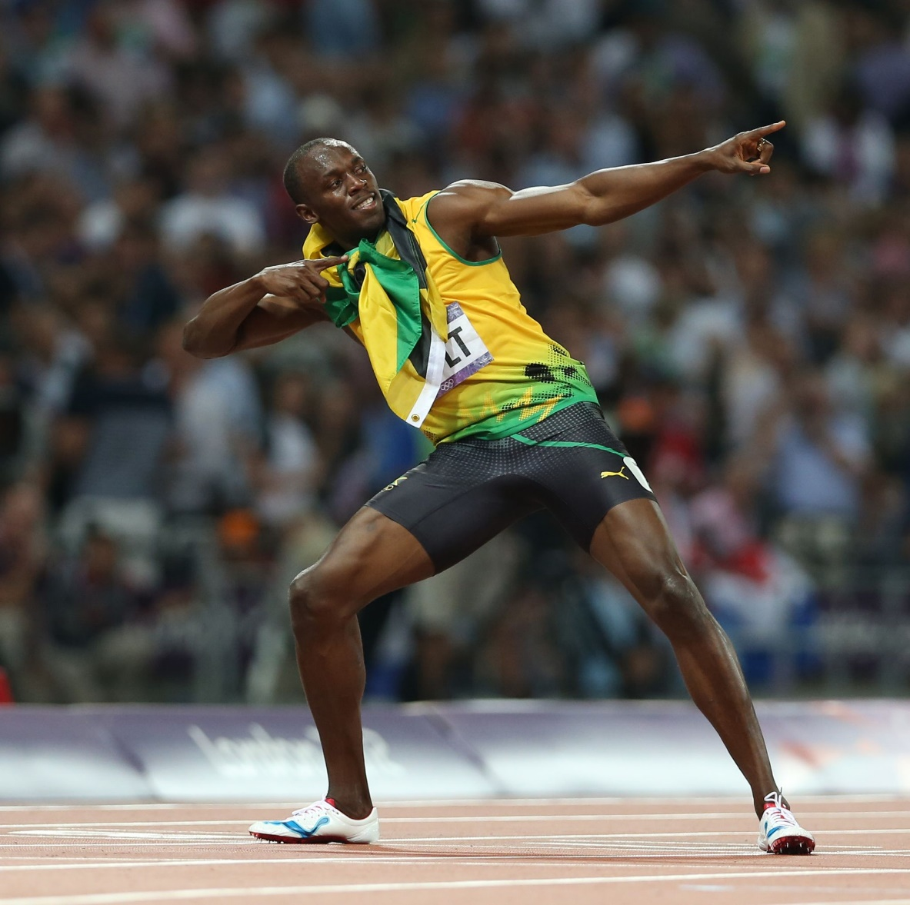
On Your Marks, Get Set, Go!
Who is this?

Slide 2

On Your Marks, Get Set, Go!
Usain Bolt
Won 8 Olympic and 11 World Championship gold medals in the 100m, the 200m and the 100m relay

Slide 3

On Your Marks, Get Set, Go!
What do you have to do to become one of the world’s greatest athletes?

Slide 4
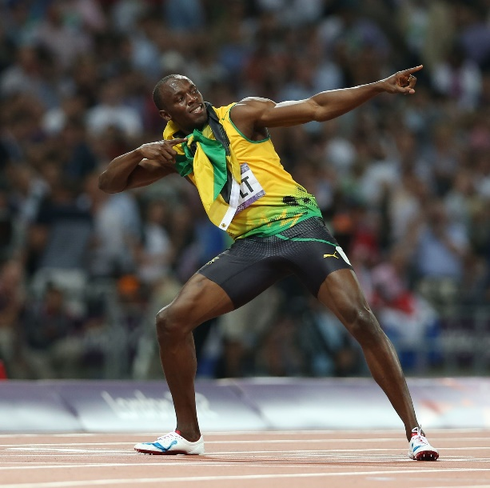
Ability
Competitiveness
On Your Marks, Get Set, Go!
Diet
Supportive family
Training
Hard work
Ambition/
targets
Attitude
Determination
Confidence
Focus
Preparation

Slide 5

Ability
Competitiveness
On Your Marks, Get Set, Go!
Diet
Supportive family
Can we use these qualities in other situations?
Training
Hard work
Ambition/
targets
Attitude
Determination
Confidence
Focus
Preparation

Slide 6
On Your Marks, Get Set,
Go!

Slide 7
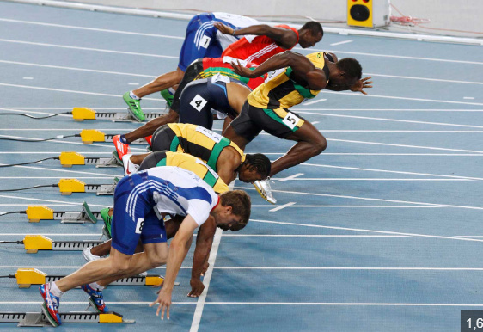
On Your Marks, Get Set,
Go!

Slide 8
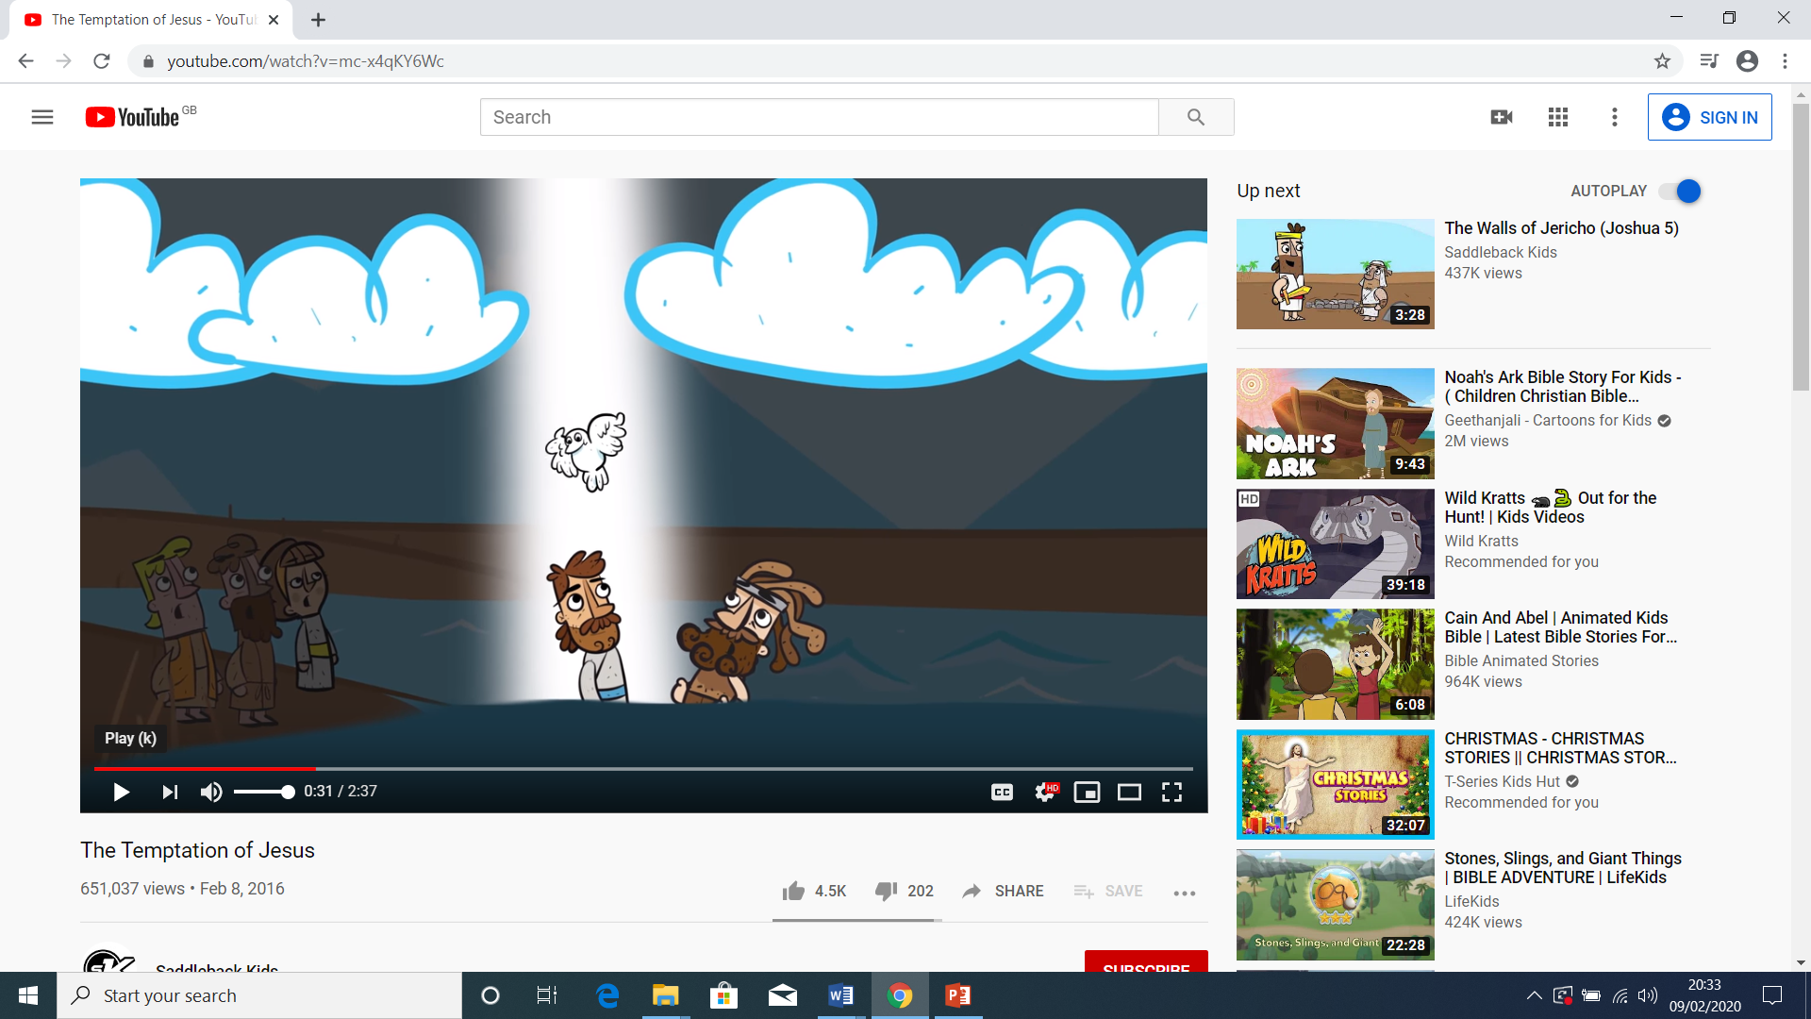
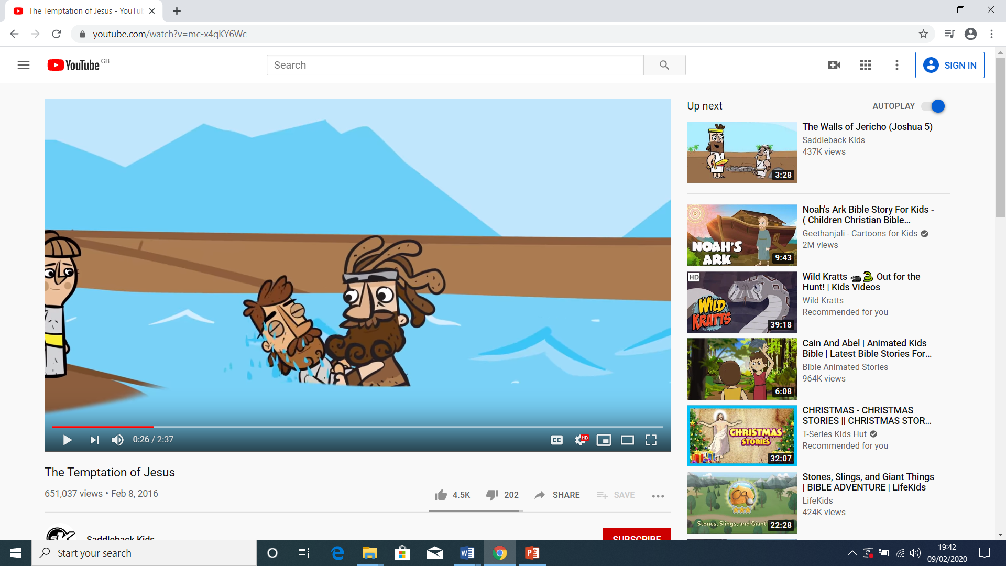
On Your Marks, Get Set, Go!
On Your Marks . . .
Supportive family
Hard work
Jesus’ baptism

Slide 9
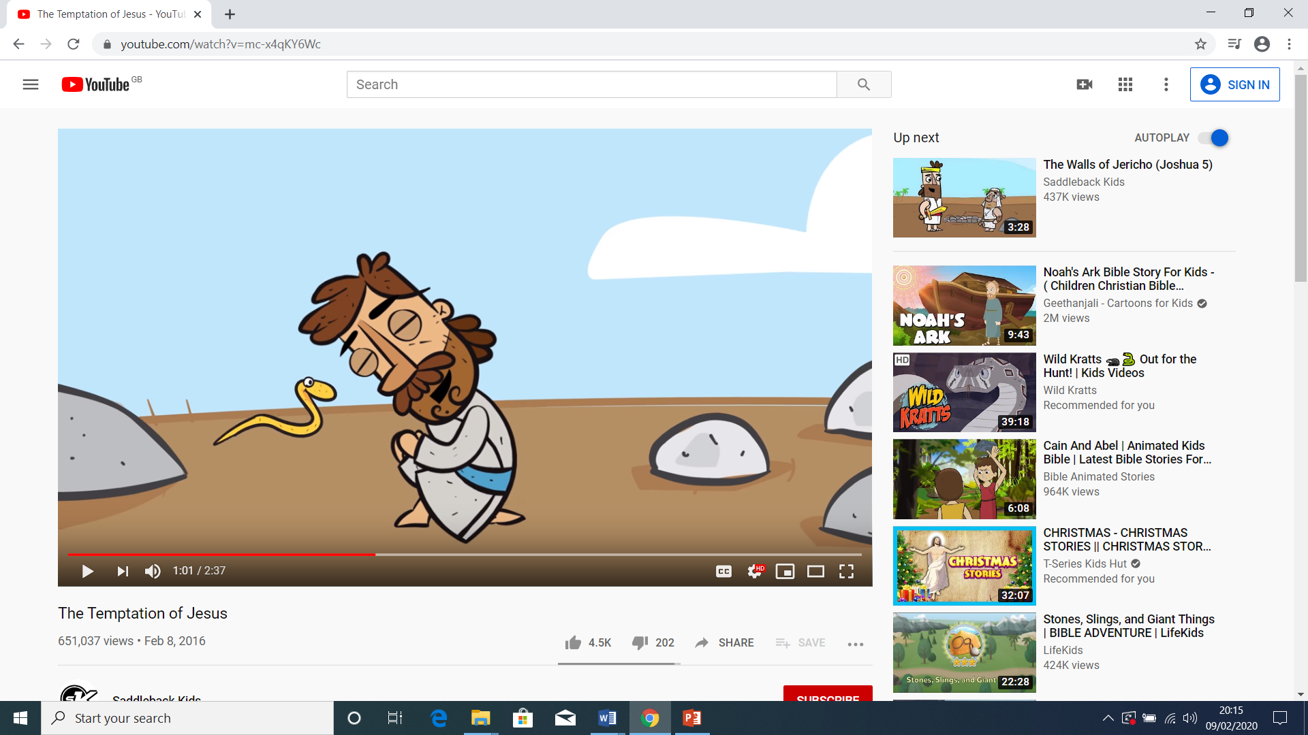
On Your Marks, Get Set, Go!
Get Set . . .
Preparation
Training
40 days in the wilderness

Slide 10
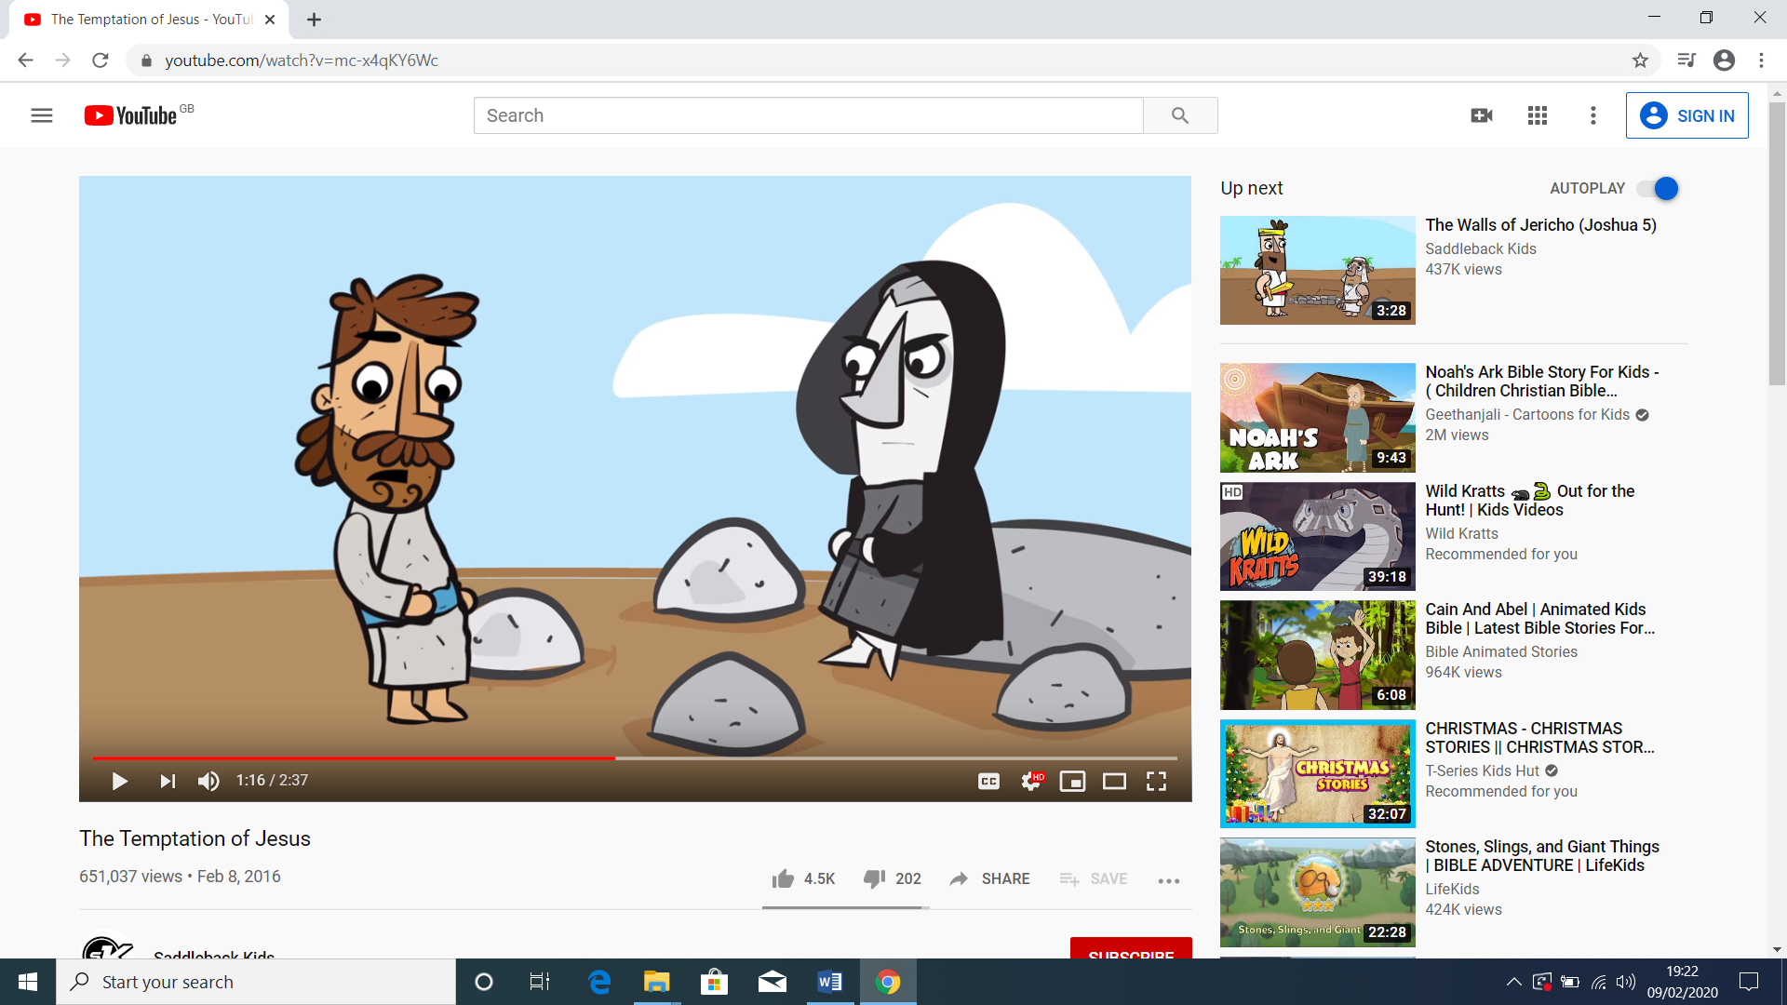
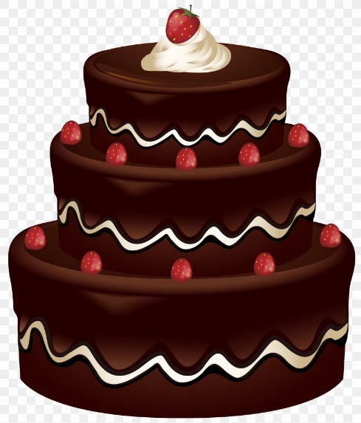

On Your Marks, Get Set, Go!
Get Set . . .
Diet
Focus
First temptation: to turn stones into bread
First temptation: what we need

Slide 11
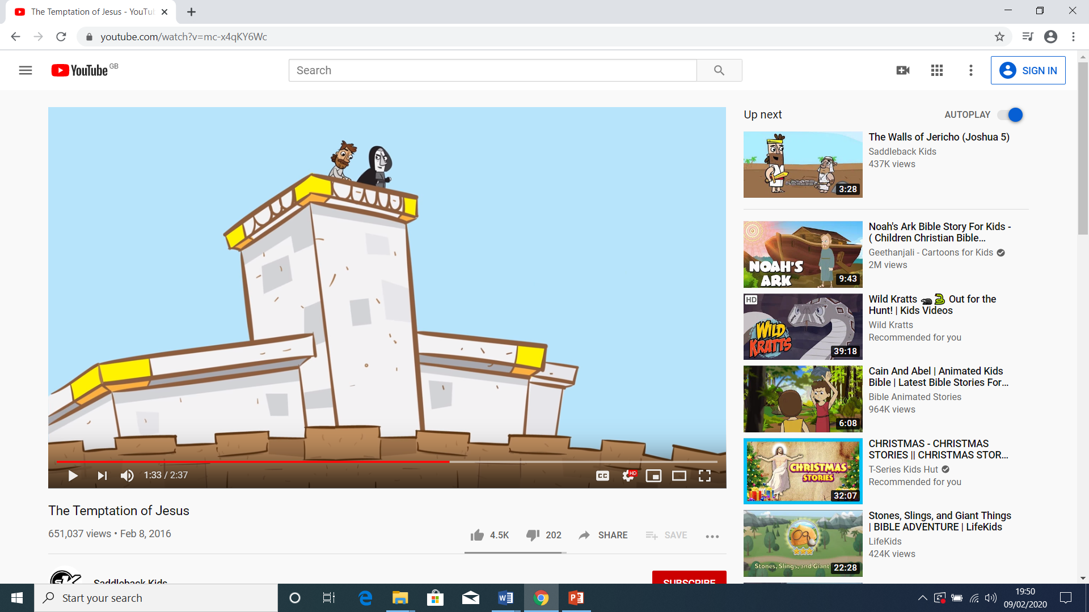


On Your Marks, Get Set, Go!
Get Set . . .
Confidence
Attitude
Second temptation: to test God
Second temptation: who we trust

Slide 12
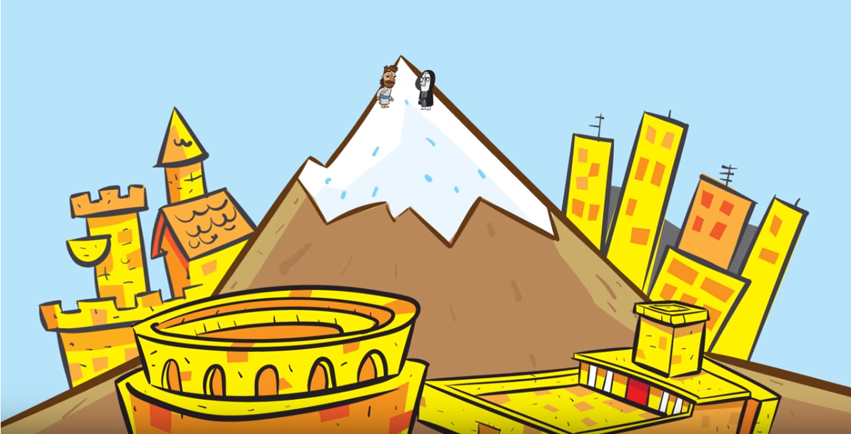

On Your Marks, Get Set, Go!
Get Set . . .
Determination
Competitiveness
Third temptation: God’s way or the Devil’s way
Third temptation: the right way or the wrong way

Slide 13
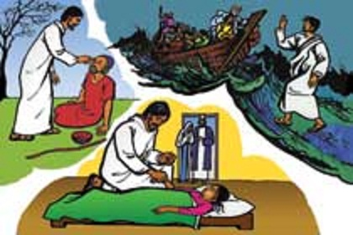
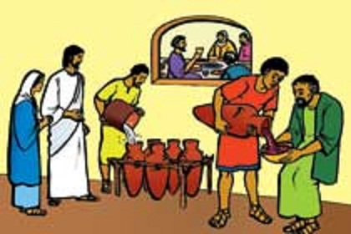
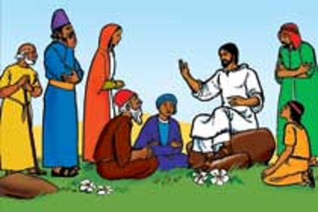
On Your Marks, Get Set, Go!
Go!
Ability
Ambition/
targets

Slide 14
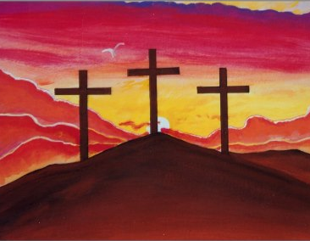
On Your Marks, Get Set, Go!

