Slide 1

Welcome

Slide 2
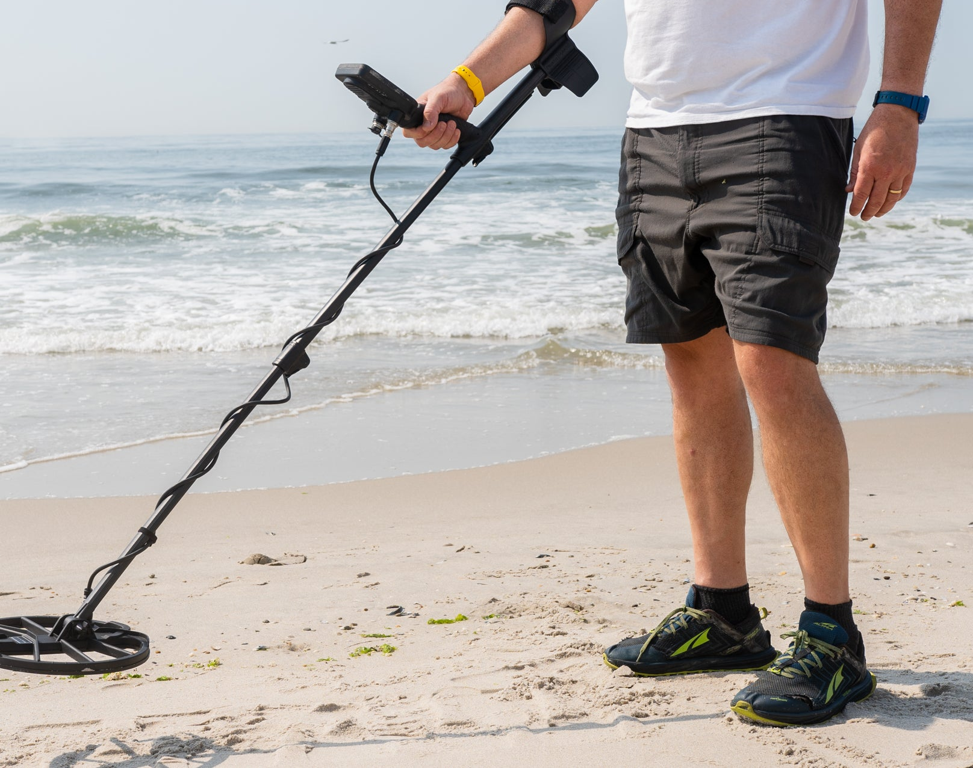
Have you ever seen anyone doing this?

Slide 3
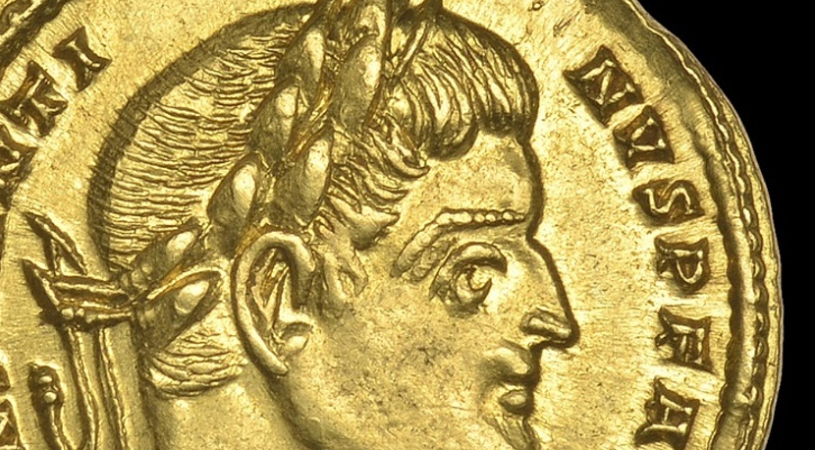

Slide 4
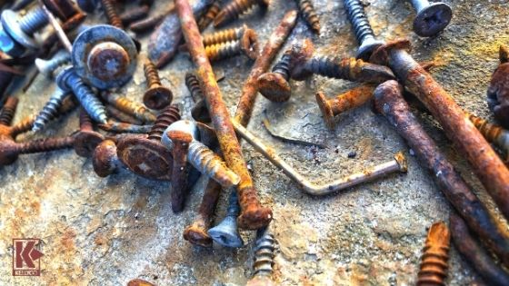

Slide 5
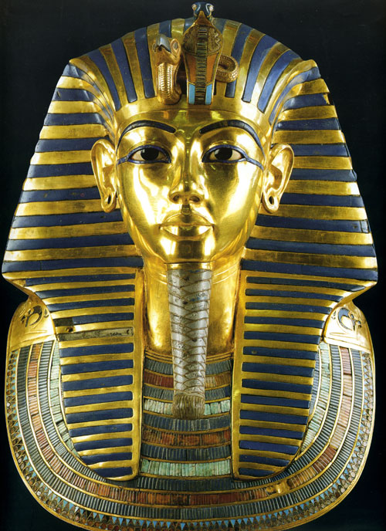

Slide 6
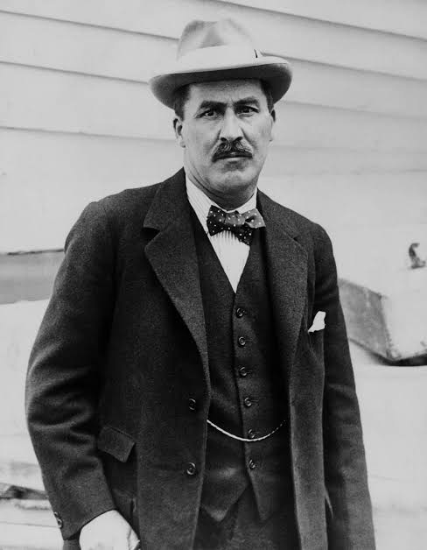
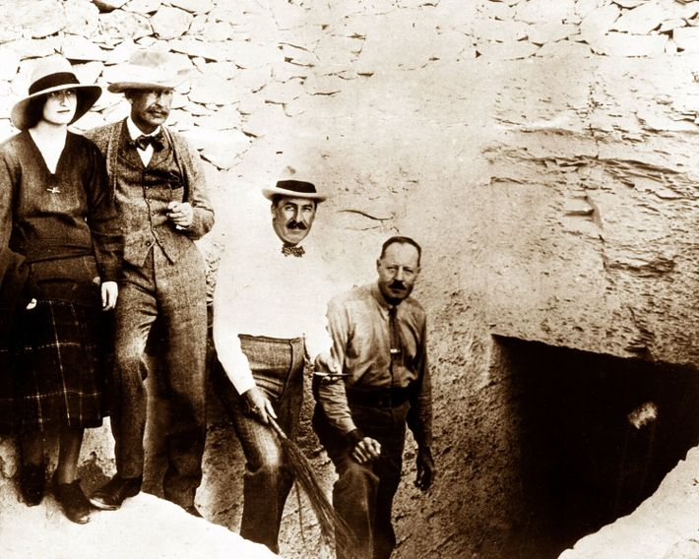
Contentment is a state of being at ease in both body and mind.

Slide 7
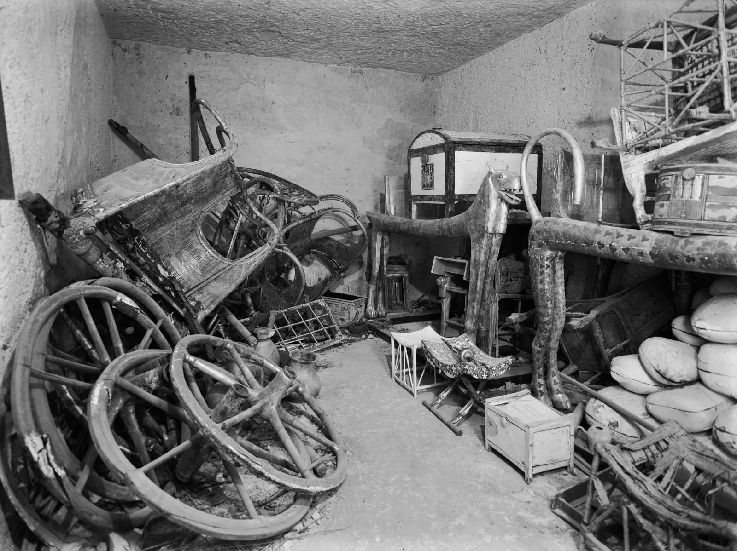

Slide 8
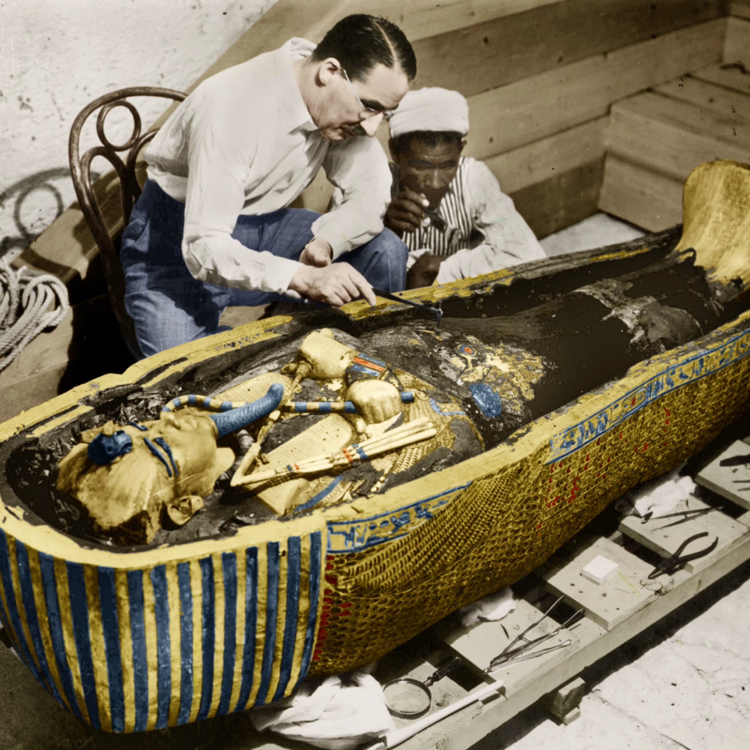

Slide 9

Treasures in Heaven
‘Do not store up for yourselves treasures on earth, where moths and vermin destroy, and where thieves break in and steal. But store up for yourselves treasures in heaven, where moths and vermin do not destroy, and where thieves do not break in and steal. For where your treasure is, there your heart will be also.’
Matthew 6.19–21

Slide 10
The Parable of the Hidden Treasure
‘The kingdom of heaven is like this. A man happens to find a treasure hidden in a field. He covers it up again, and is so happy that he goes and sells everything he has, and then goes back and buys that field.’
Matthew 13.44

