Slide 1


Slide 2


Slide 3



Slide 4
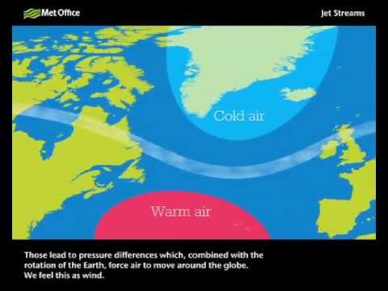

Slide 5


Slide 6
‘And after you have suffered a little while, the God of all grace . . . will himself restore, confirm, strengthen and establish you.’
1 Peter 5.10

