Slide 1
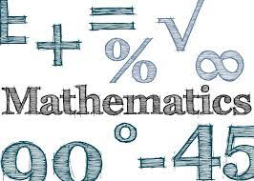
‘Mathematics is the language in which God has written the universe.’
Galileo Galilei

Slide 2
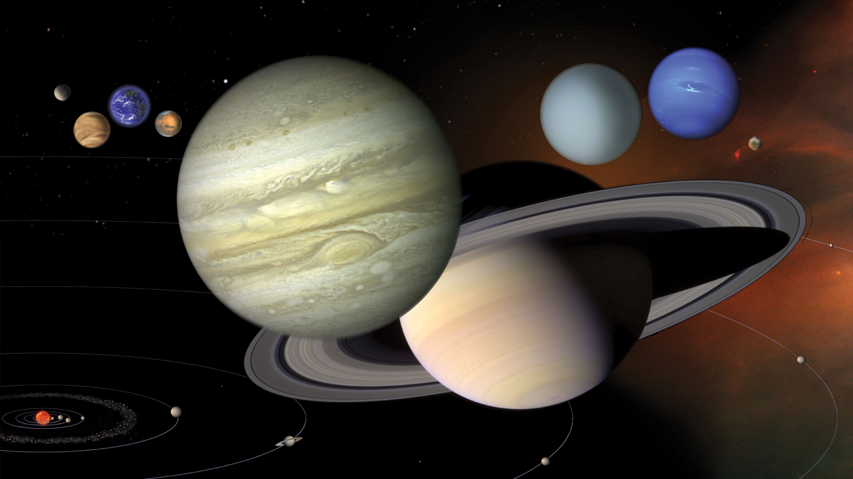

Slide 3
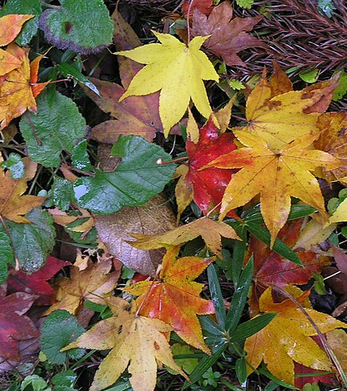


Slide 4


Slide 5


Slide 6
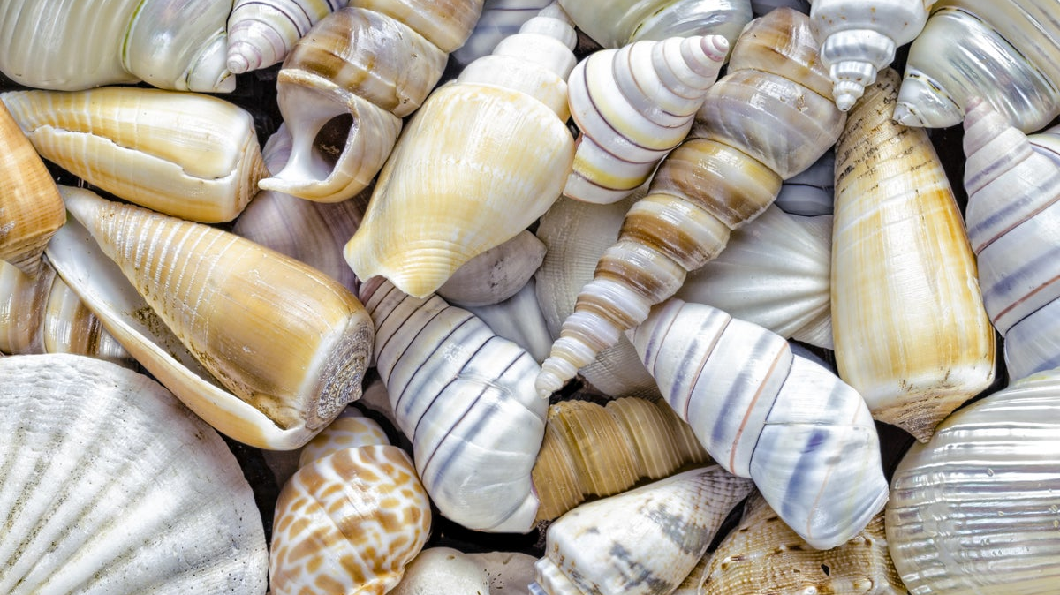

Slide 7
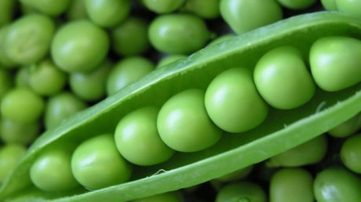

Slide 8

‘God is one and the same God, always and everywhere.’
Sir Isaac Newton

