Slide 1
What do these words mean?
Stick it out!

Slide 2

Stick It Out!
Overcoming a problem, mistake or challenge

Slide 3
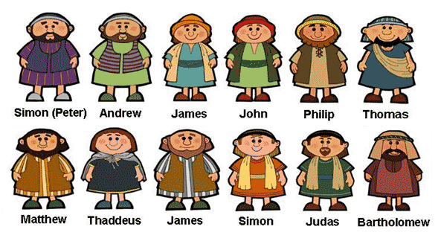
Stick It Out!
How were these men
connected to Jesus?

Slide 4
Stick It Out!
Which man betrayed Jesus?

Slide 5
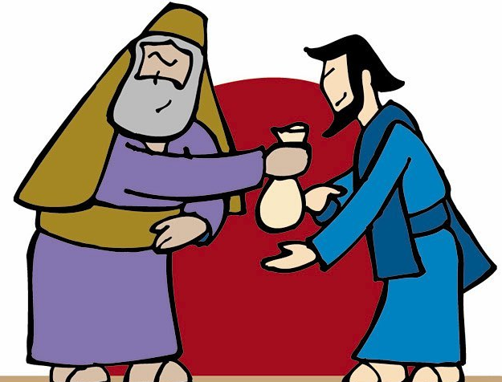
Stick It Out!
Judas betrayed Jesus for 30 pieces of silver

Slide 6
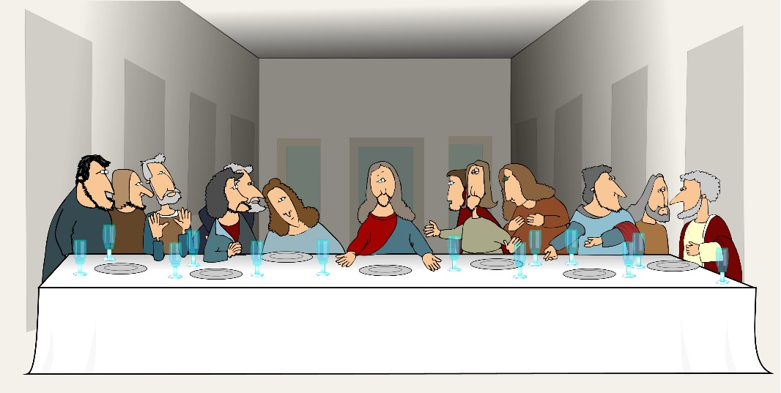
Stick It Out!
The Last Supper

Slide 7
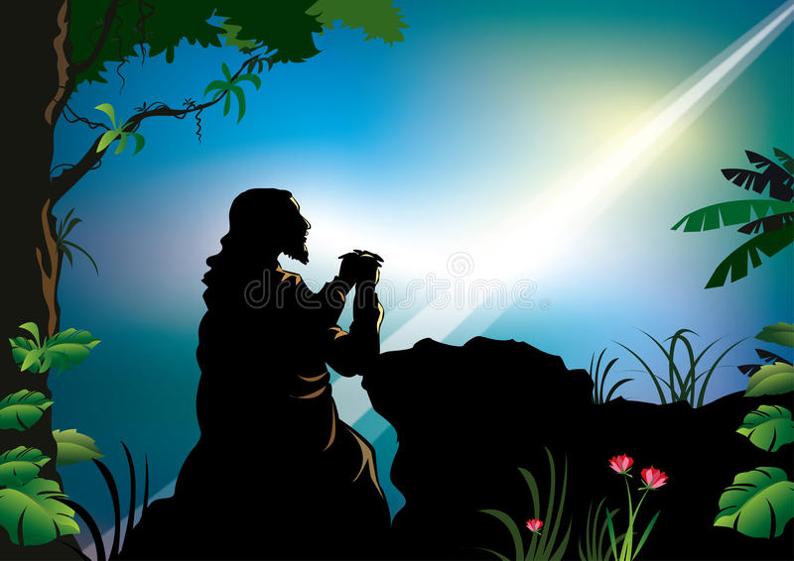
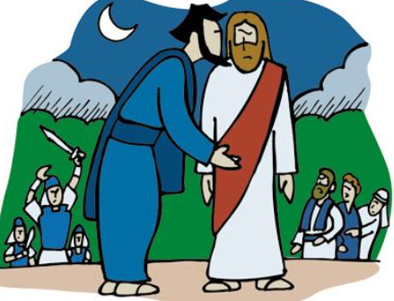
Stick It Out!
The Garden
of Gethsemane

Slide 8
Stick It Out!
Which other disciple betrayed Jesus?

Slide 9
Stick It Out!
Judas and Peter both made big mistakes

Slide 10
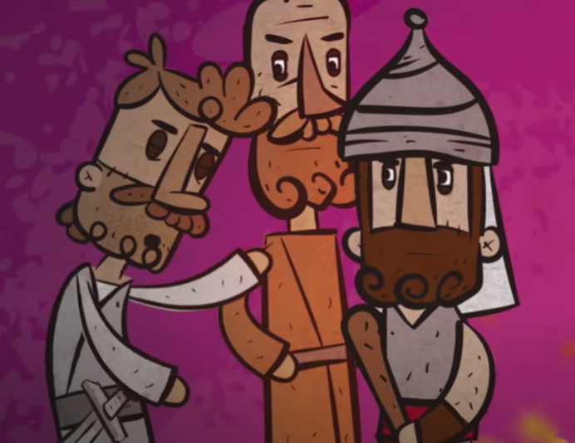
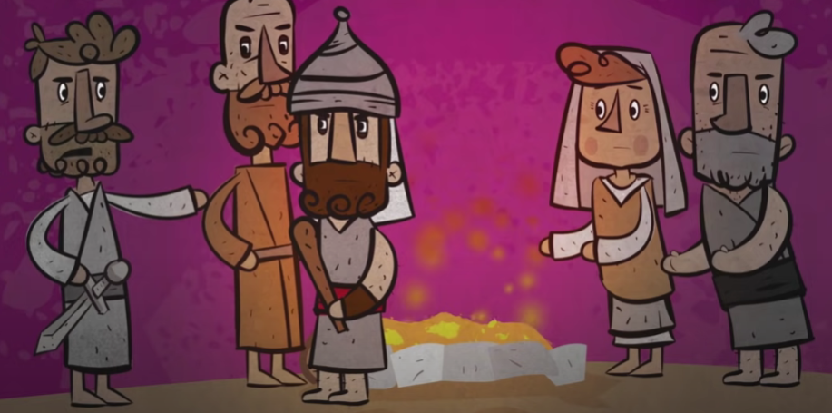
Stick It Out!
Recognize the mistake

Slide 11
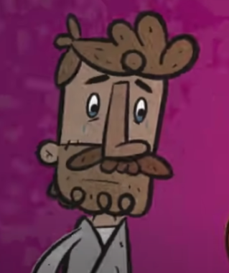

Stick It Out!
Forgive yourself

Slide 12
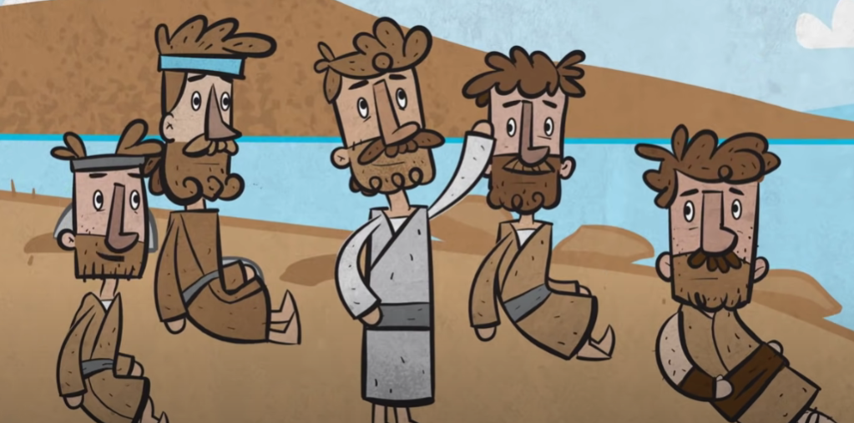
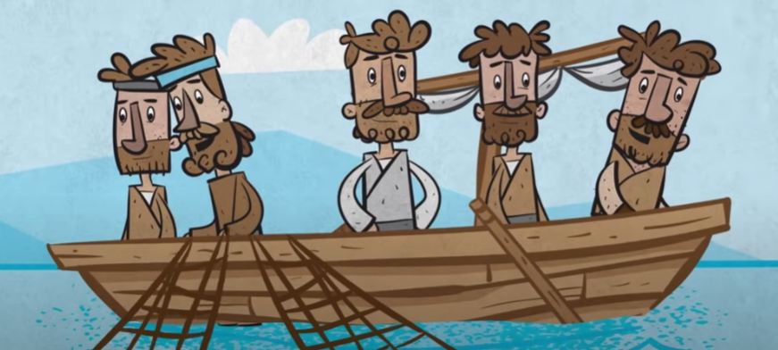
Stick It Out!
Spend time with others

Slide 13
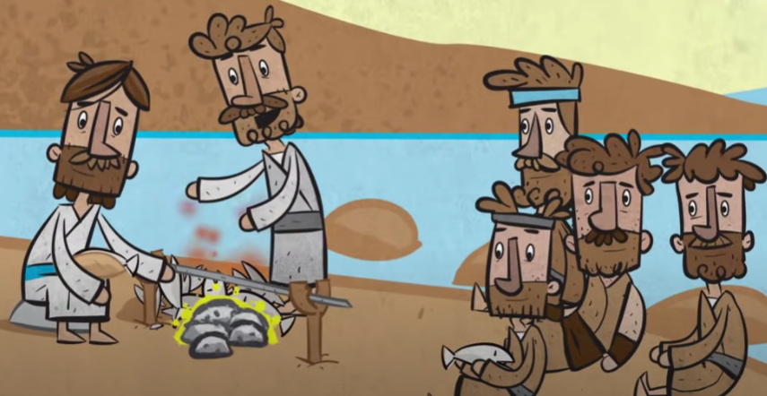
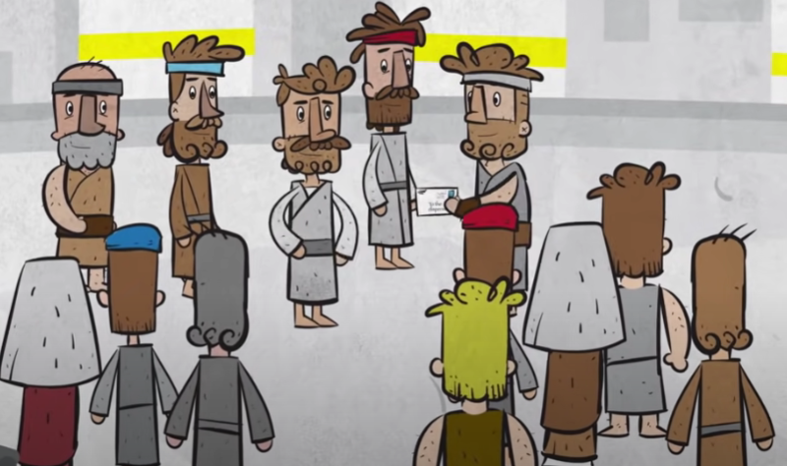
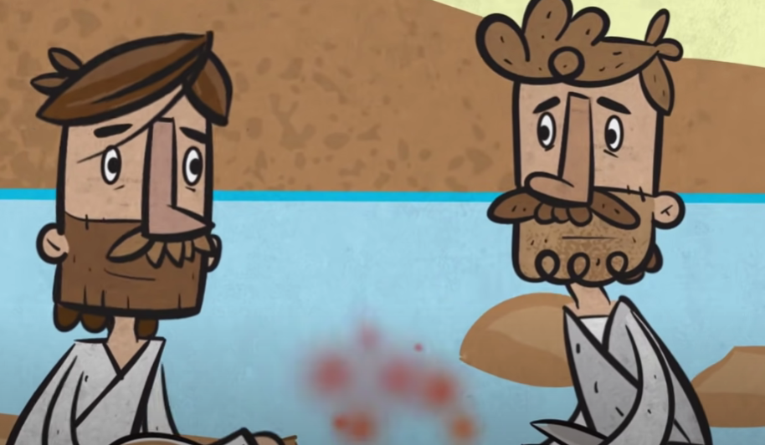
Stick It Out!
Move forward

Slide 14

Stick It Out!

