Slide 1
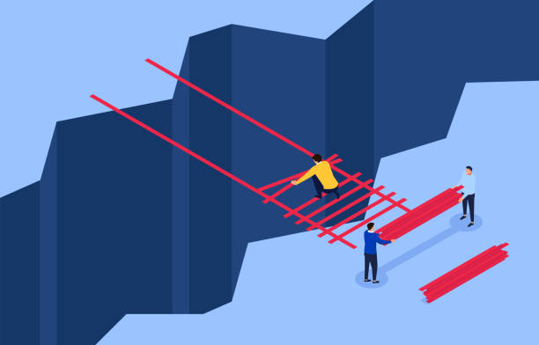
Overcoming a problem, mistake or challenge

Slide 2
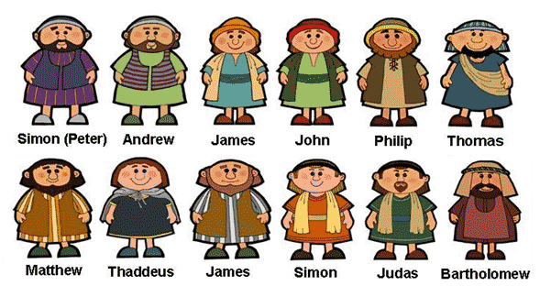
How were these men
connected to Jesus?

Slide 3
Which man betrayed Jesus?

Slide 4
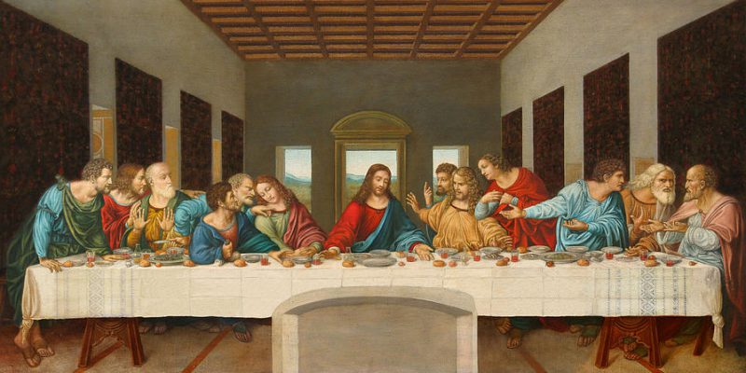
The Last Supper

Slide 5
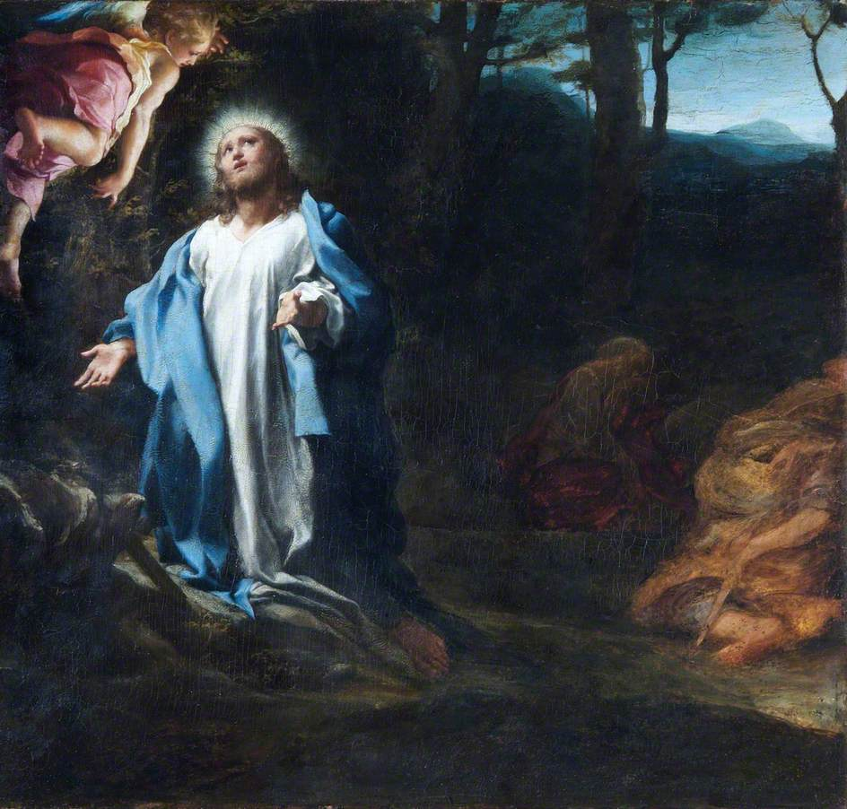
The Garden of Gethsemane

Slide 6
Which other disciple betrayed Jesus?

Slide 7


Slide 8

Recognize the mistake

Slide 9

Forgive yourself

Slide 10

Spend time with others

Slide 11

Move forward

Slide 12
