Slide 1
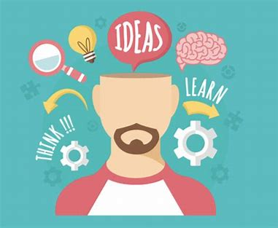
Welcome

Slide 2

Low Openness
You are more likely to behave in ways that others perceive as predictable
You are likely to stick to routine and resist change
You may well keep a small, familiar group of friends
You prefer to stick to one or two hobbies rather than trying lots of new activities
You can easily jump to conclusions
You choose predictability over spontaneity

Slide 3

High Openness
You’re more likely to behave in ways that others might perceive as reckless
You have many hobbies and interests
You may ask lots of questions because they are curious
You can easily become bored
You may feel OK about challenging authority
You like to ask questions to understand someone else’s viewpoint
You are happy to socialize with a range of people, including people from different cultures
You show a sensitivity to beauty and emotion

Slide 4
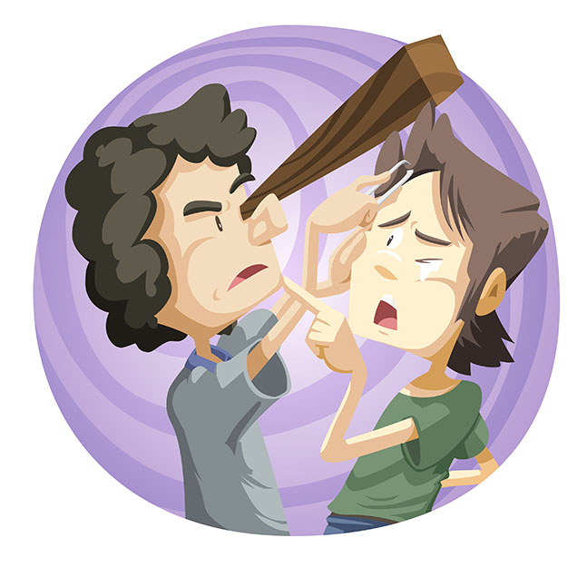
Matthew 7.3
‘Why do you look at the speck of sawdust in your brother’s eye and pay no attention to the plank in your own eye?’

Slide 5

Adopt a Non-Judgmental Approach
Practise moment-to-moment
non-judgmental awareness
Jon Kabat-Zinn

Slide 6
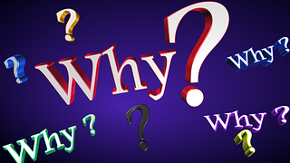
Keep Learning

Slide 7


Embrace Creativity

