Slide 1
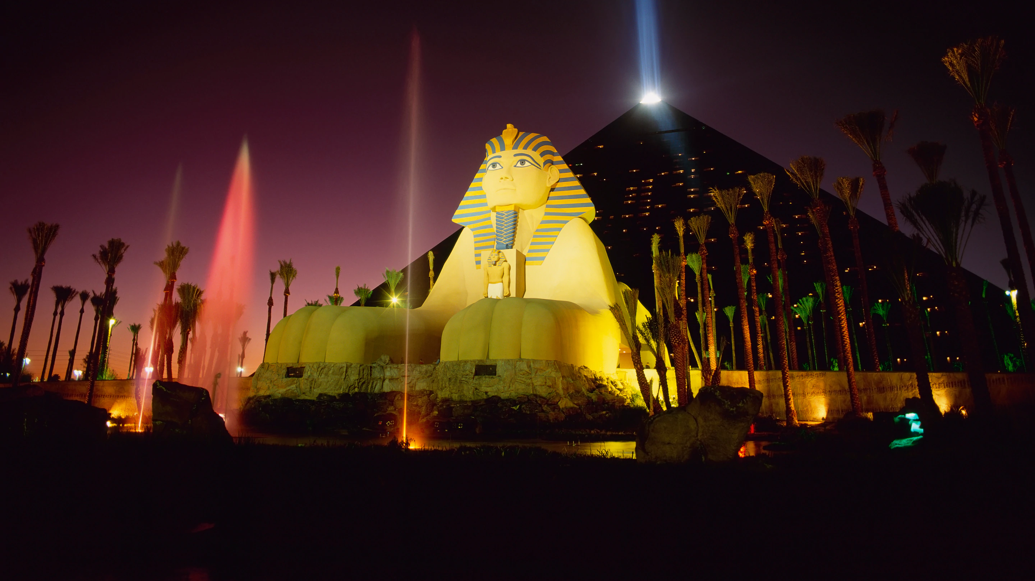
1
2
3
4
5
6
7
8
9
10
11
12
13
14
15
16
17
18
19
20
Where in the world is this?

Slide 3
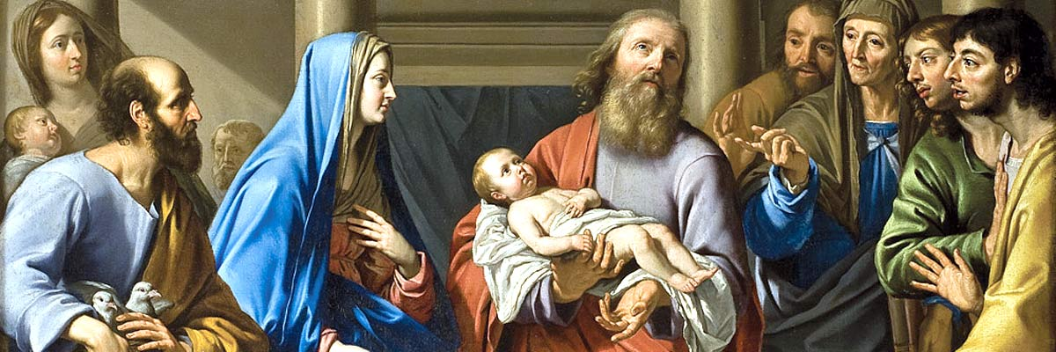
Luke 2.32
‘He is a light to reveal God to the nations, and he is the glory of your people Israel!’

Slide 4
