Slide 1

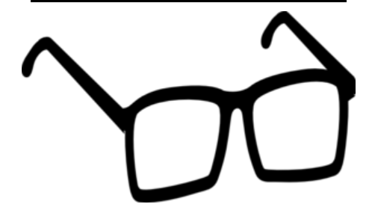


Fully Focused
How are these connected?
magnifying glass
glasses
binoculars
microscope

Slide 2
Fully Focused
They all help us to focus fully on whatever we’re looking at

Slide 3
Fully Focused
What does being focused mean?
Being focused means giving our full attention to an activity or target

Slide 4

Fully Focused
Can we lose our focus?

Slide 5

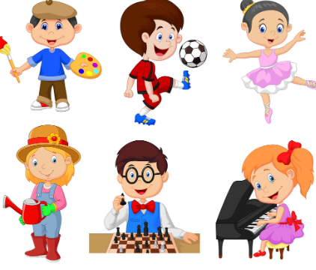

Fully Focused
What sort of things can we focus on?
School
Hobbies

Slide 6
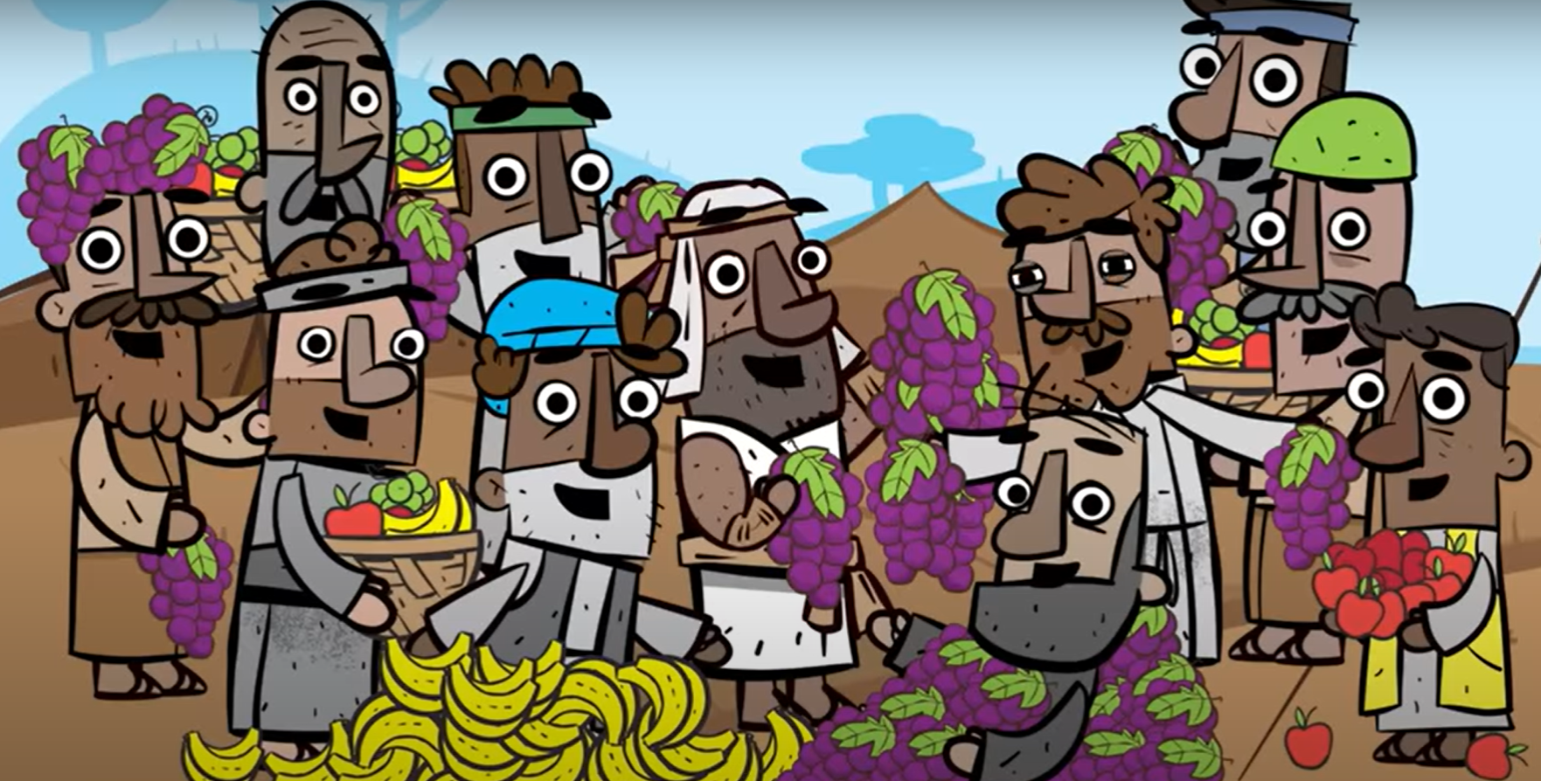
Fully Focused
How can we lose our focus?
Too much choice

Slide 7
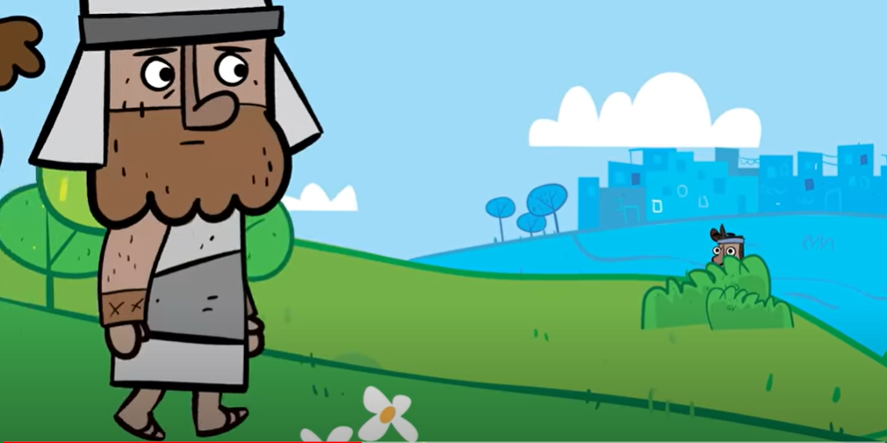
Fully Focused
How can we lose our focus?
There’s a problem

Slide 8
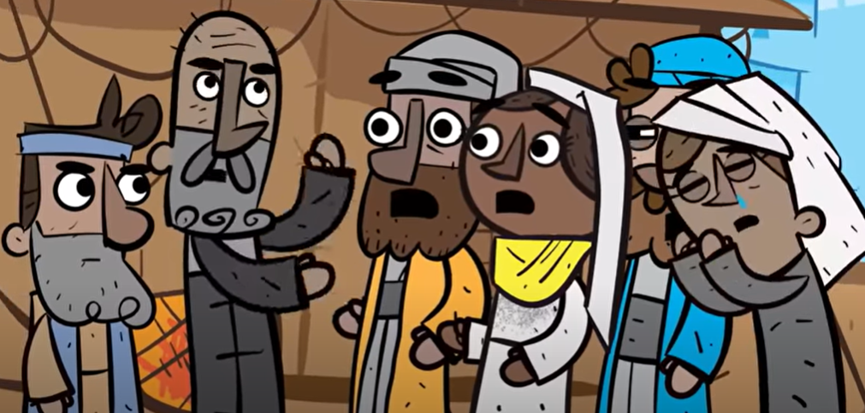
Fully Focused
How can we lose our focus?
What our friends think

Slide 9
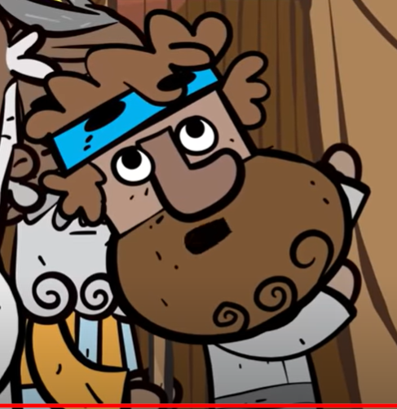
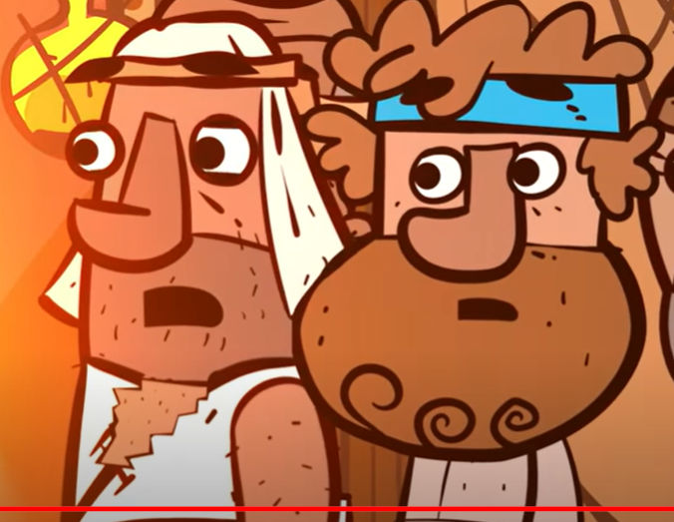
Fully Focused
How do we keep fully focused?
By having a positive attitude

Slide 10
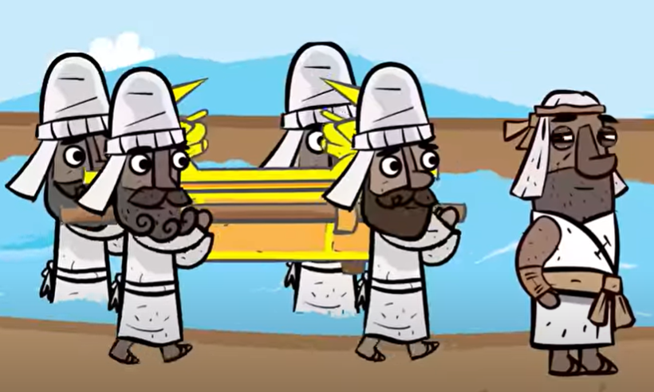
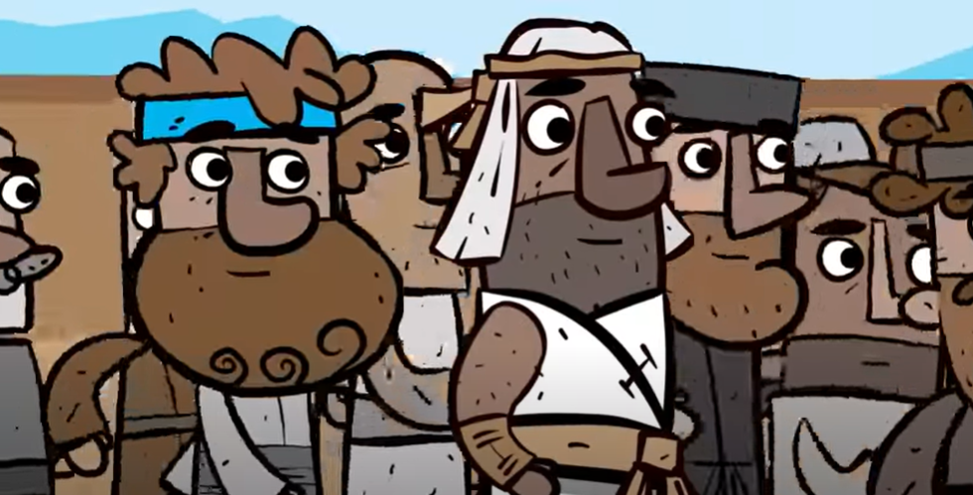
Fully Focused
How do we keep fully focused?
By not giving up!

