Slide 1
Many Parts Make a Whole
What are the parts (or fractions) in the following shapes?

Slide 2
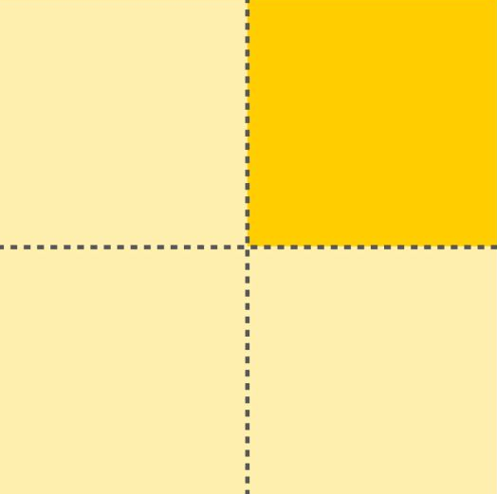
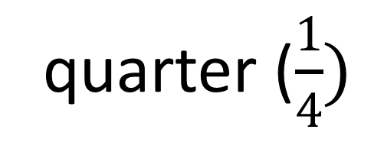
Many Parts Make a Whole
quarter ($\frac{1}{4})$
4 parts = 1 whole

Slide 3
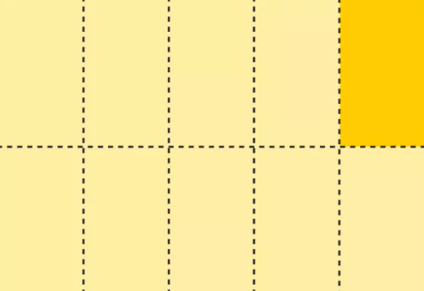
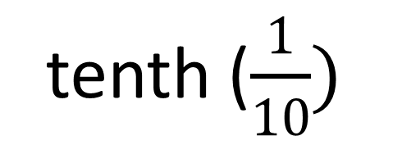
Many Parts Make a Whole
tenth ($\frac{1}{10})$
10 parts = 1 whole

Slide 4
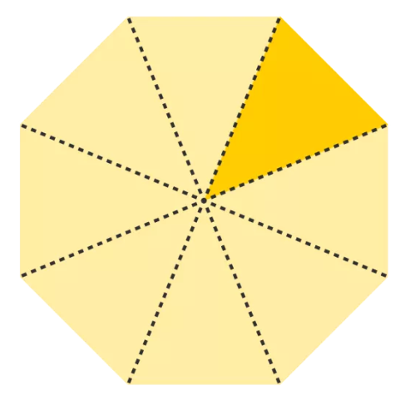
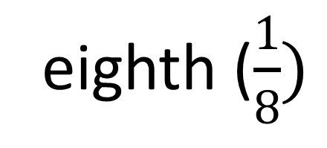
Many Parts Make a Whole
eighth ($\frac{1}{8})$
8 parts = 1 whole

Slide 5
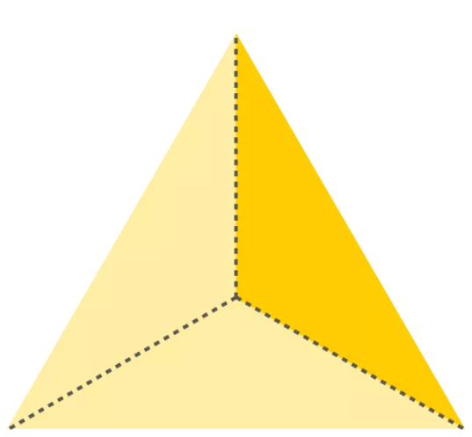
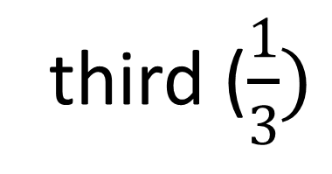
Many Parts Make a Whole
third ($\frac{1}{3})$
3 parts = 1 whole

Slide 6

Many Parts Make a Whole
Our school is made up of many parts and we come together to make a whole

Slide 7
Many Parts Make a Whole
The parts can be divided into . . .

Slide 8
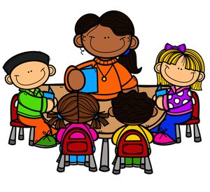
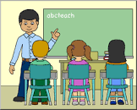
Many Parts Make a Whole
Adults
Children

Slide 9
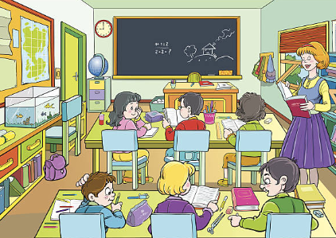
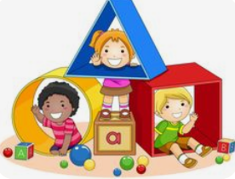
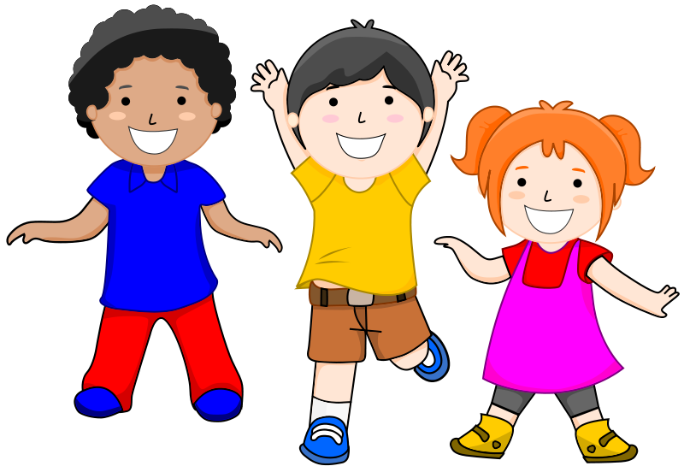
Many Parts Make a Whole
Children in different year groups

Slide 10



Many Parts Make a Whole
Different skills . . .

Slide 11


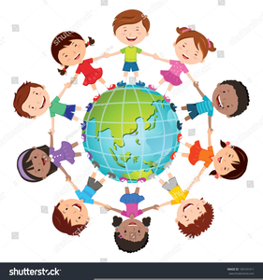
Many Parts Make a Whole
Different faiths . . .

Slide 12
Many Parts Make a Whole
How do we play our part?

Slide 13
Many Parts Make a Whole
The parts | How do we play our part?
Adults and children
Adults look after children and teach them. They also sort out any problems.
Children are kind to one another and behave well.

Slide 14
Many Parts Make a Whole
The parts | How do we play our part?
Adults and children | Adults look after children and teach them. They also sort out any problems. Children are kind to one another and behave well.
Children in different year groups
Older children set an example to the younger children in how to behave and be kind.

Slide 15
Many Parts Make a Whole
The parts | How do we play our part?
Adults and children | Adults look after children and teach them. They also sort out any problems. Children are kind to one another and behave well.
Children in different year groups | Older children set an example to the younger children in how to behave and be kind.
Different skills
Adults and children support others who find a particular skill or topic challenging.

Slide 16
Many Parts Make a Whole
The parts | How do we play our part?
Adults and children | Adults look after children and teach them. They also sort out any problems. Children are kind to one another and behave well.
Children in different year groups | Older children set an example to the younger children in how to behave and be kind.
Different skills | Adults and children support others who find a particular skill or topic challenging.
Different faiths
Adults and children are respectful of all faiths and want to learn about them.

Slide 17
Many Parts Make a Whole
We are all needed to play our part because every part is equally important

