Slide 1
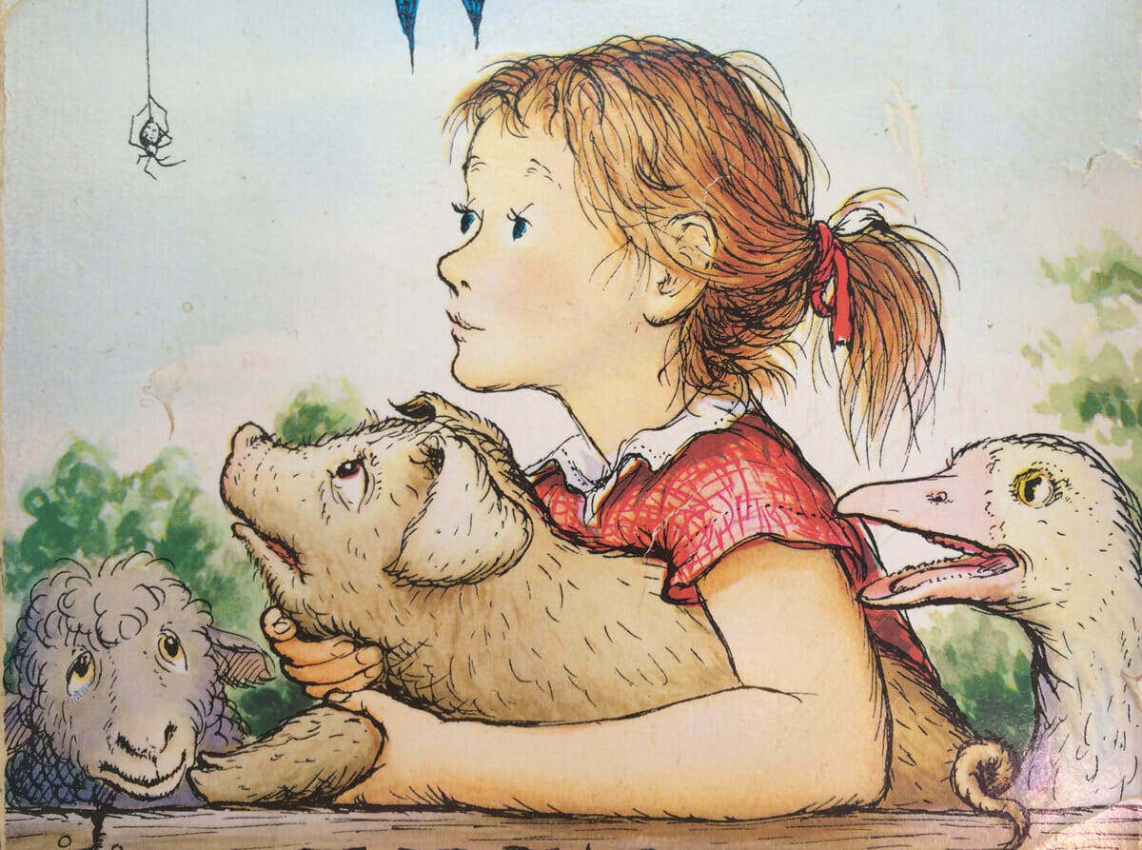
Name the book

Slide 2
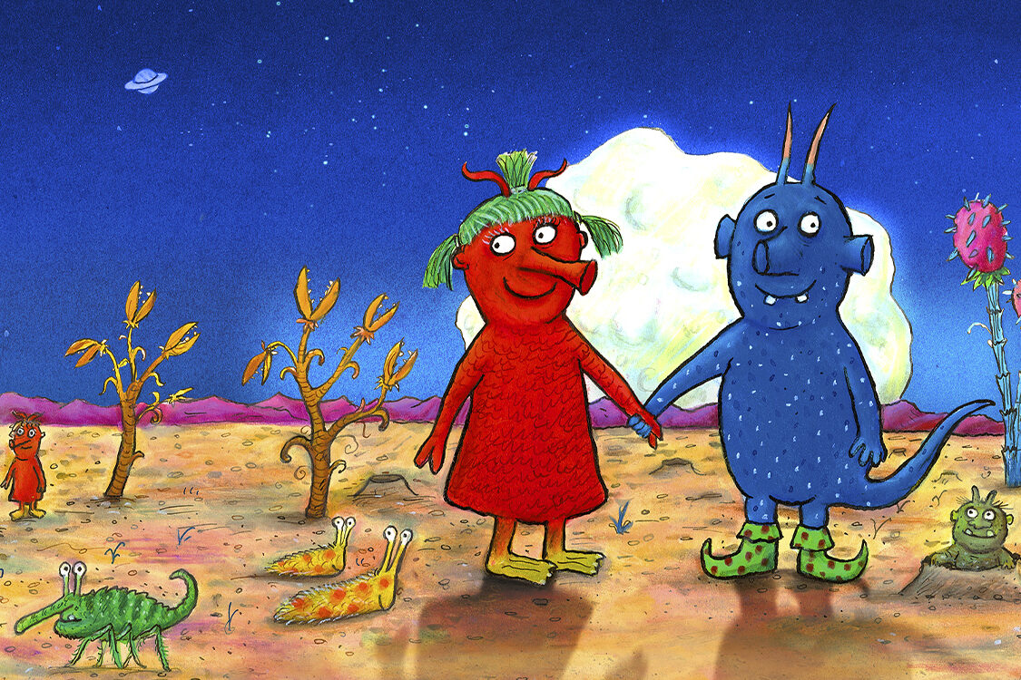
Name the book

Slide 3
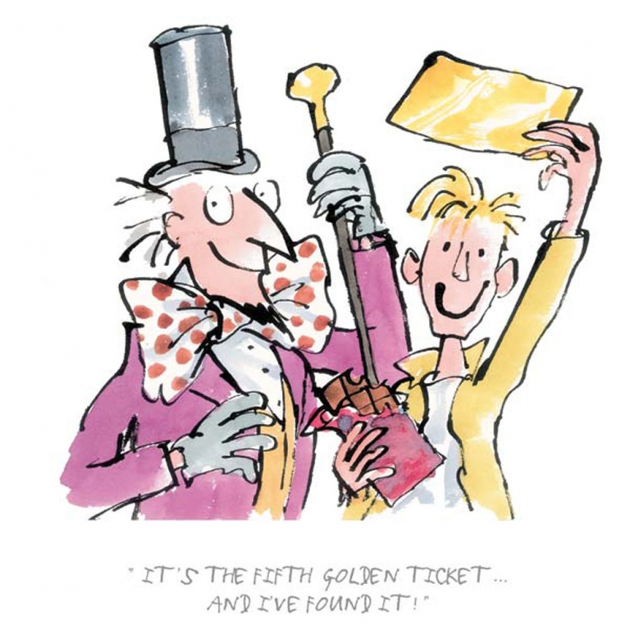
Name the book

Slide 4
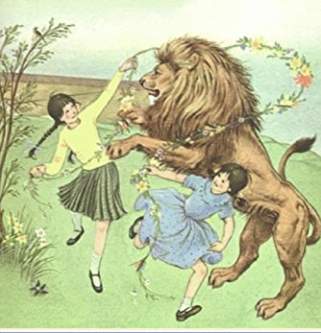
Name the book

Slide 5
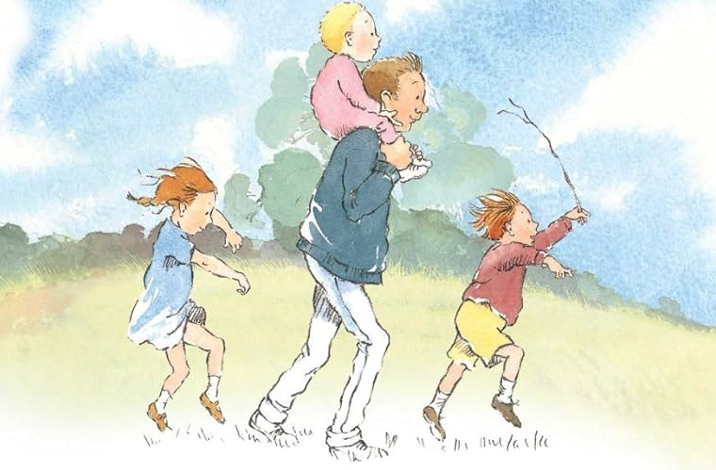
Name the book

Slide 6
Elements of a story
The plot
The setting
The characters
The conflict
The resolution

