Slide 1

What do the following things all have in common…..?

Slide 2
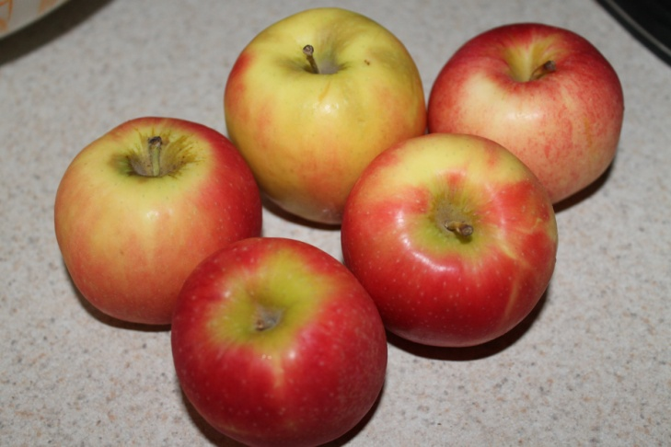


10-5
1+4
3+2

Slide 3
What do the following things all have in common…..?

Slide 4
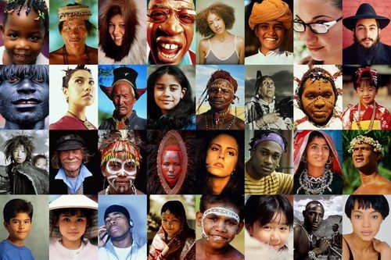

Slide 5

The answer to both questions are the same.
They are all equal!

Slide 6
They are all equal!

Slide 7

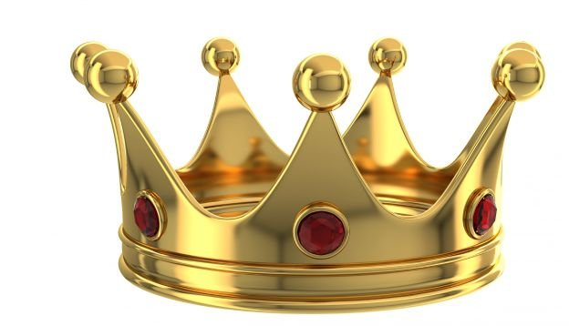

Slide 8
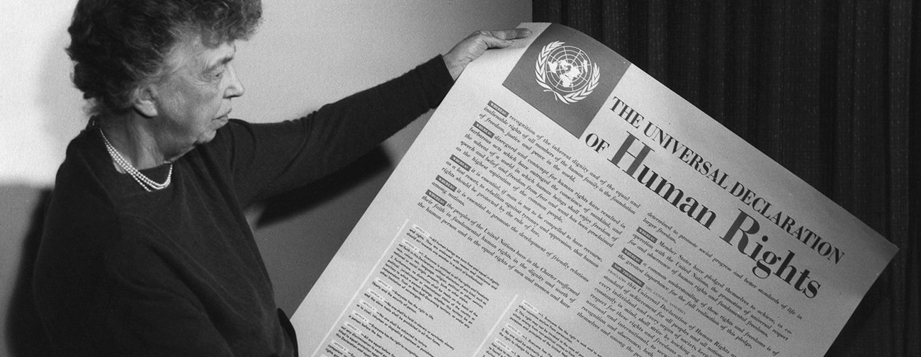
Eleanor Roosevelt with the Universal Declaration of Human Rights in 1948.

Slide 9
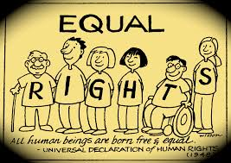
Human rights are the fundamental rights and freedoms that belong to every single one of us.

Slide 10

“In Christ’s family there can be no division into Jew and non-Jew, slave and free, male and female. Among us you are all equal”.
Galatians 3:28 (The Message).

Slide 11


