Slide 1

Welcome
This Photo by Unknown Author is licensed under CC BY-NC-ND

Slide 2


Slide 3

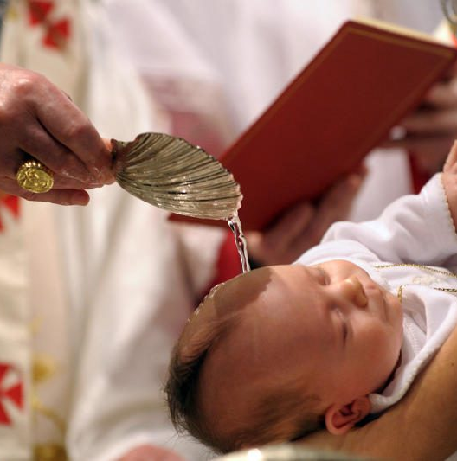

Slide 4
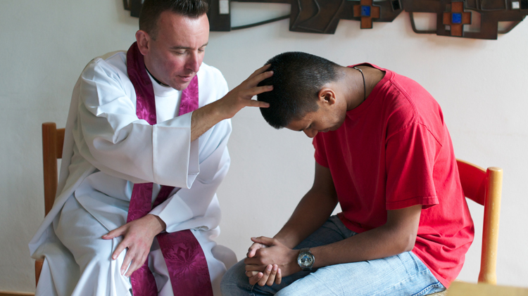

Slide 5

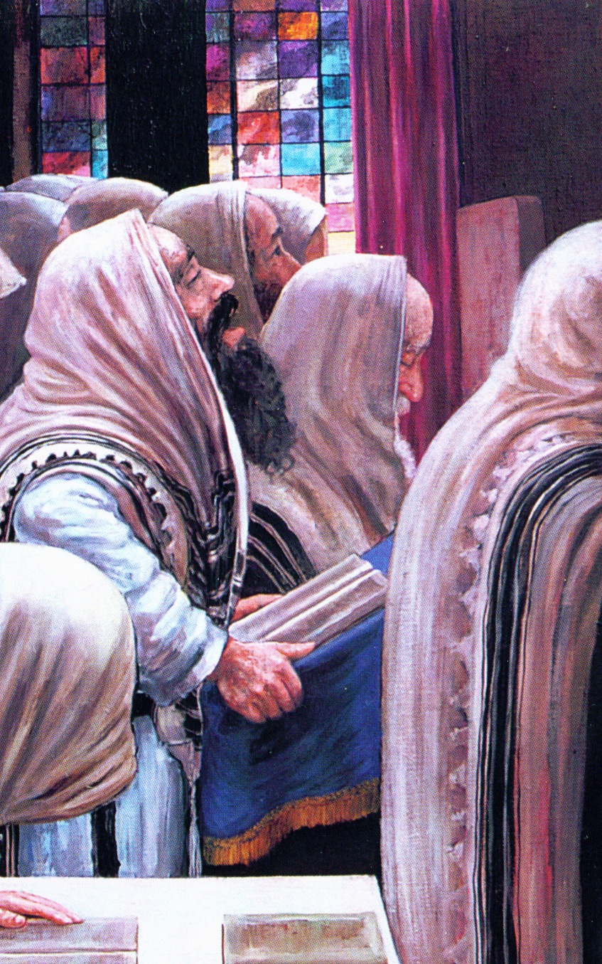

This Photo by Unknown Author is licensed under CC BY-NC-ND
This Photo by Unknown Author is licensed under CC BY-NC-ND

Slide 6
