Slide 1
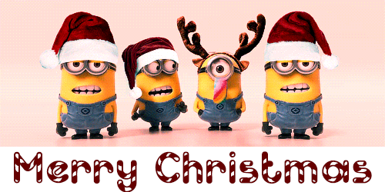
A traditional Christmas?

Slide 2
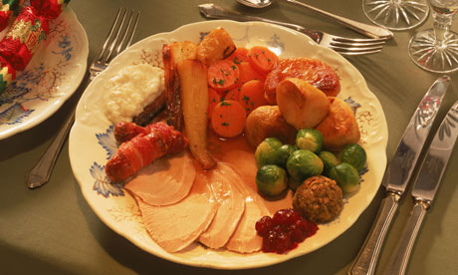
OR….

Slide 3
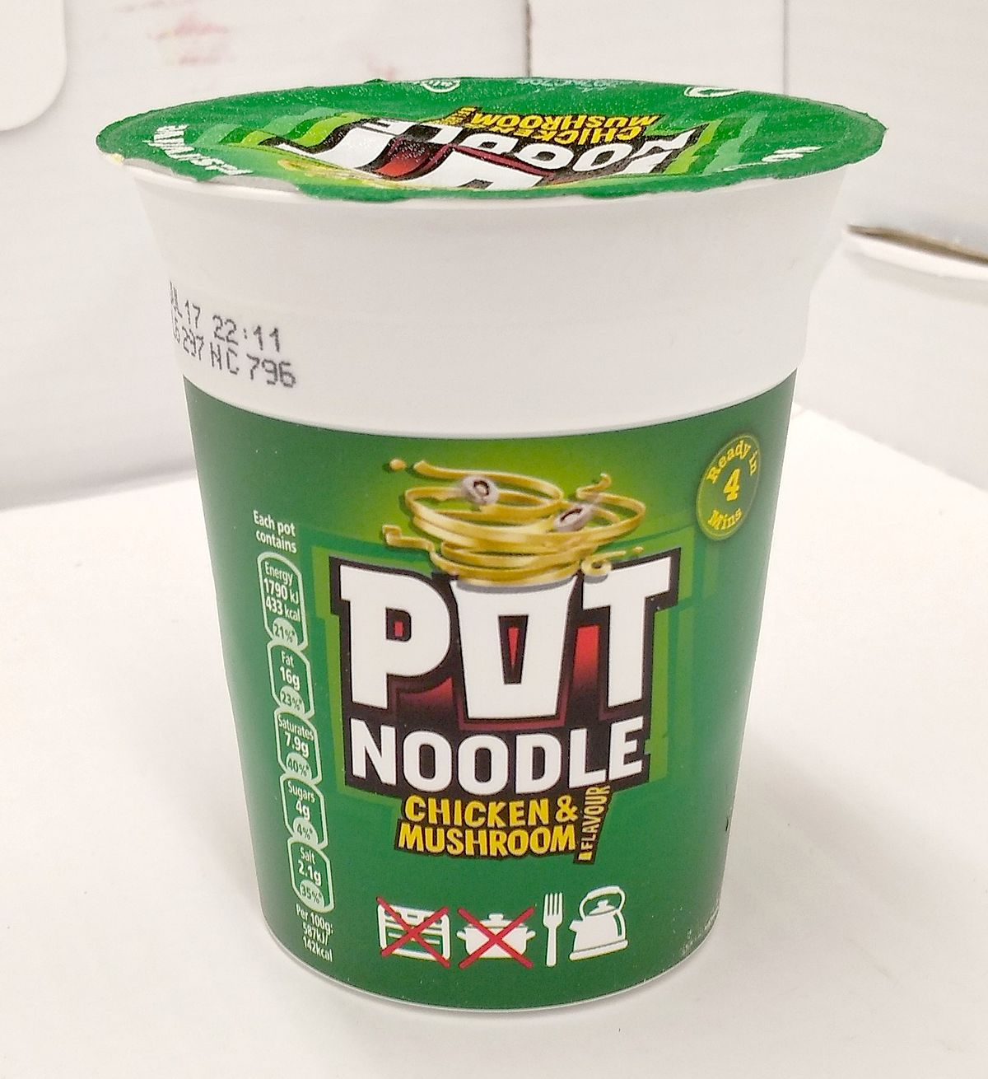

Slide 4
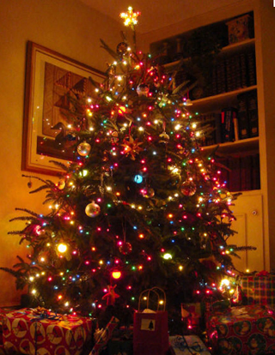
OR….

Slide 5
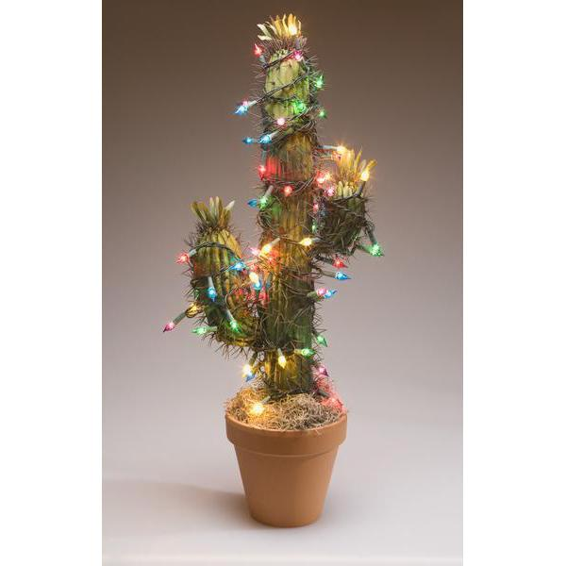

Slide 6
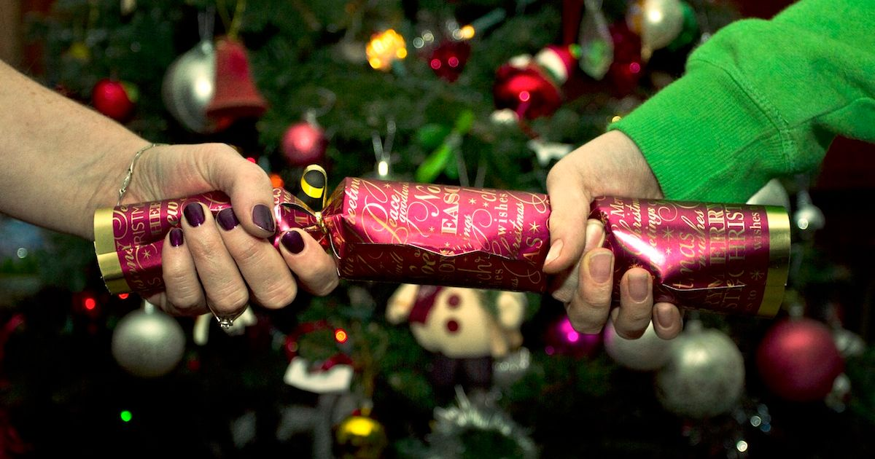
OR….

Slide 7
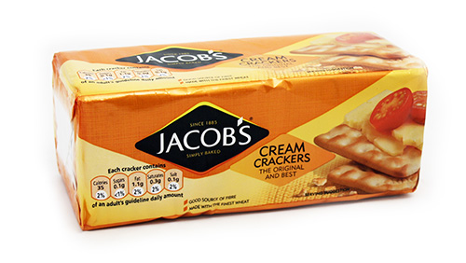

Slide 8
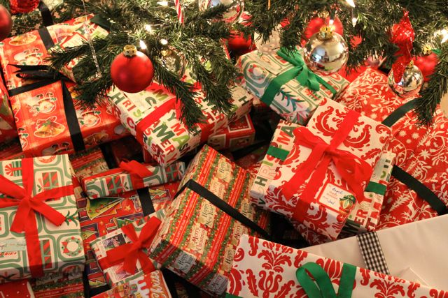
OR….

Slide 9


Slide 10
Traditional?
The handing down from generation to generation of the same customs, beliefs, etc.
A long-established way of thinking or acting.

Slide 11
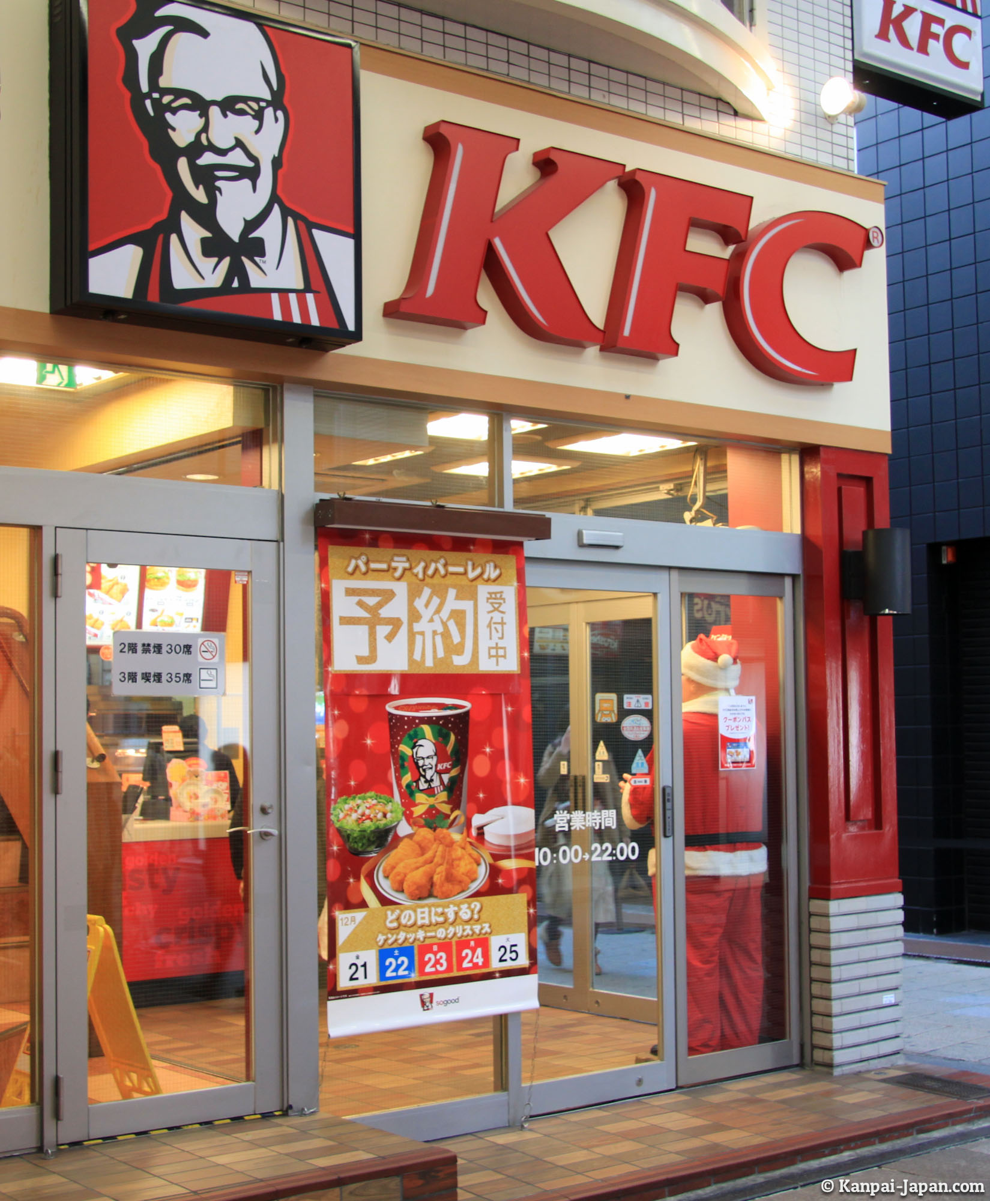
Japan

Slide 12
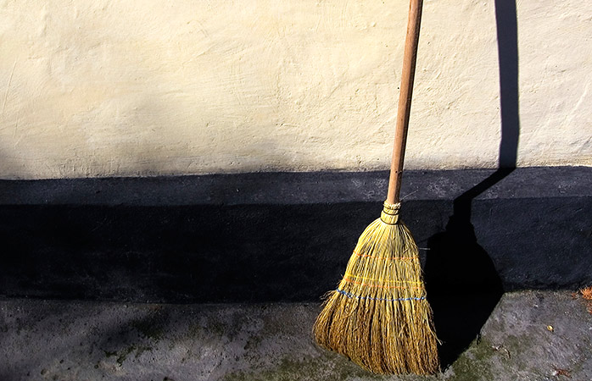
Norway

Slide 13
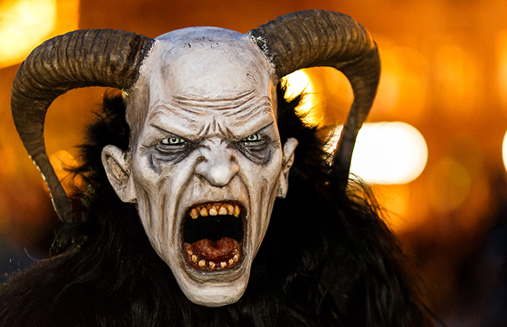
“Krampus”, Austria

Slide 14
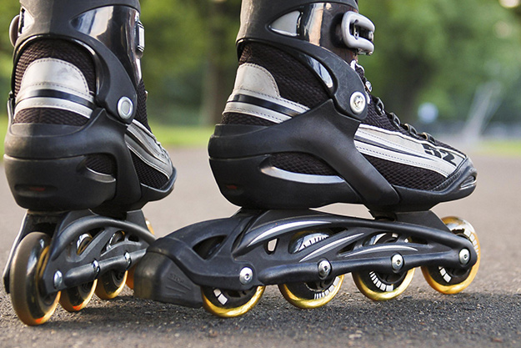
Venezuela

Slide 15



