Slide 1
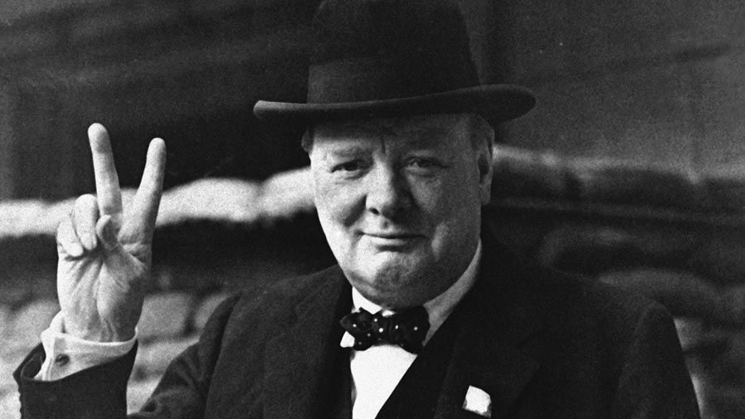

Slide 2
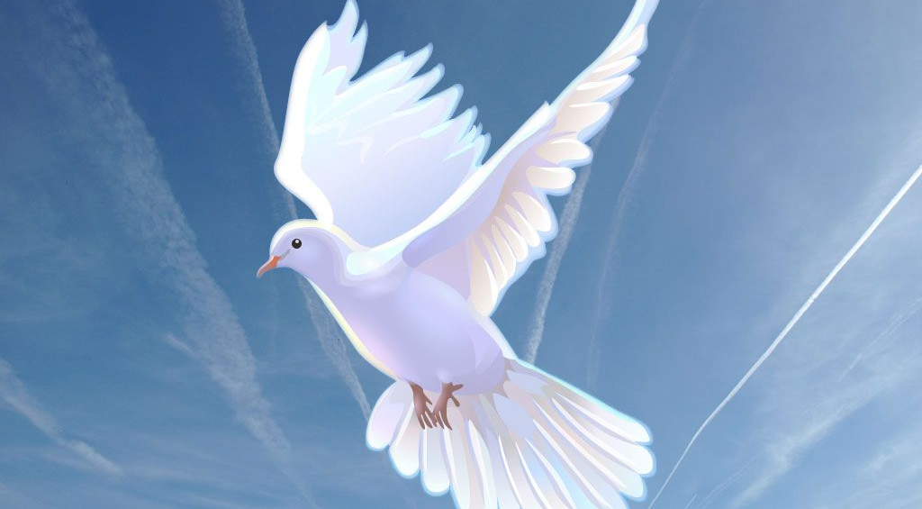

Slide 3


Slide 4
‘Peace cannot be achieved through violence; it can only be attained through understanding.’
Ralph Waldo Emerson

Slide 5
‘Blessed are the peacemakers, for they will be called children of God.’
Matthew 5.9

