Slide 1
Welcome

Slide 2


Slide 3


Slide 4


Slide 5
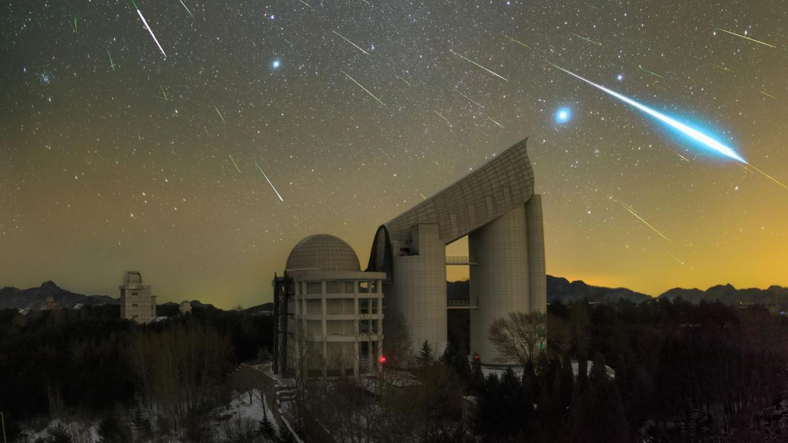

Slide 10

Try staring at one point of the sky for around 20 minutes, rather than scanning across the sky

Slide 11
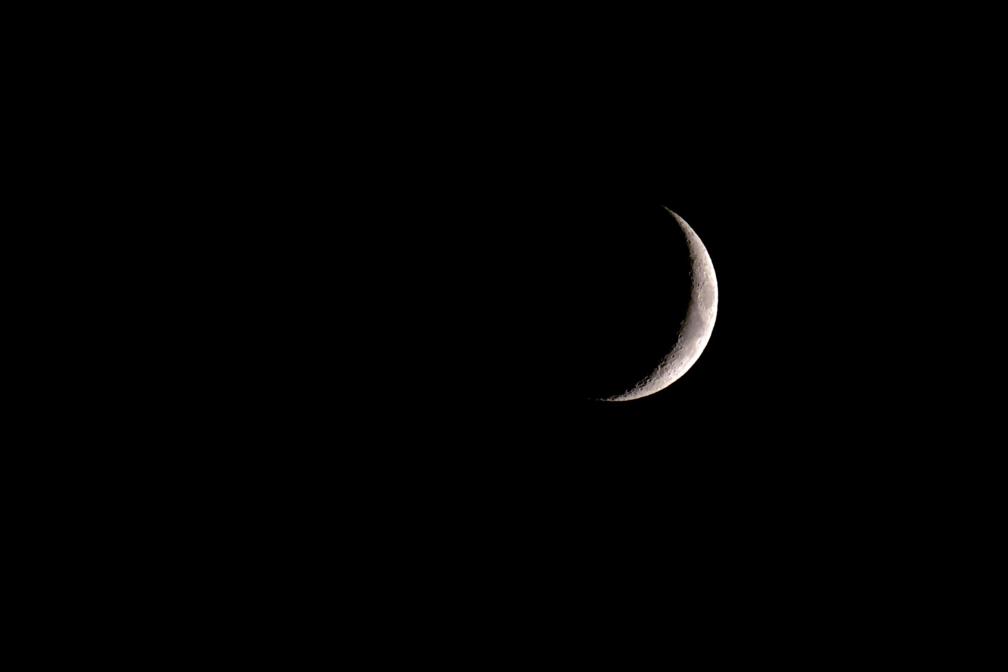
It helps to look at the sky on a clear night, where cloud cover won’t obscure your view

Slide 12
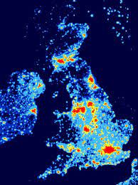
Aim to find a place where light pollution is minimal

Slide 13


Slide 14
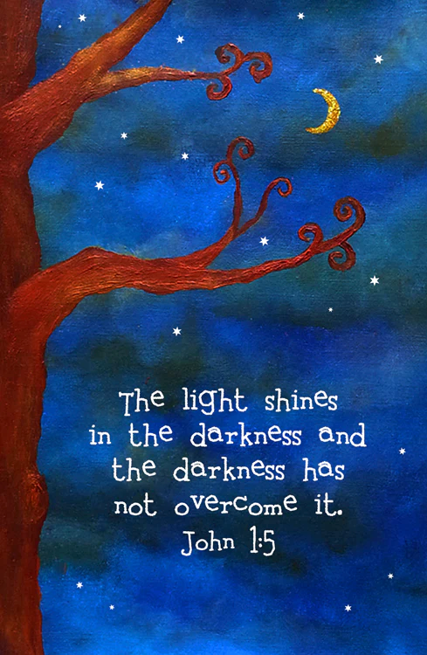
The light shines in the darkness, and the darkness has not overcome it
John 1.5

