Slide 1
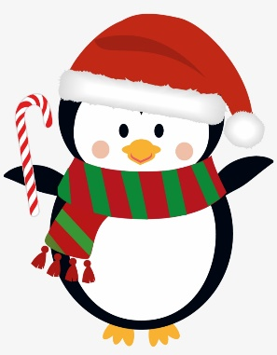




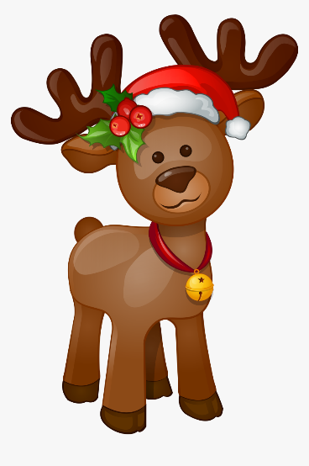
Christmas
Kennings

Slide 2


Christmas Kennings
Toy-inventor
Elf-carer
Sleigh-driver
Chimney-climber
Present-giver
Who am I?

Slide 3
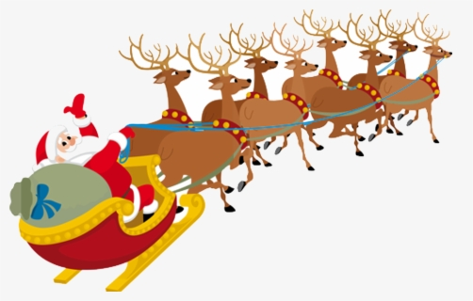
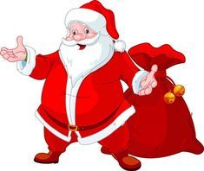
Christmas Kennings
Toy-inventor
Elf-carer
Sleigh-driver
Chimney-climber
Present-giver
Father Christmas!

Slide 4
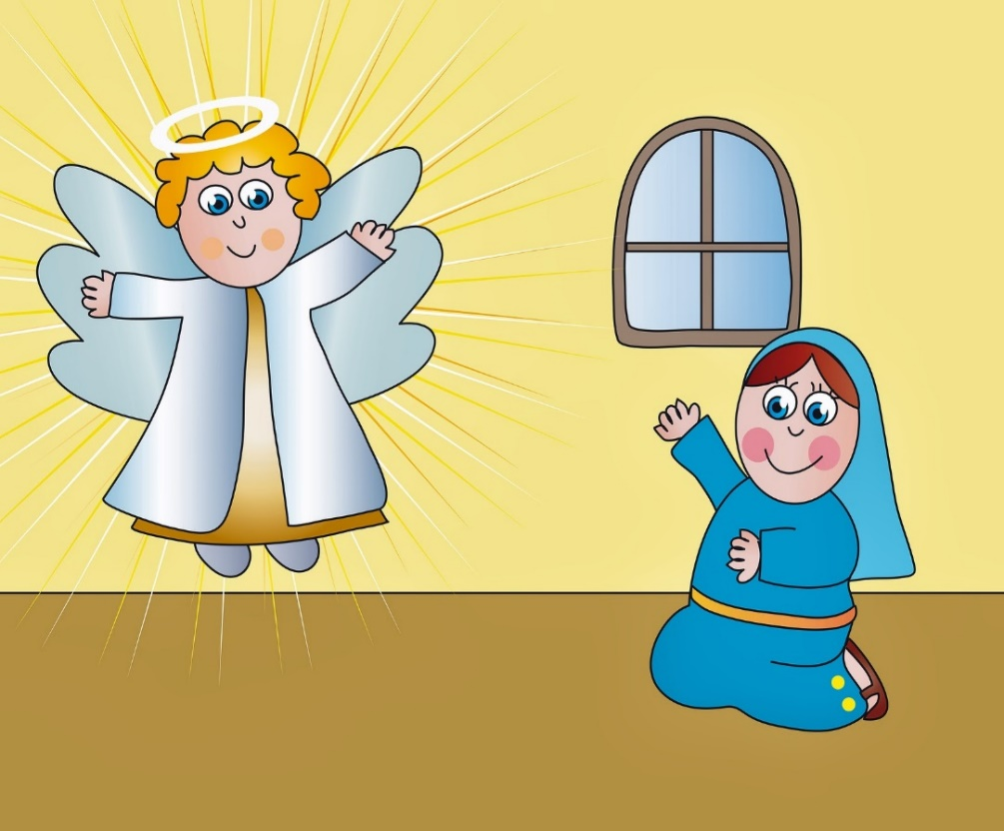
Christmas Kennings
Angel-fearer
Message-listener
Promise-giver
Baby-carrier

Slide 5
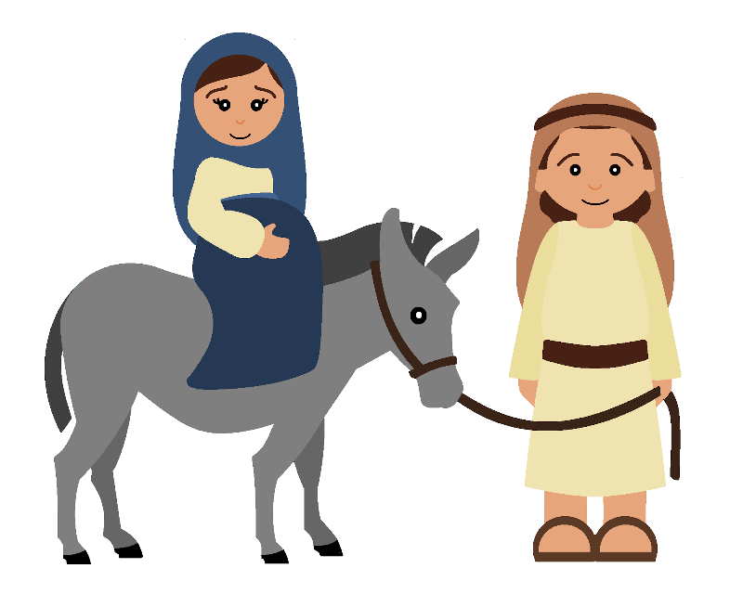
Christmas Kennings
Journey-takers
Donkey-riders
Home-comers

Slide 6
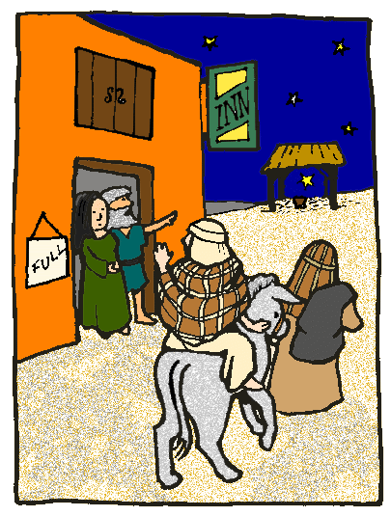
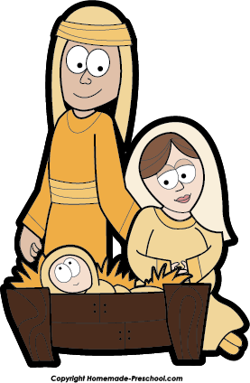
Christmas Kennings
Compassion-showing
Stable-finding
Manger-sleeping
Baby-protecting

Slide 7
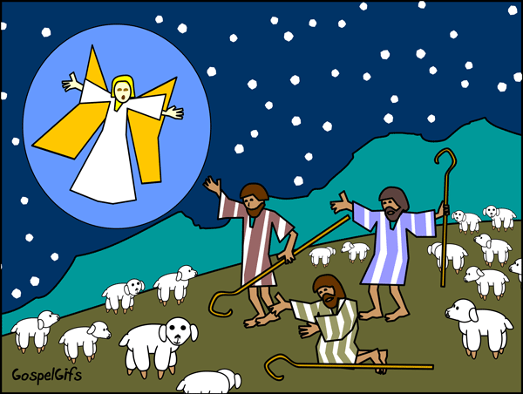
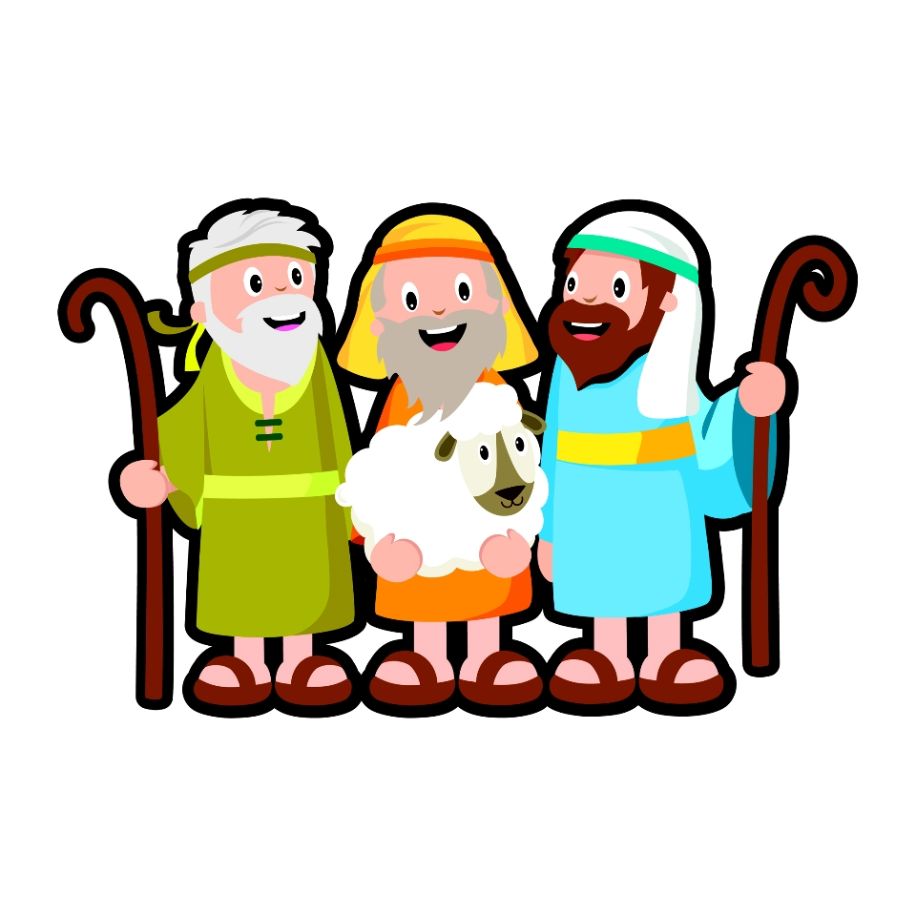
Christmas Kennings
Flock-watching
Angel-fearing
Baby-visiting

Slide 8
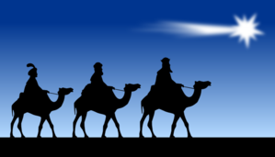
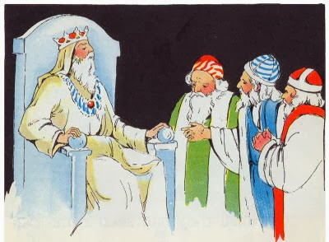
Christmas Kennings
Camel-riders
Star-followers
Desert-travellers

Slide 9
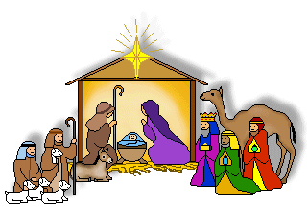
Christmas Kennings
Present-givers

Slide 10
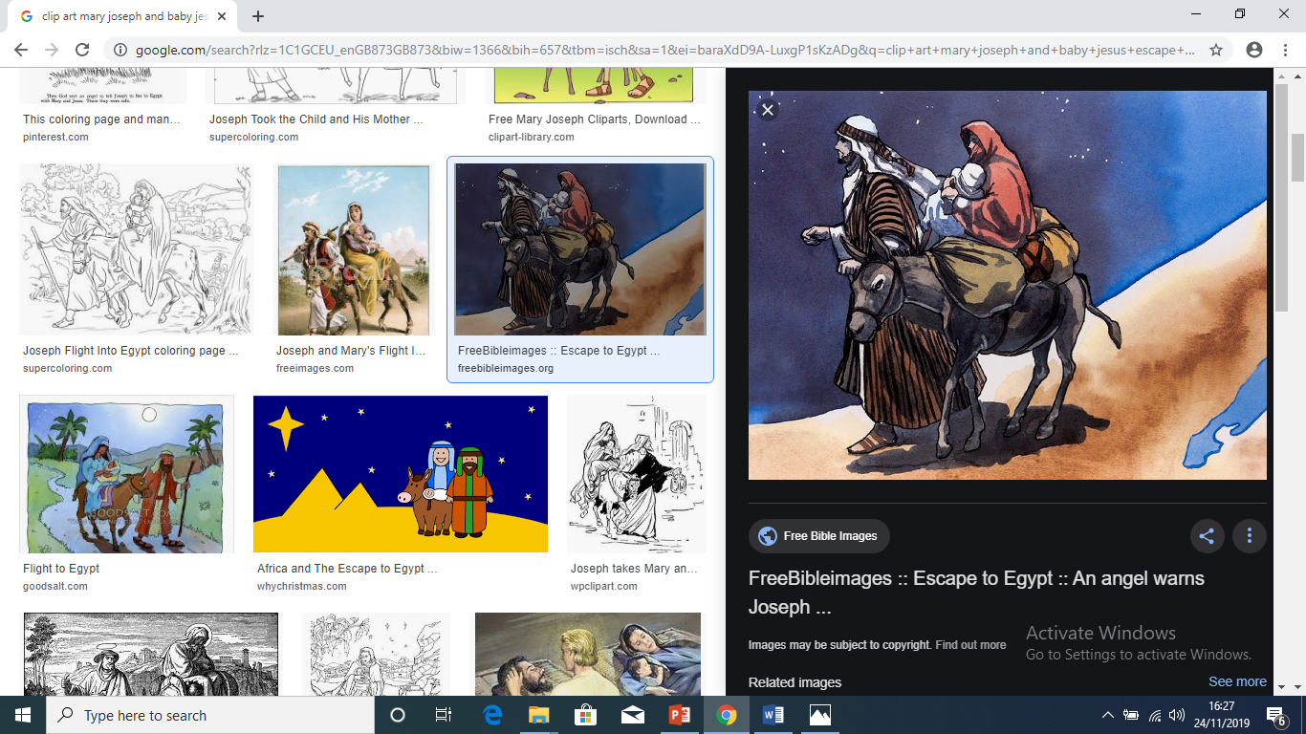
Christmas Kennings
Herod-sufferers
Egypt-escapers

Slide 11
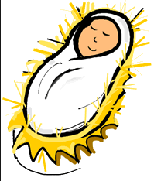
Christmas Kennings
Earth-living
Heaven-ruling

