Slide 1
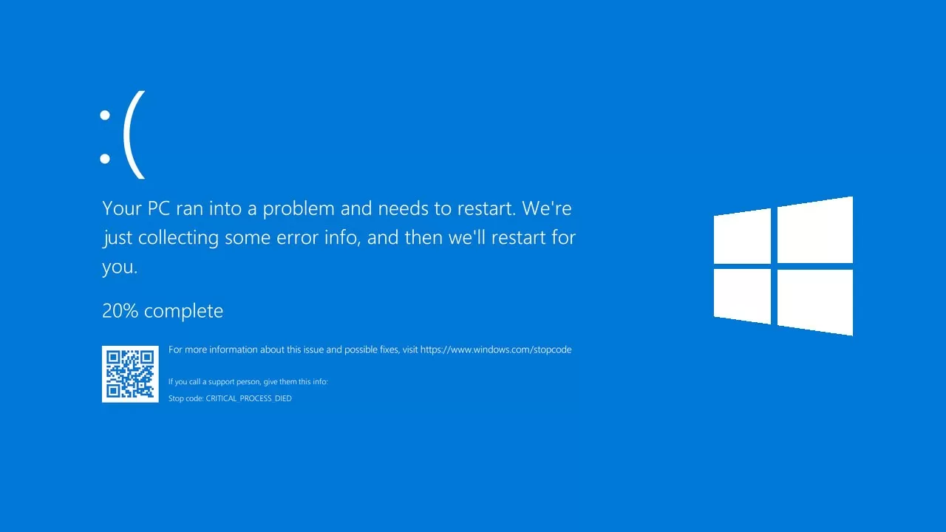

Slide 2


Slide 3
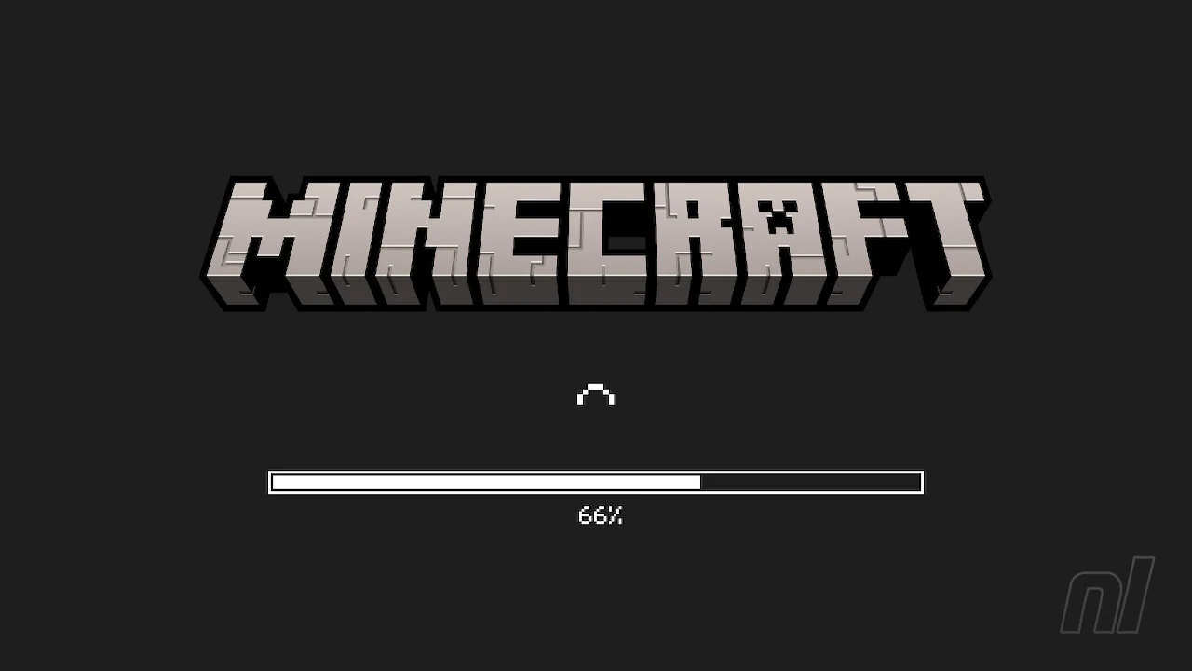

Slide 4
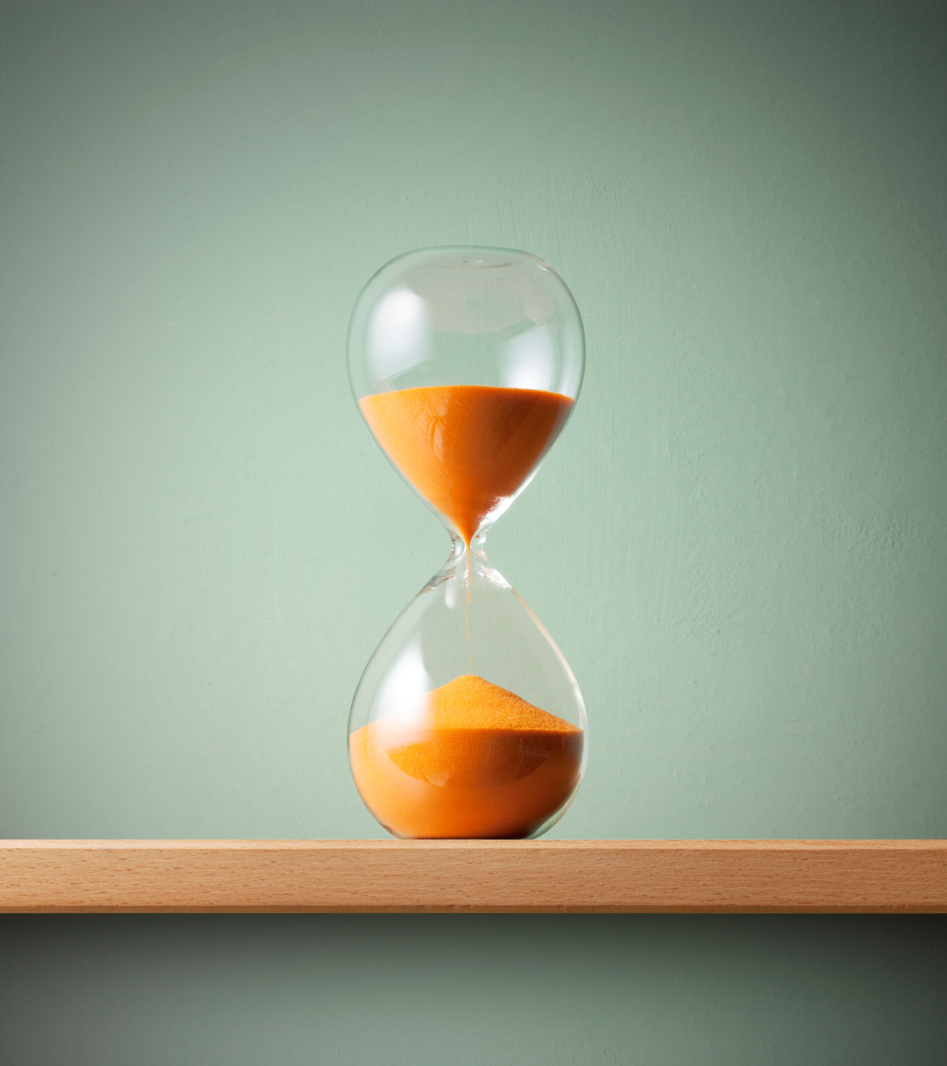
Waiting for food to cook
Waiting for other people to arrive
Queuing
Waiting for the kettle to boil
Being on hold
Waiting for traffic lights to change
Waiting for a bus or train

Slide 5
