Slide 1
Welcome

Slide 2

What is the capital city of France?
How many days are in a leap year?
What was the name of the first person to walk on the moon?

Slide 3
What is the meaning and purpose of your life?
How do you decide what is the right course of action when any choice will result in suffering?
What is love?

Slide 4
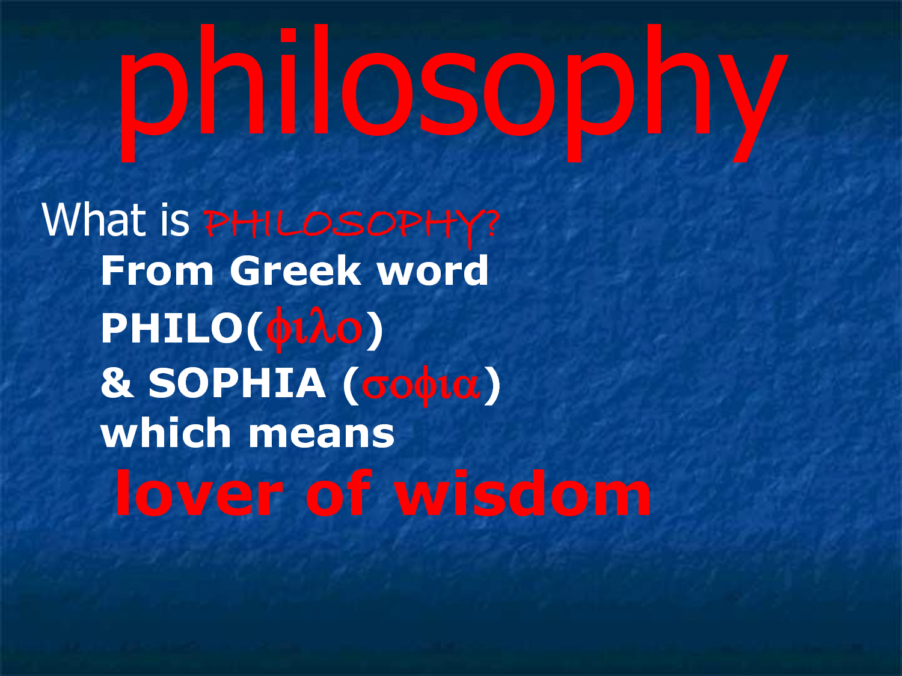

Slide 5
