Slide 1
November by Thomas Hood
No sun - no moon!
No morn - no noon -
No dawn - no dusk - no proper time of day -
No sky - no earthly view -
No distance looking blue -
No road - no street - no 't'other side the way' -
No end to any Row -
No indications where the Crescents go -
No top to any steeple -
No recognitions of familiar people -
No courtesies for showing 'em -
No knowing 'em -

Slide 2
November continued…
No travelling at all - no locomotion,
No inkling of the way - no notion -
'No go' - by land or ocean -
No mail - no post -
No news from any foreign coast -
No Park - no Ring - no afternoon gentility -
No company - no nobility -
No warmth, no cheerfulness, no healthful ease,
No comfortable feel in any member -
No shade, no shine, no butterflies, no bees,
No fruits, no flowers, no leaves, no birds, -
November!

Slide 3
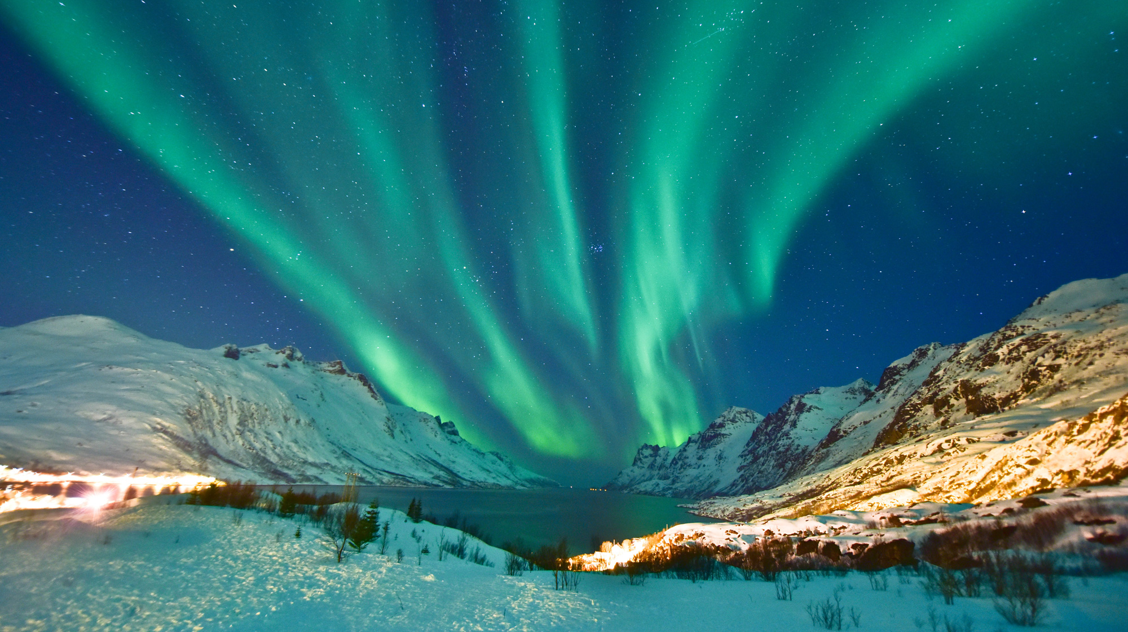

Slide 4


Slide 5
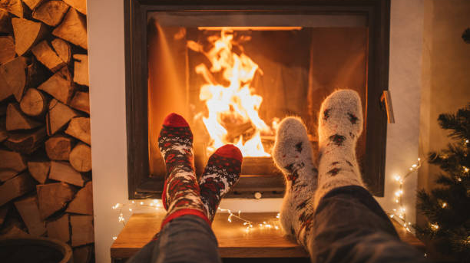

Slide 6
