Slide 1
Today’s Work, Tomorrow’s Strength
What does strength mean?

Slide 2
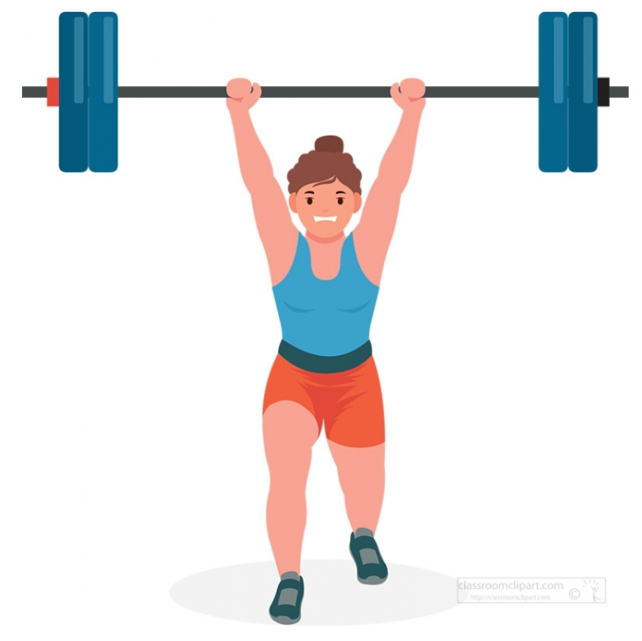
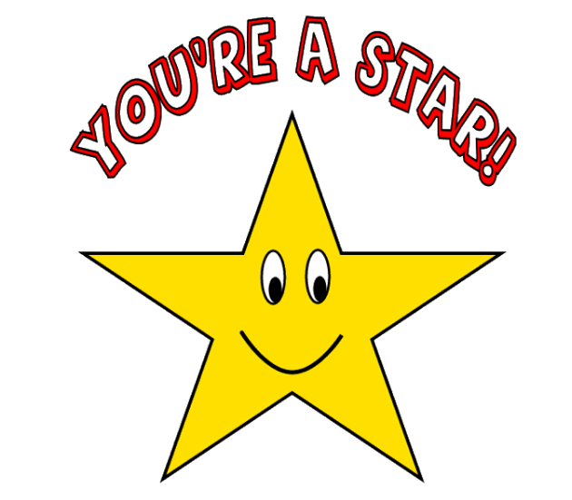
Today’s Work, Tomorrow’s Strength
What does strength mean?
Physical strength
A talent

Slide 3
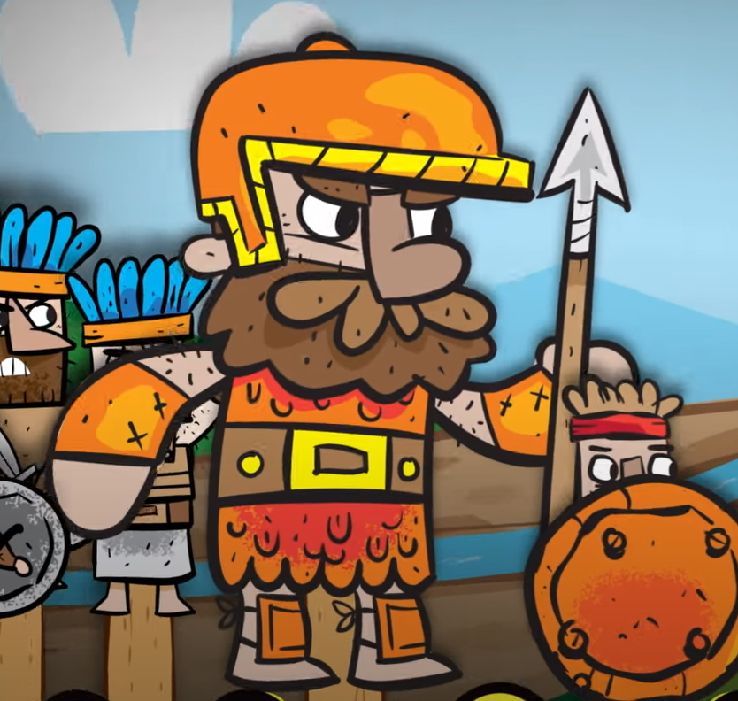
Today’s Work, Tomorrow’s Strength
What strengths did Goliath have?

Slide 4
Today’s Work, Tomorrow’s Strength
What strengths did Goliath have?
Muscles
Height
Armour
Self-confidence

Slide 5
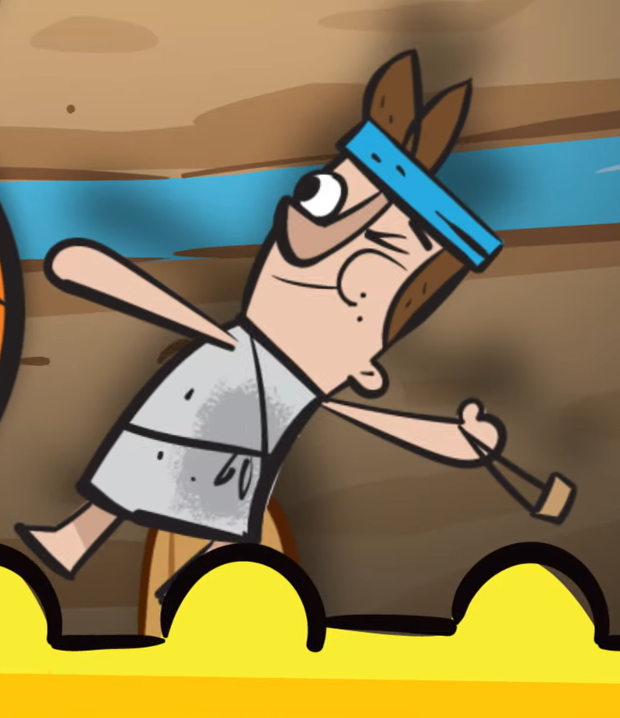
Today’s Work, Tomorrow’s Strength
What strengths did David have?

Slide 6
Today’s Work, Tomorrow’s Strength
What strengths did David have?
Slingshot skills
Courage
Determination
Faith in God

Slide 7
Today’s Work, Tomorrow’s Strength
There are many types of strength.
What other strengths are there?

Slide 8
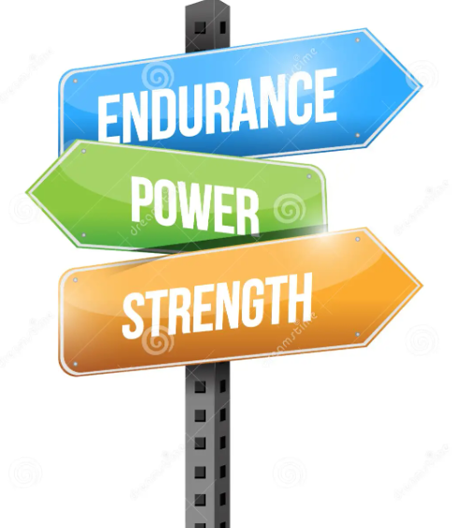
Today’s Work, Tomorrow’s Strength
Art
Music/singing
Academic work
Kindness
Perseverance
Bravery
Friendships
Sporting activities
Setting goals
Problem-solving

Slide 9
Today’s Work, Tomorrow’s Strength
Strength doesn’t come from what you can do. Strength comes from overcoming the things you thought you couldn’t do.

Slide 10
Today’s Work, Tomorrow’s Strength
Today’s work | What to do | Gives you
Learning your times tables | Play times tables games | Tomorrow’s strength
Learning how to dribble a ball | Practise with a family member or friend
Learning a musical instrument | Practise how to play the notes or chords
Learning how to ride a scooter or a bike | Put on a bicycle helmet and practise in a safe place like a local park

Slide 11
Today’s Work, Tomorrow’s Strength
If you want to find tomorrow’s strength . . .
Practice makes perfect!

