Slide 1
Welcome

Slide 2
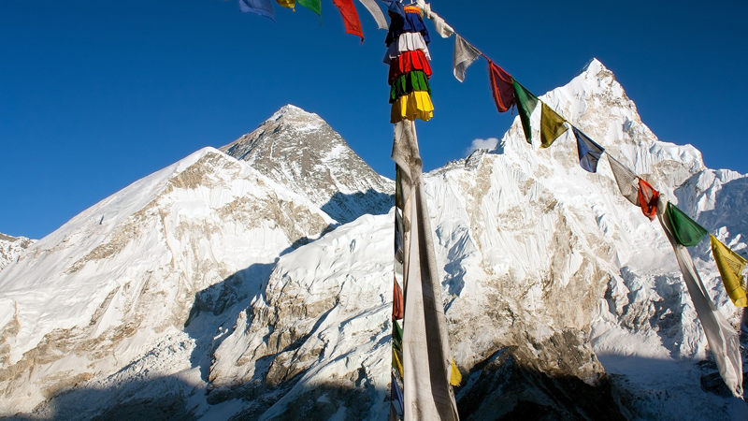

Slide 3
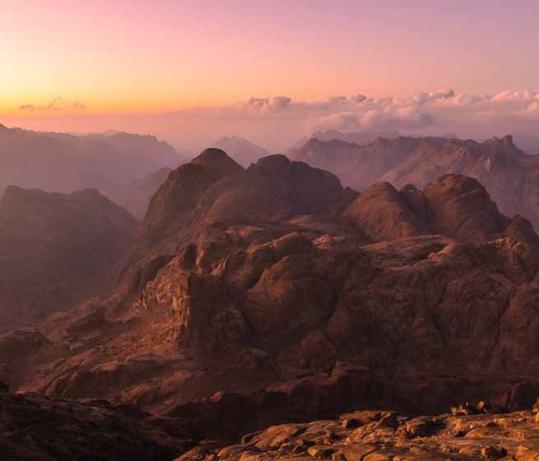
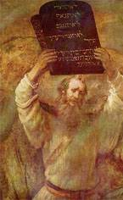

Slide 4
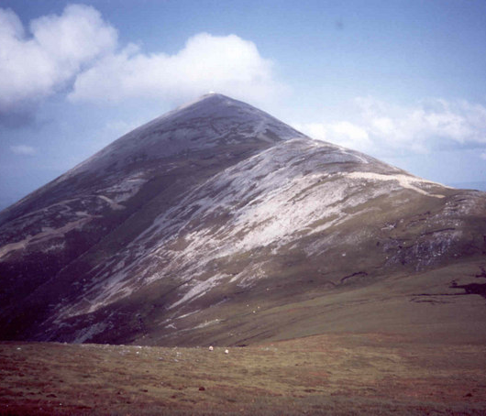
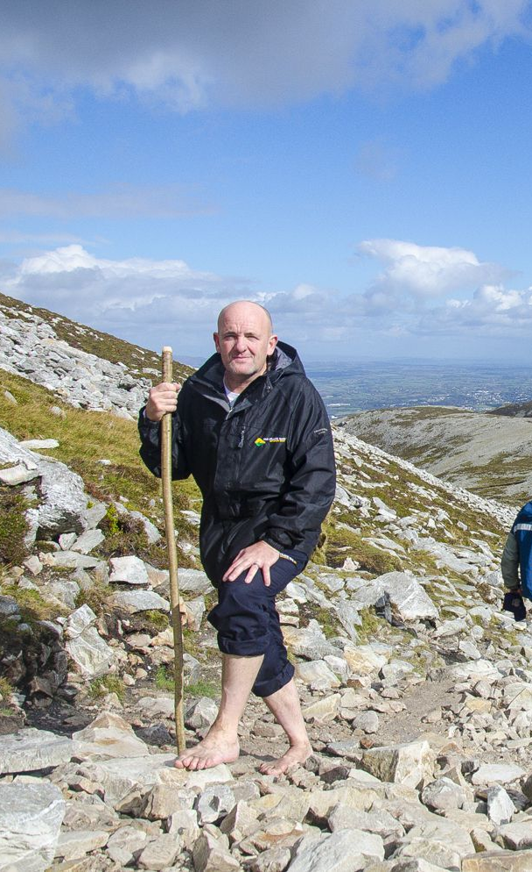

Slide 5
Revising for my exams feels like I’m traipsing up a mountain!
I’d move mountains for you.
You’re making a mountain out of a molehill!
I feel like I’m on top of the world!

