Slide 1
Welcome

Slide 2



Slide 3
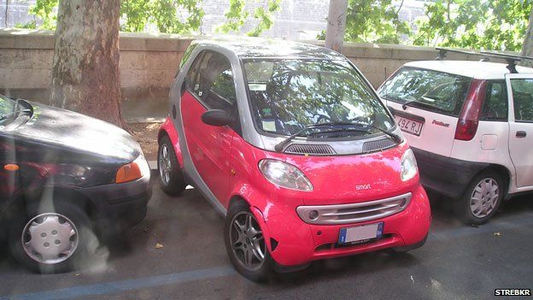

Slide 4


Slide 5

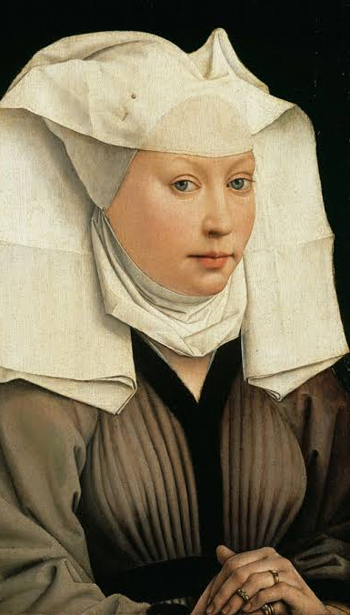
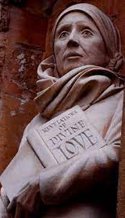
Julian of Norwich
c. 1343 – after 1416

Slide 6
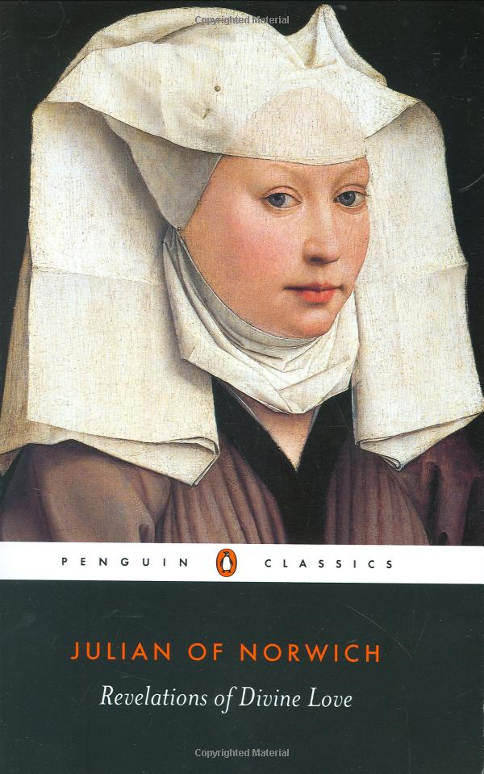

Slide 7
‘A little thing, the quantity of a hazel nut, lying in the palm of my hand . . . And it was as round as any ball. I looked upon it with the eye of my understanding, and thought, ‘What may this be?’ And it was answered generally thus, ‘It is all that is made.’ I marvelled at how it might last, for I thought it might suddenly have fallen to nothing for littleness. And I was answered in my understanding: it lasts and ever shall, for God loves it.
In this little thing I saw three properties. The first is that God made it. The second that God loves it. And the third, that God keeps it.’

