Slide 1
Welcome
Today, we are going to talk about the power of positivity!

Slide 2
Positivity can be demonstrated in many ways
Showing respect and having good manners
Being supportive and encouraging
Being friendly
Being truthful, but kind
Considering other people’s feelings
Being constructive when people communicate with us
Being cheerful
Being attentive; listening carefully

Slide 3

What do you see?

Slide 4
A famous saying!
‘Is the glass half full or half empty?’ is a well-known saying
It means that we can view situations in different ways
If we feel gloomy, we might only see what is lacking or what still needs to be done
If we feel positive, we will celebrate what has been achieved, and feel optimistic about what is to come

Slide 5
Negativity
Being rude or ill-mannered
Being bad-tempered
Being judgmental rather than constructive
Always seeing the worst in someone; labelling people
Being insensitive to those around them
Being destructive
Being discouraging
Being ungracious
Being selfish

Slide 6

Let’s celebrate!

Slide 7
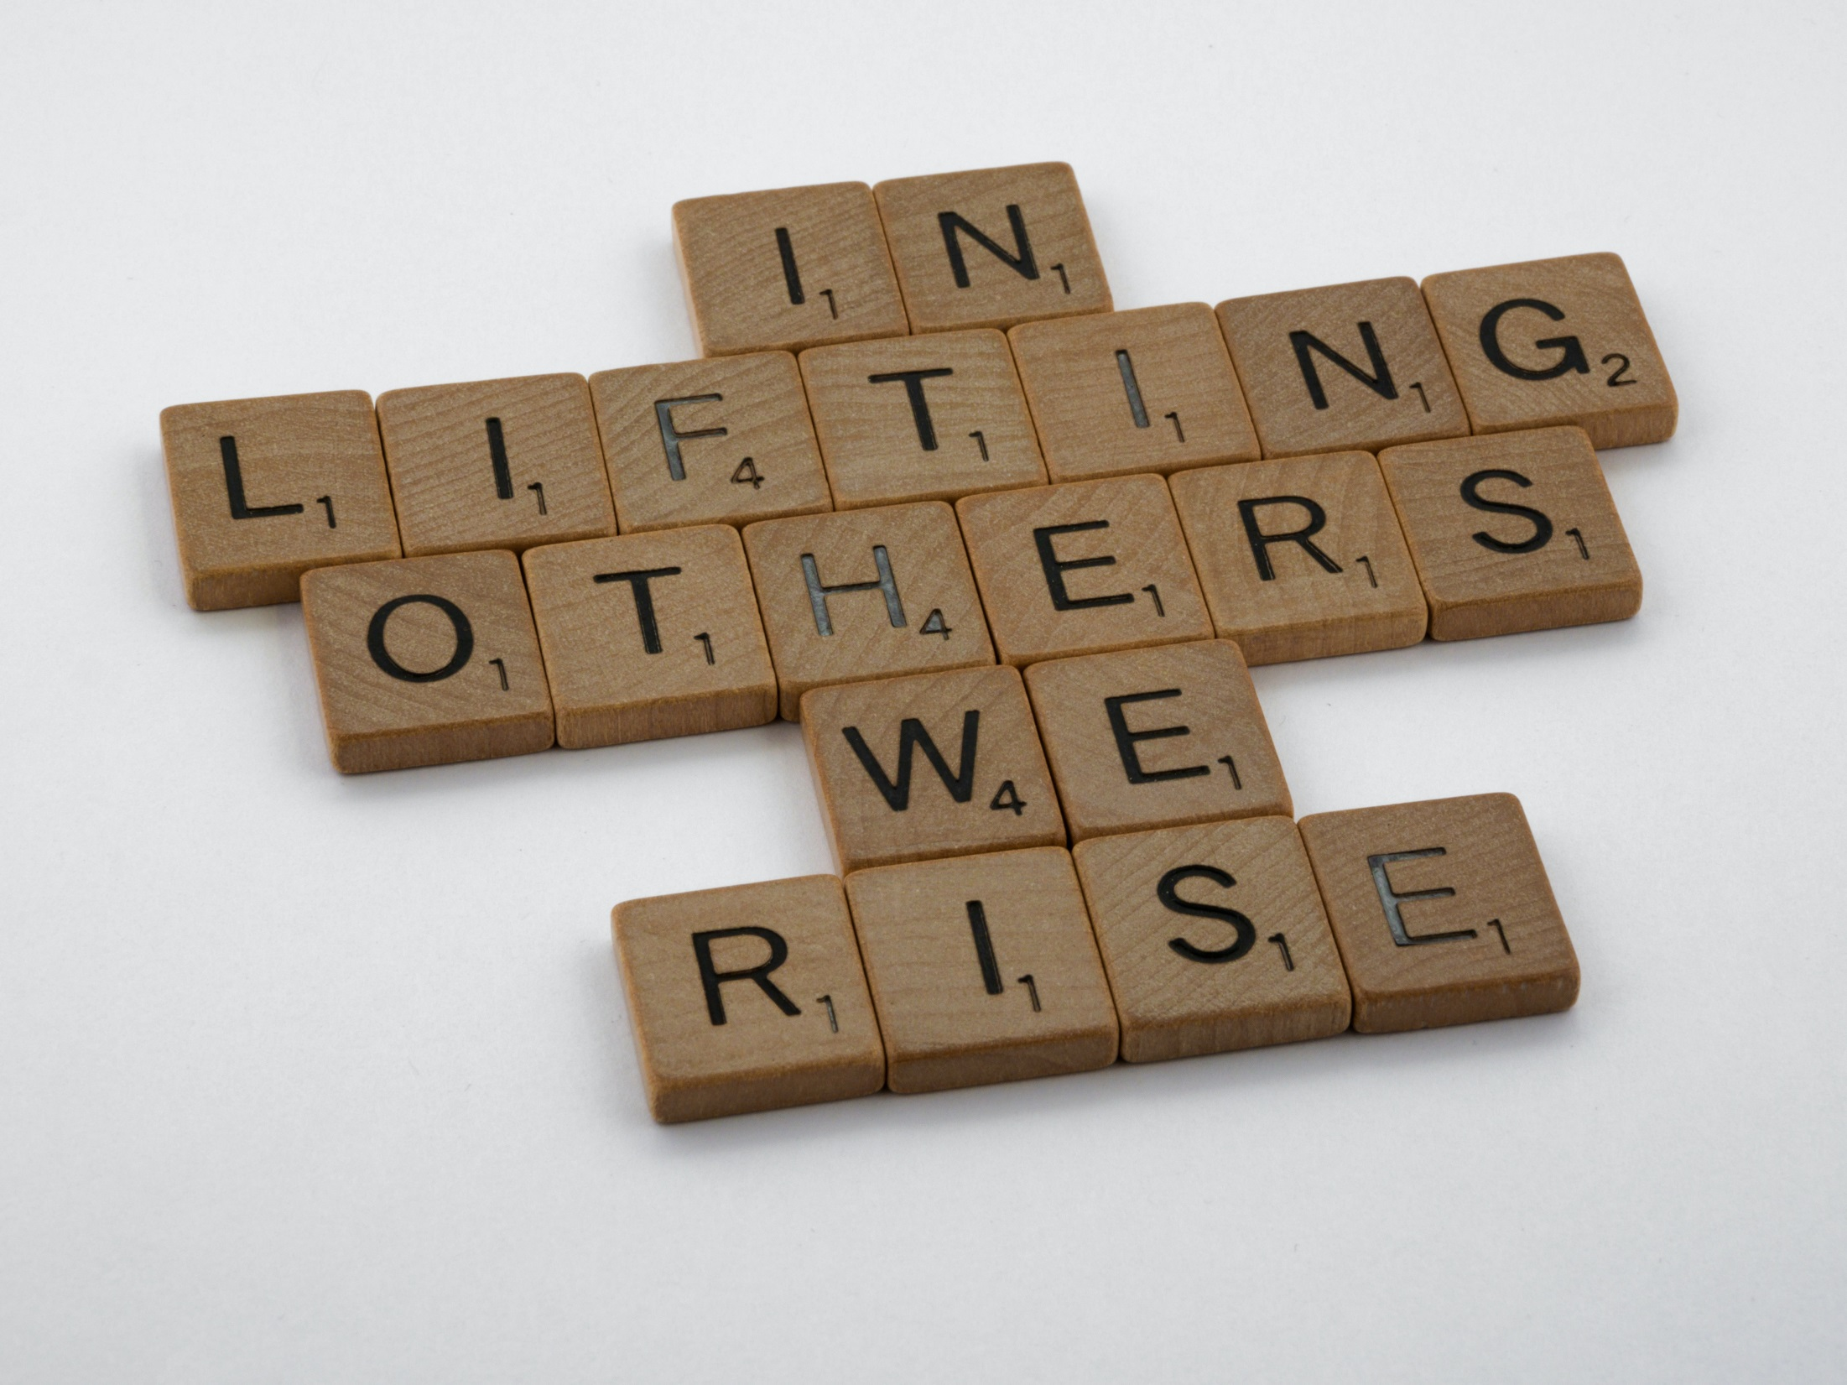
Gospel of Matthew (7:12)
Gospel of Luke 6:31
“Do unto others as you would have them do unto you.”

Slide 8
The Golden Rule
‘Do to others as you would have them do to you.’
Matthew 7.12

