Slide 1
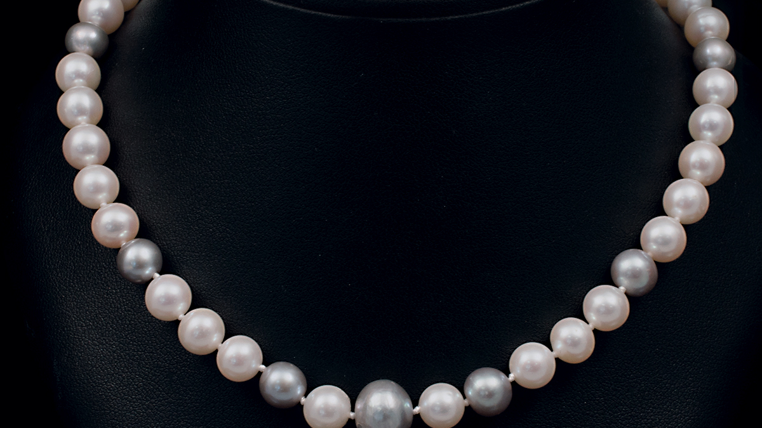

Slide 2
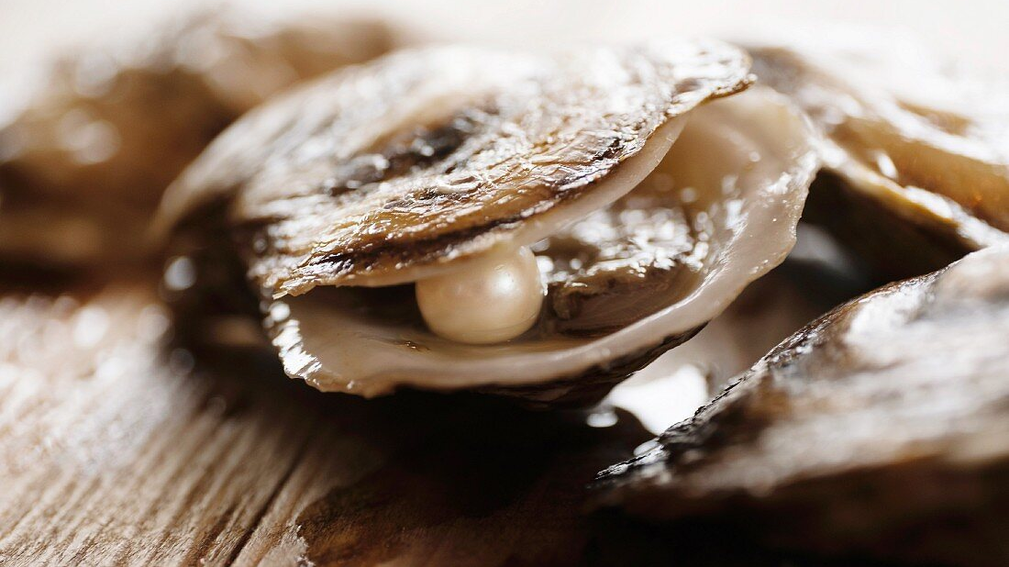

Slide 3
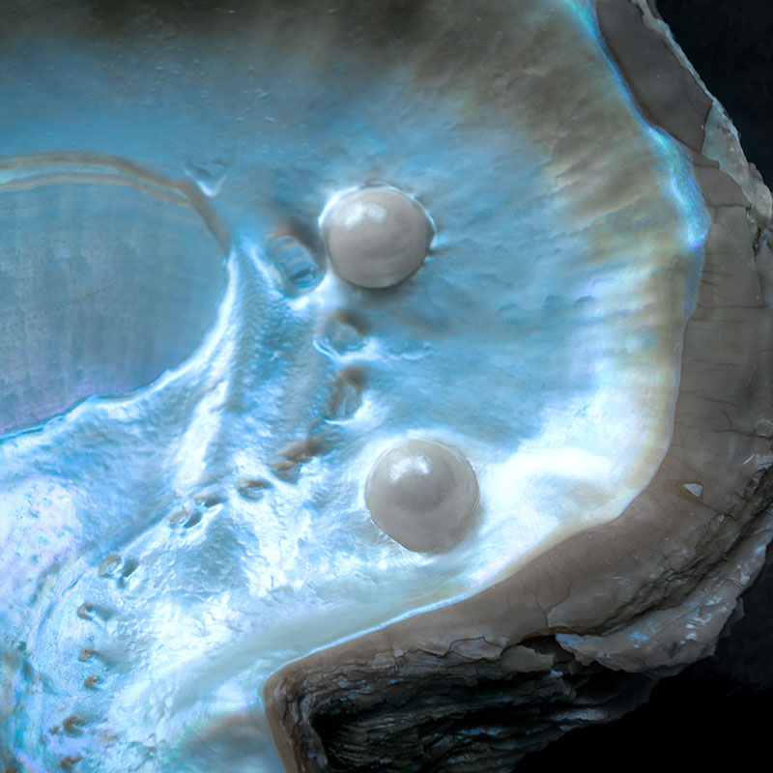

Slide 4
‘Again, the kingdom of heaven is like a merchant looking for fine pearls. When he found one of great value, he went away and sold everything he had and bought it.’
Matthew 13.45-46

