Slide 1
Strong Roots Produce
Good Fruits
What are the four main parts of a plant?

Slide 2
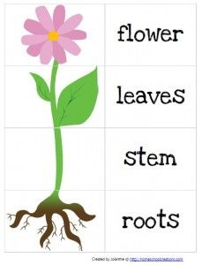
Strong Roots Produce
Good Fruits

Slide 3
Strong Roots Produce
Good Fruits
What happens to a tree
when it doesn’t have
strong roots?

Slide 4
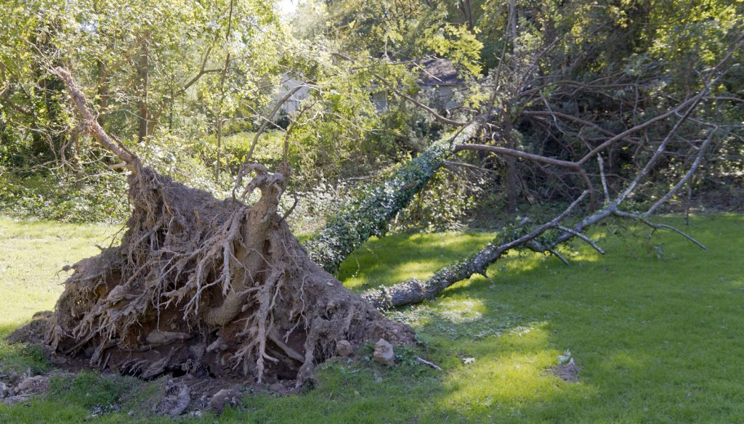
Strong Roots Produce
Good Fruits

Slide 5
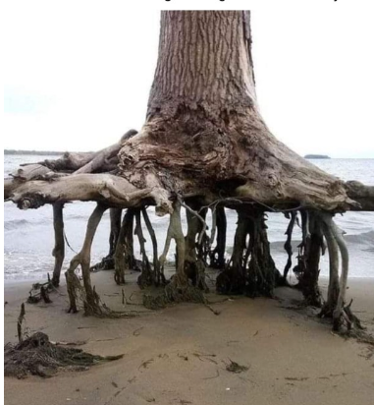
Strong Roots Produce
Good Fruits
What has happened to this tree?

Slide 6

Strong Roots Produce
Good Fruits
Does the tree have strong roots?

Slide 7
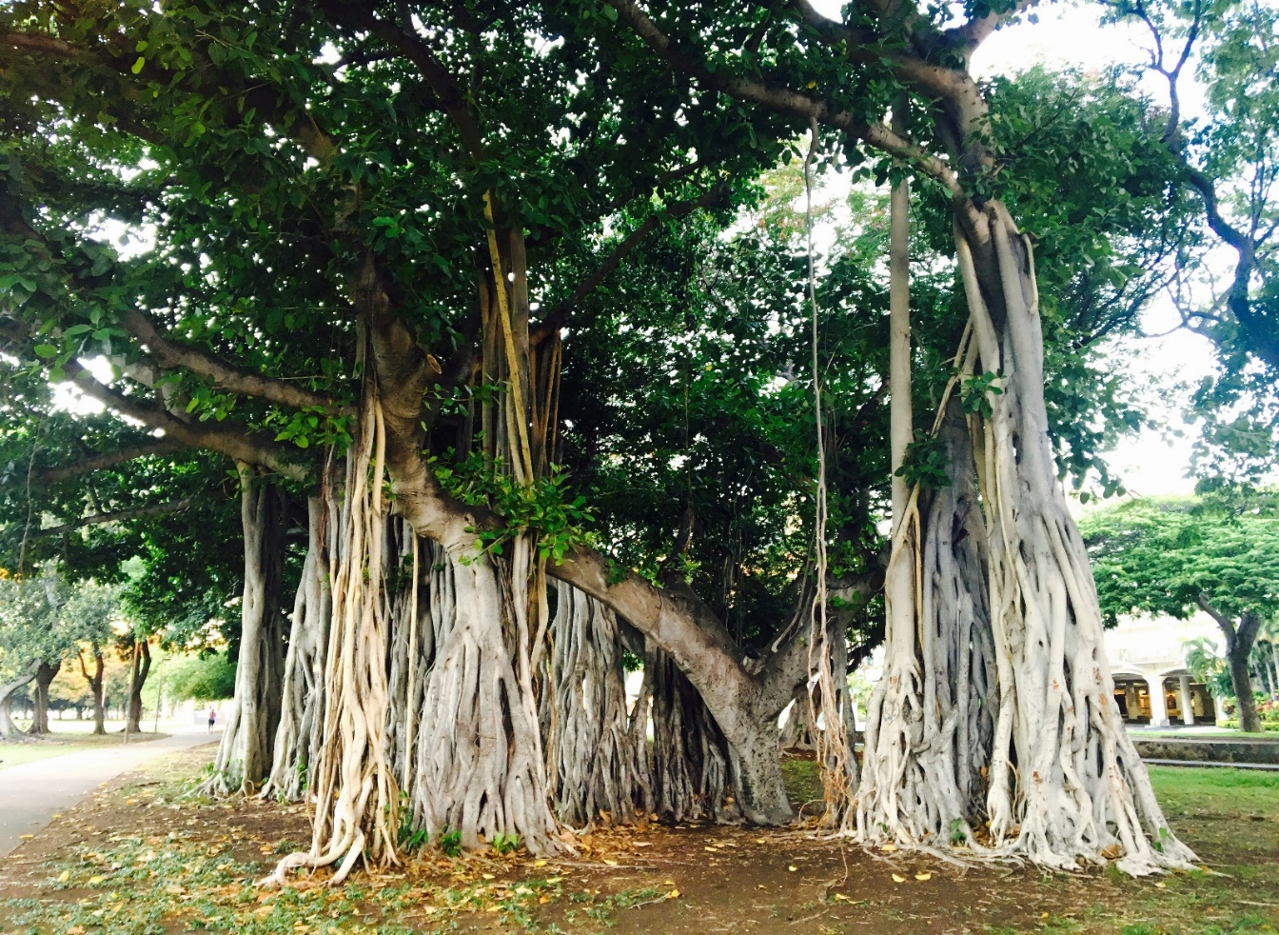
Strong Roots Produce
Good Fruits
What’s different about the banyan tree’s roots?

Slide 8

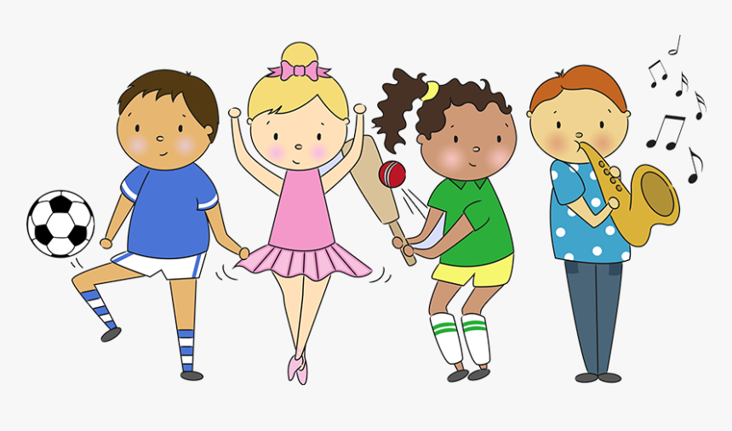

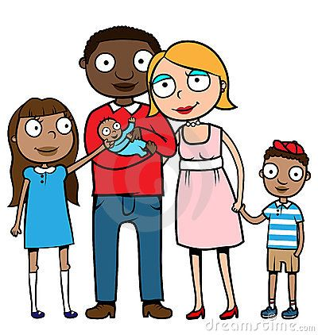
If we have strong roots, we will produce good fruits

Slide 9
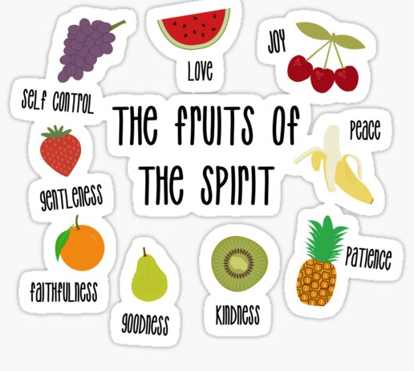
Strong Roots Produce
Good Fruits
Fruits in the Bible

Slide 10

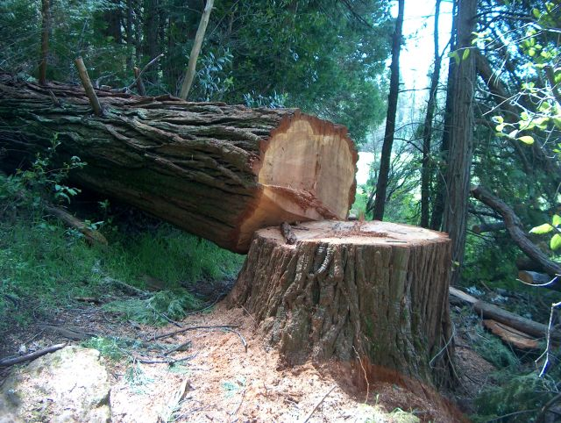
Strong Roots Produce
Good Fruits
What should we do if something goes wrong?

Slide 11
Strong Roots Produce
Good Fruits
Can a tree that has been chopped down regrow?

Slide 12
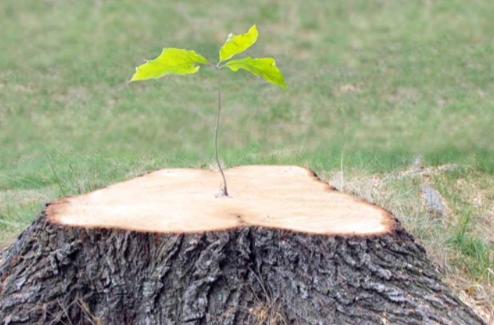
Strong Roots Produce
Good Fruits
If we have strong roots . . .
anything is possible!

