Slide 1
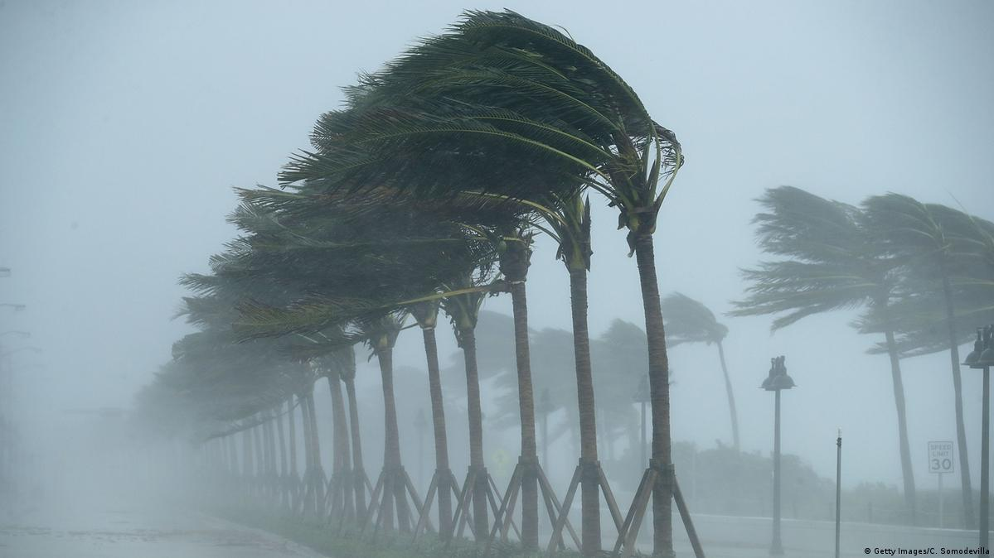
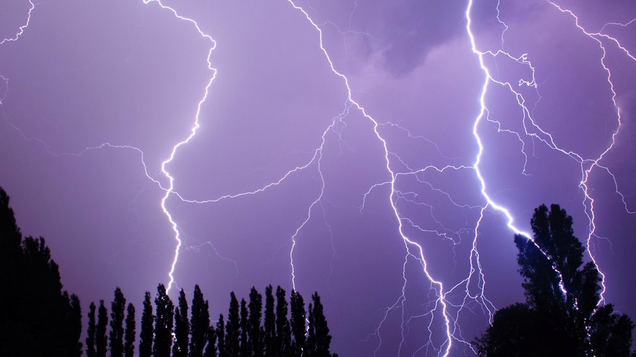
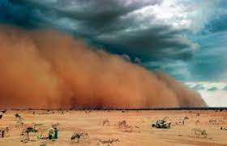
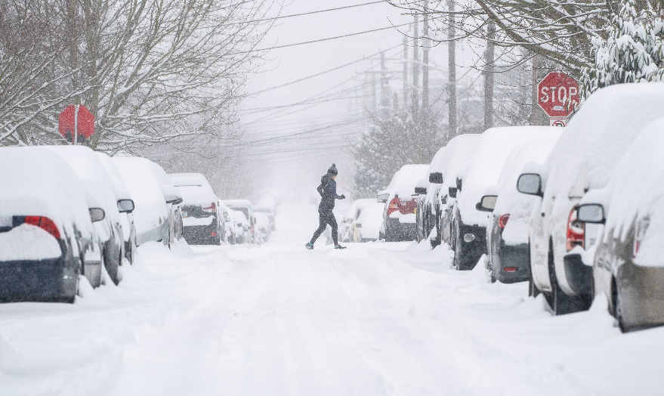
What problems do these storms cause?

Slide 2
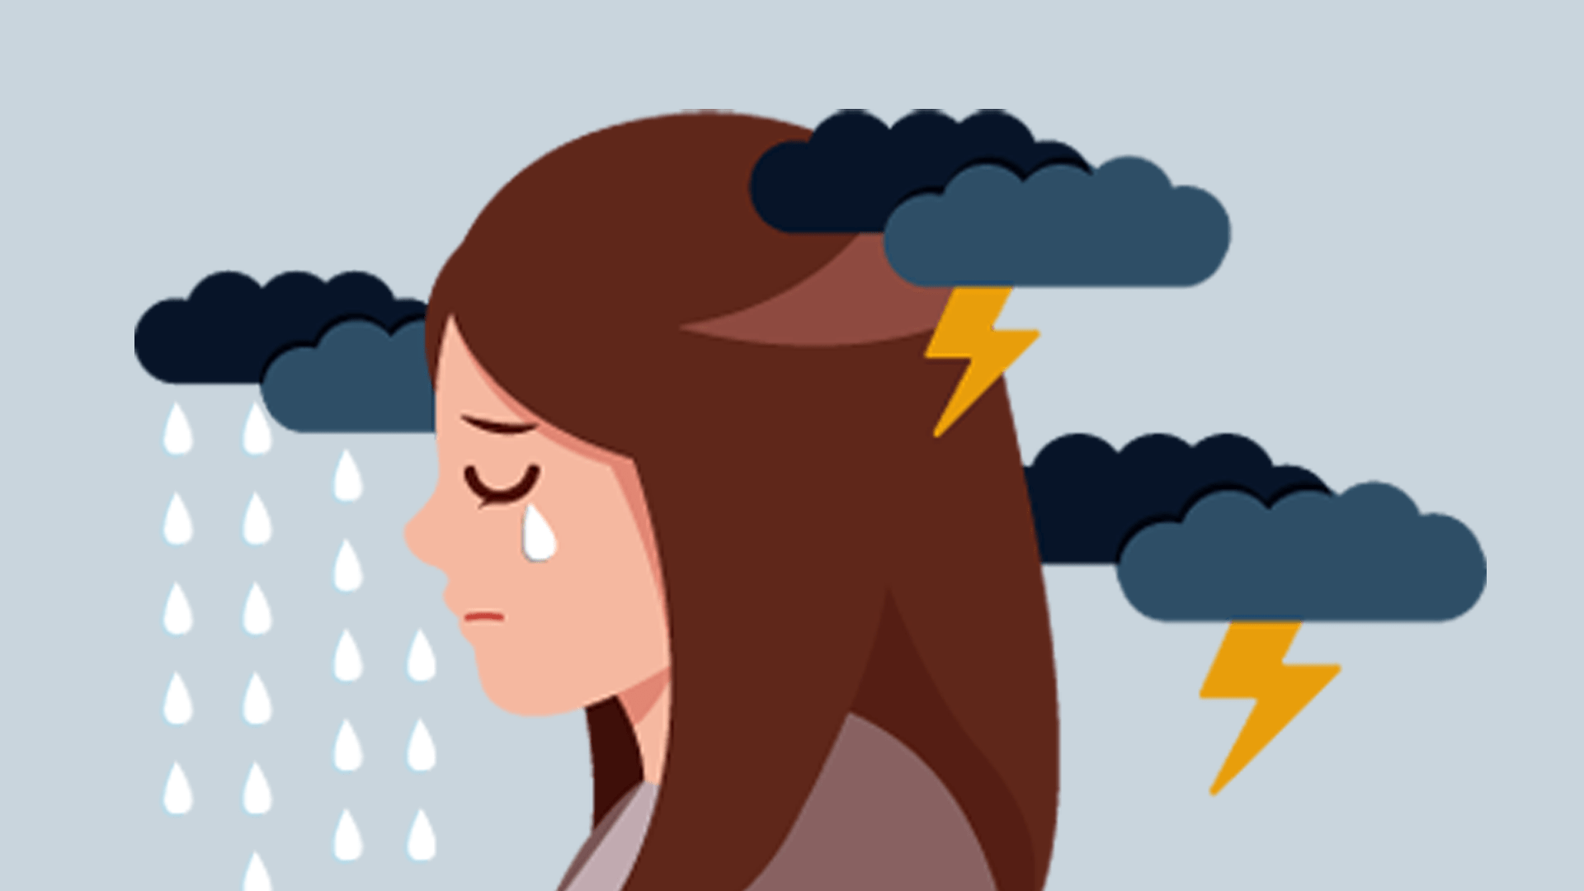
A storm can be a metaphor for life’s problems or how we’re feeling . . .
Why do you think that is?

Slide 3

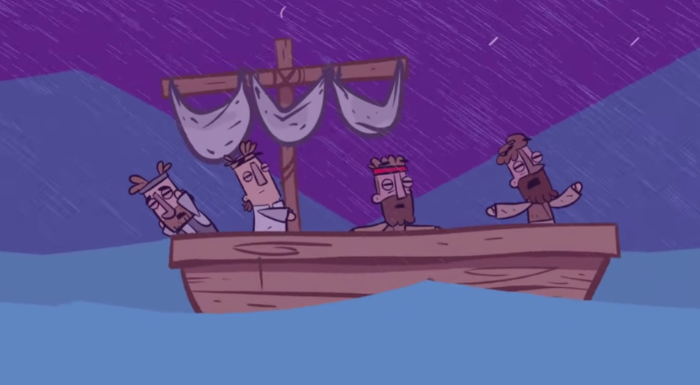

Every storm has . . .
positive or negative purposes

Slide 4
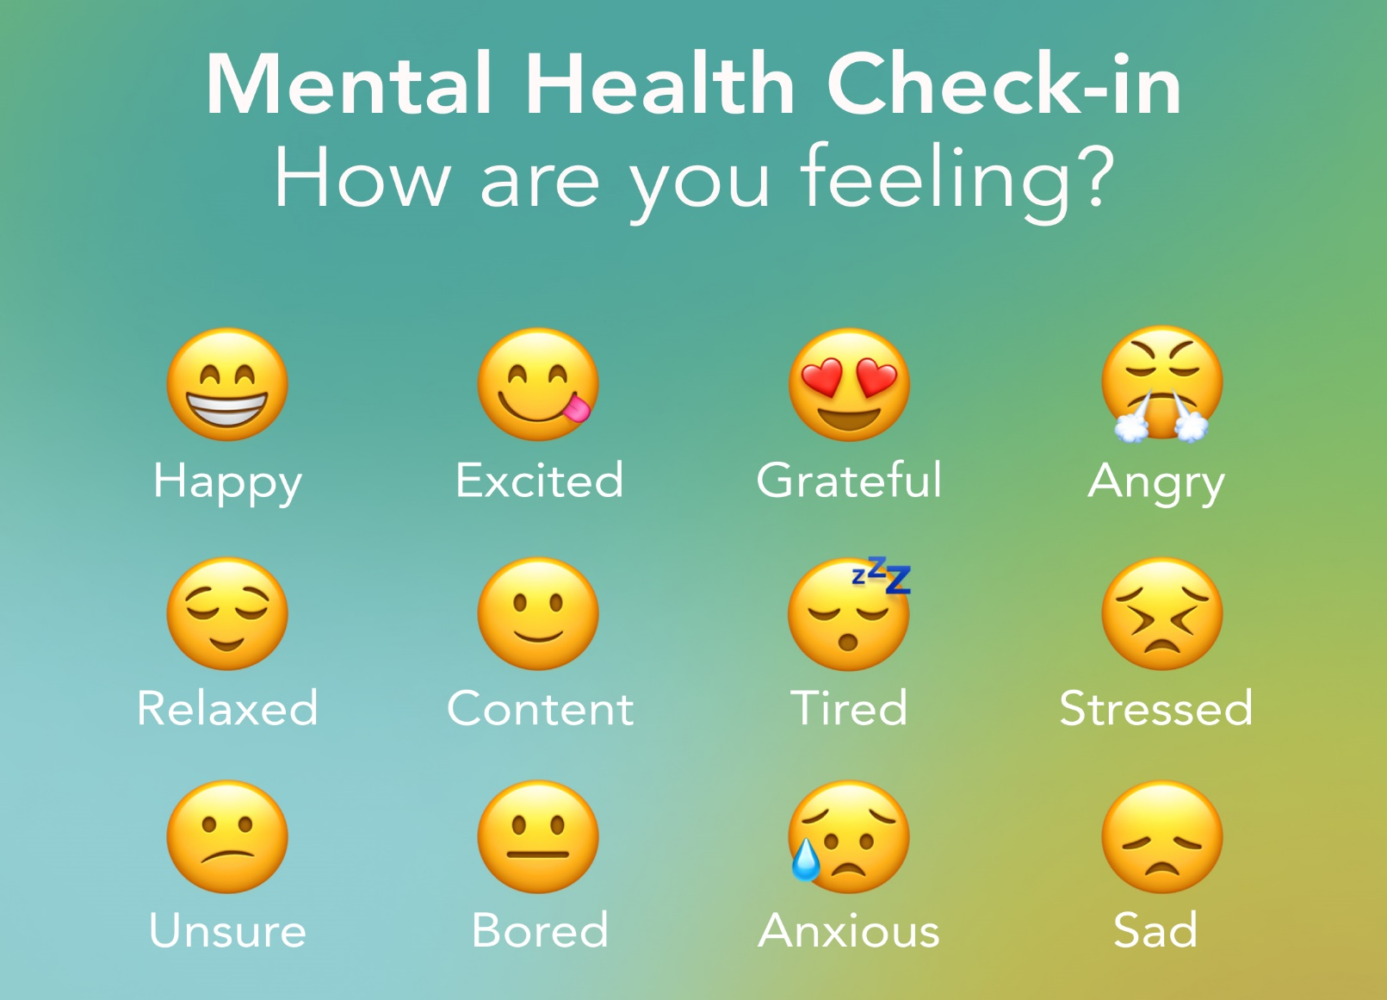

Slide 5
What should we do if we experience a stormy problem?

Slide 6
We should:
Keep going
Take courage
Step out
Ask for help
Keep calm

Slide 7
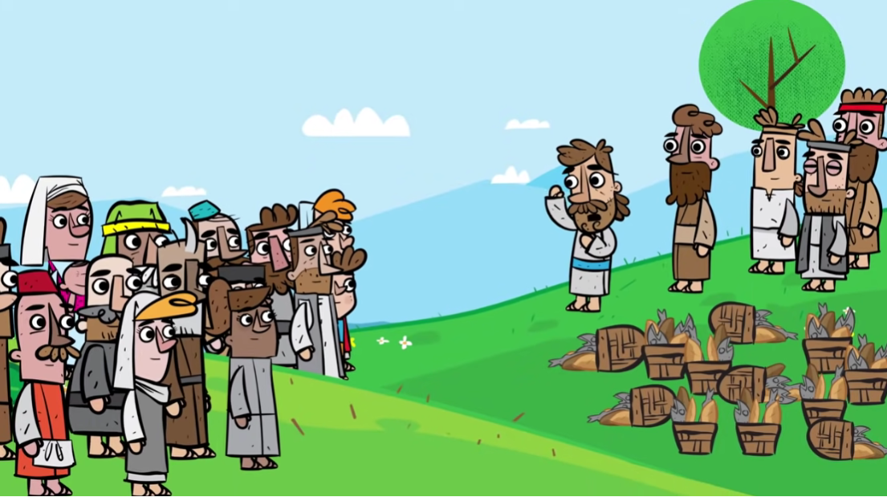
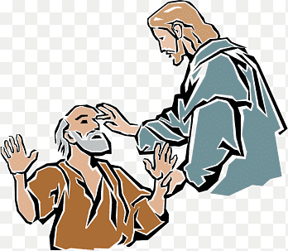
The storm was sandwiched between two miracles, but the disciples didn’t know that.
They just needed to get to the other side of their problem.

