Slide 1

What is an achievement?

Slide 2
What are you proud of achieving?

Slide 3
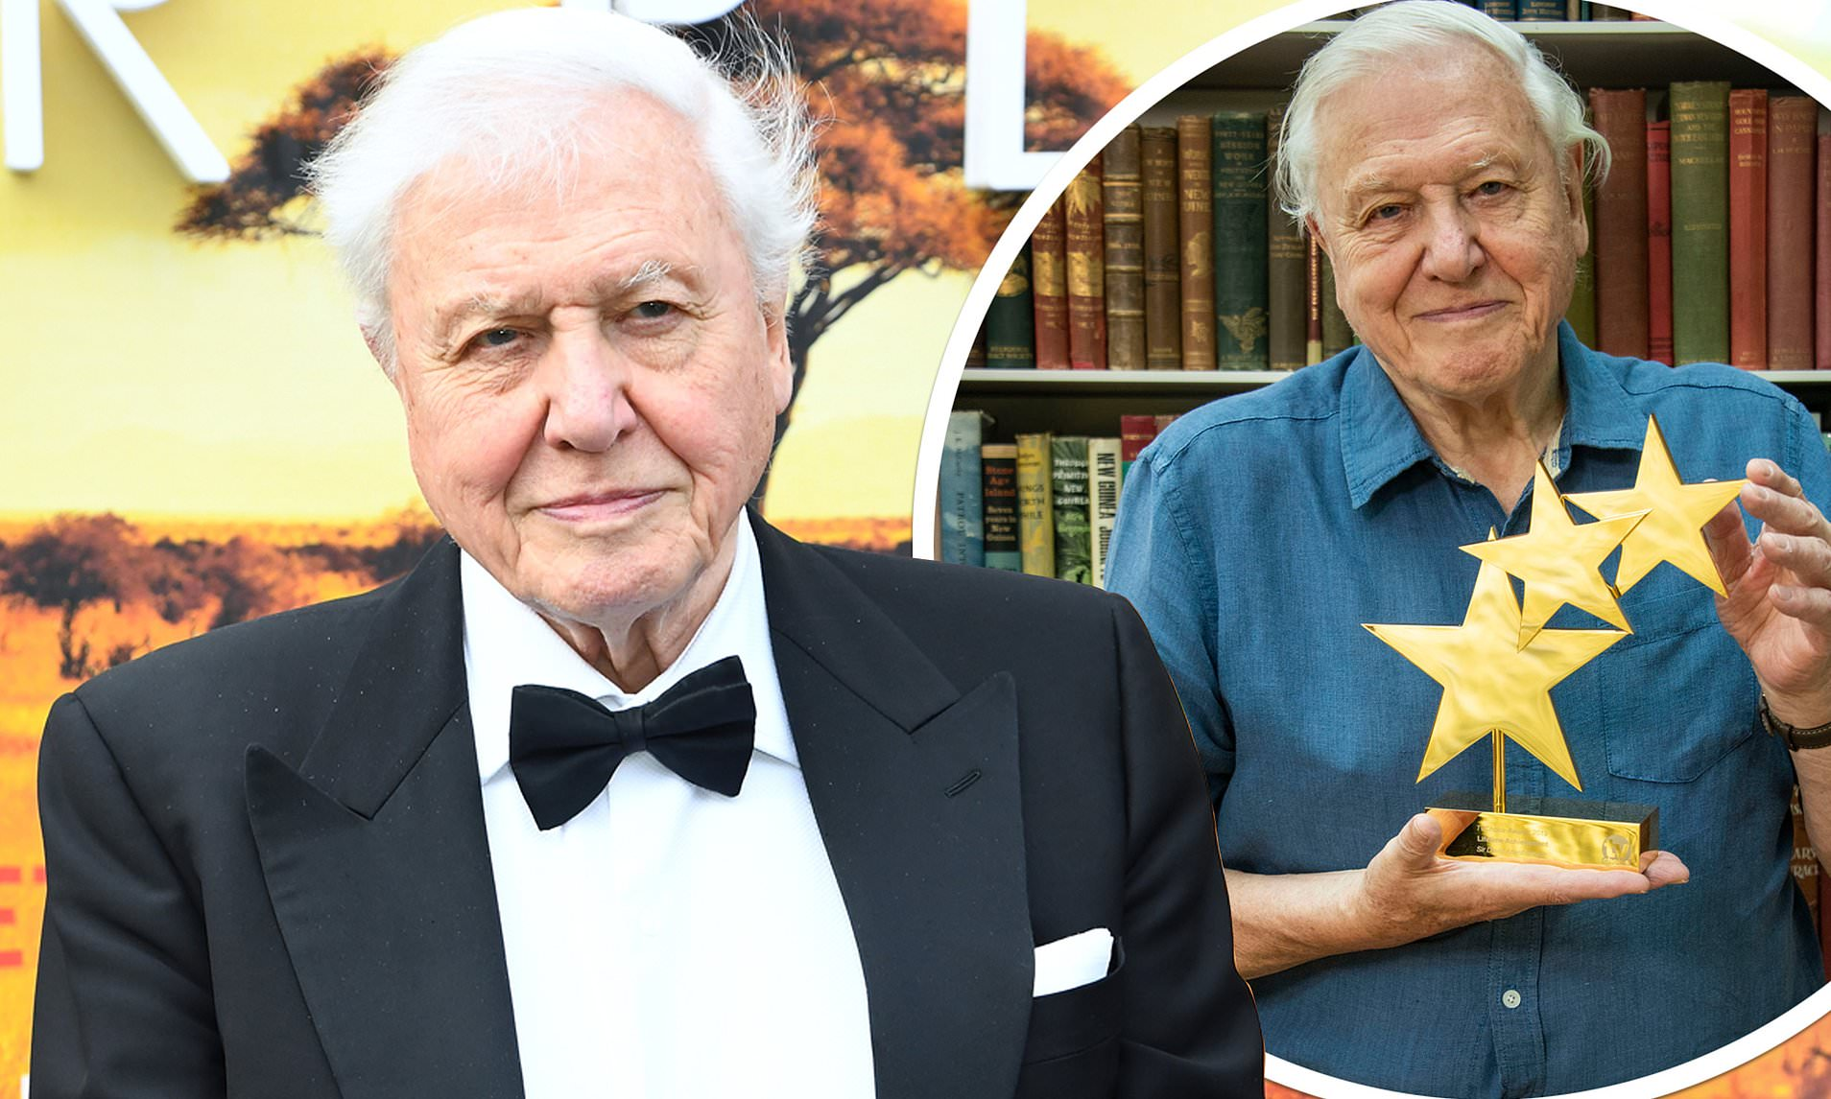

Slide 4
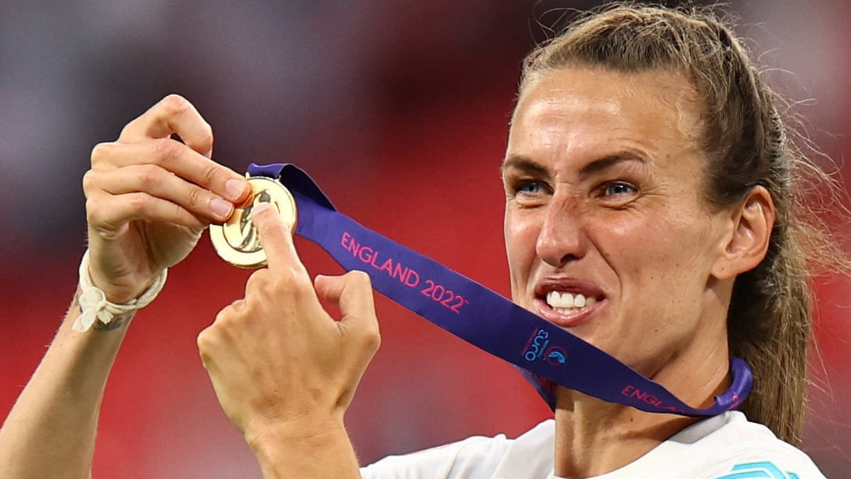

Slide 5
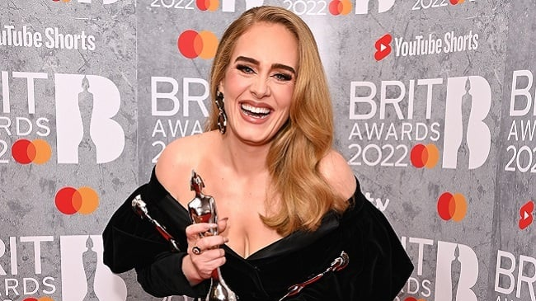

Slide 6
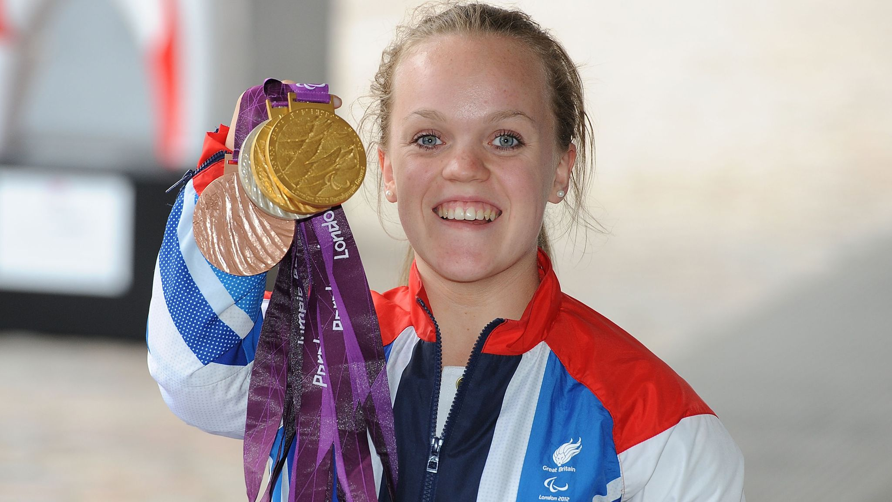

Slide 7
What would you like to achieve?

Slide 8
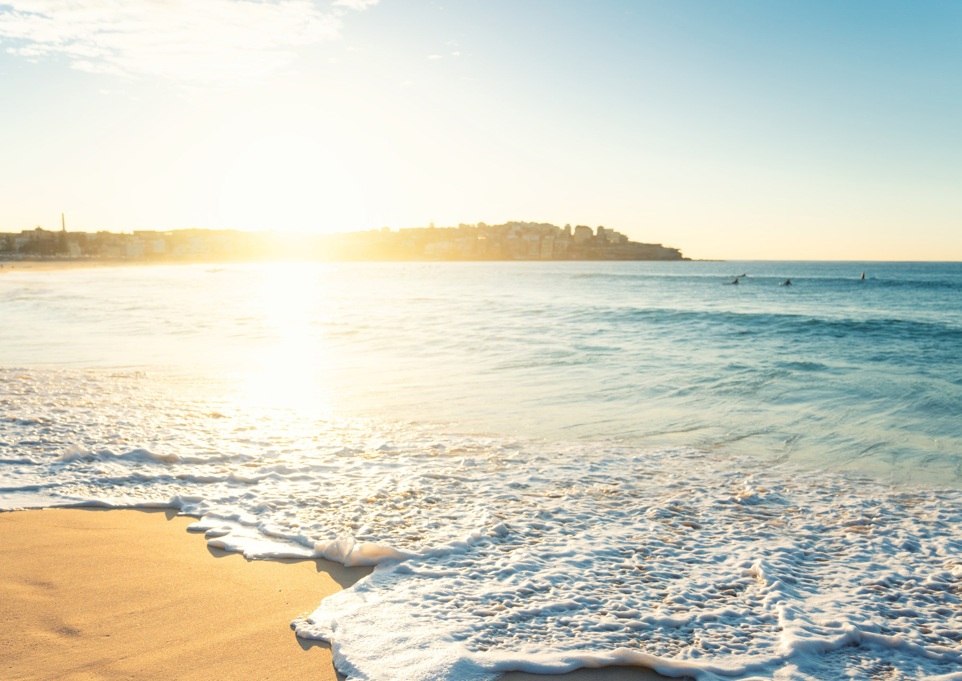
Autumn is round the corner.
We have so much we can achieve.
In order to do these things,
All we have to do is believe.
So hold your head up proudly:
We know that you’ll go far.
You’ll be a shining beacon,
Just being who you are.

