Slide 1
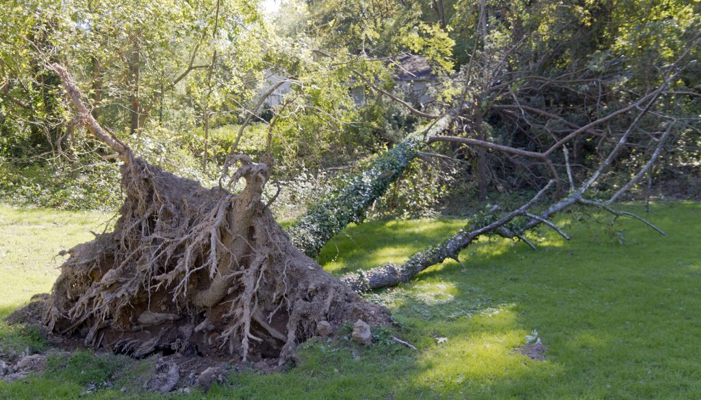

Slide 2
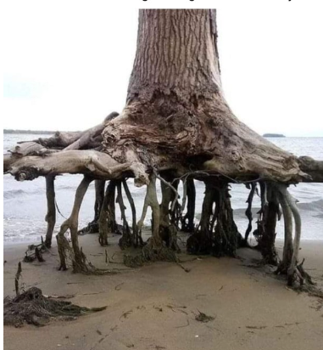
What has happened to this tree?

Slide 3

Does the tree have strong roots?

Slide 4
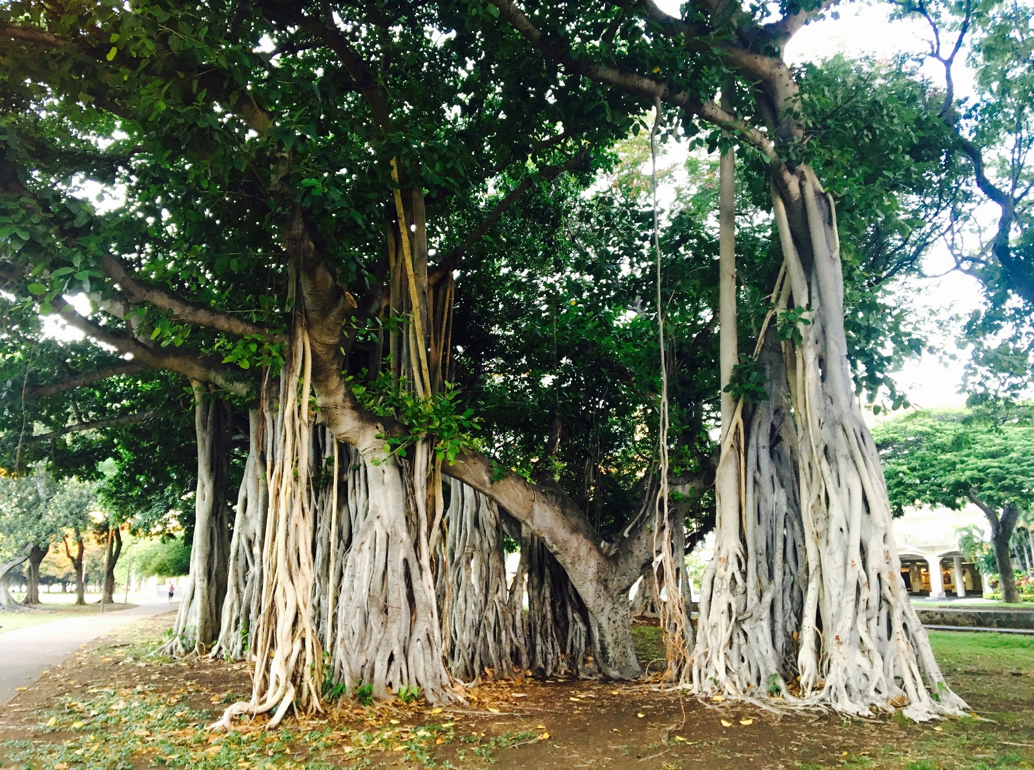
What’s different about the banyan tree’s roots?

Slide 5
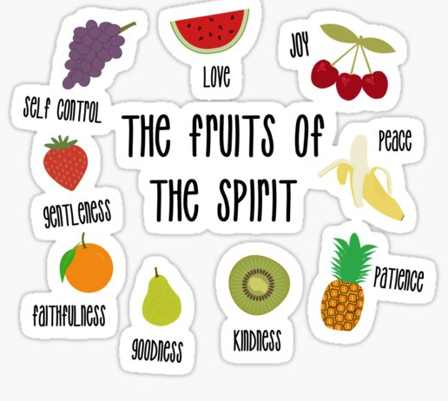
Fruits in the Bible

Slide 6

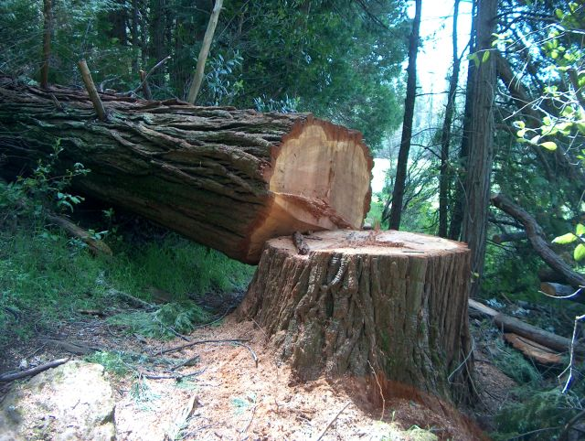
What should we do if something goes wrong?
Can a tree that has been chopped down regrow?

Slide 7
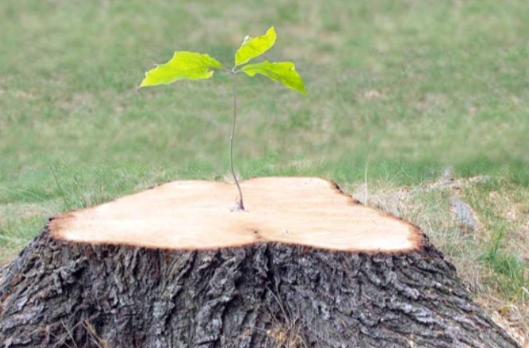
If we have strong roots . . .
anything is possible!

