Slide 1
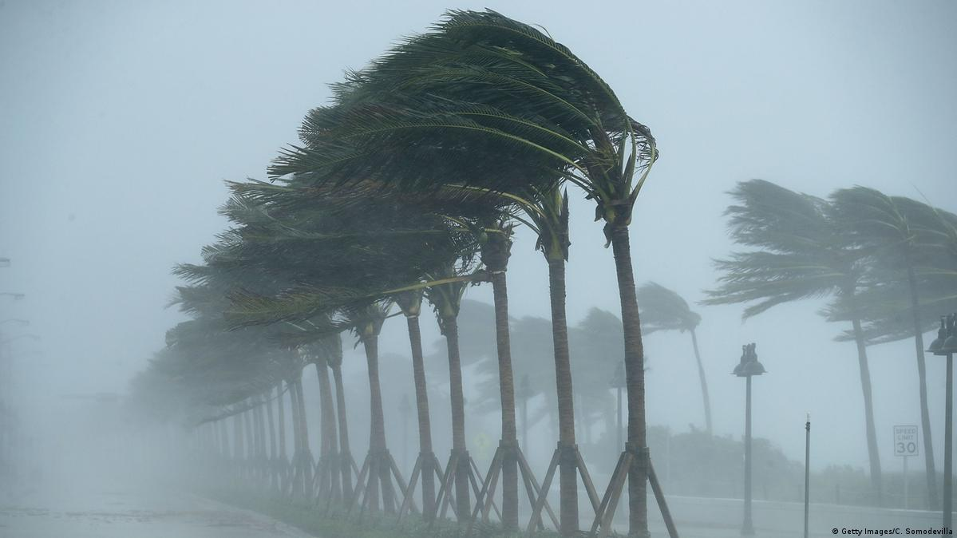
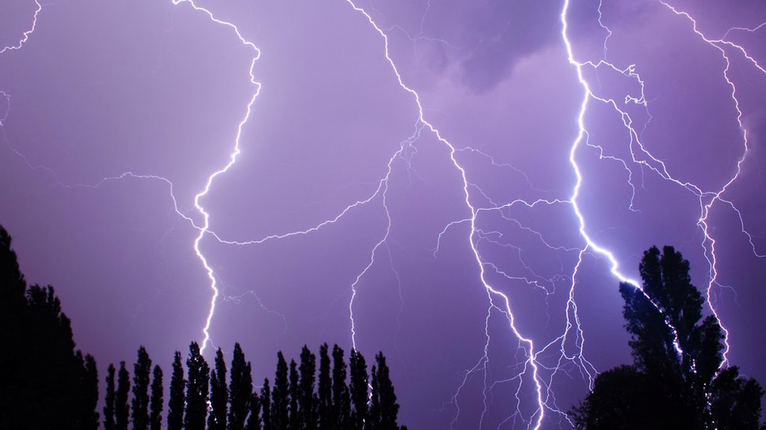
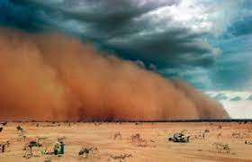
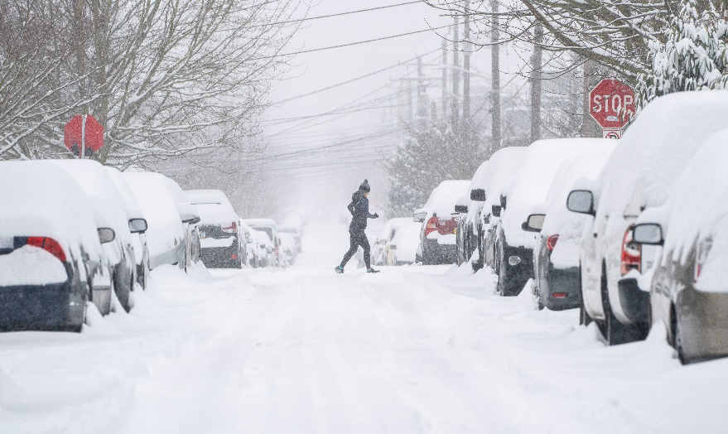
A Stormy Problem
What problems do these storms cause?

Slide 2
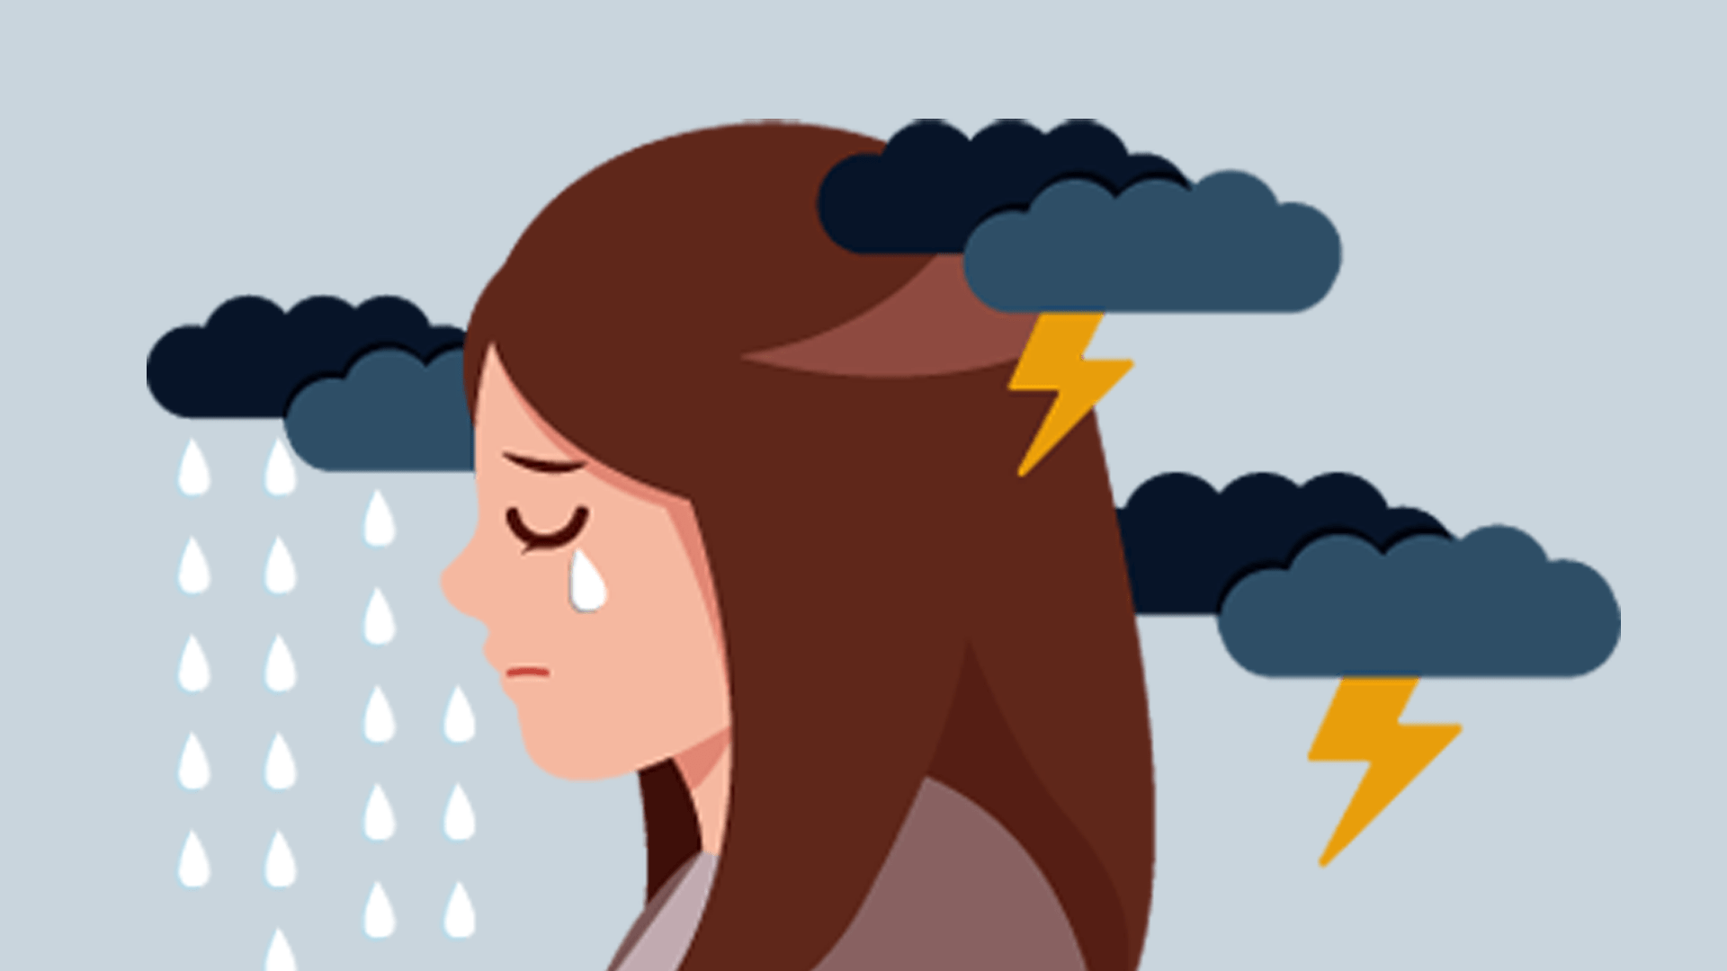
A Stormy Problem
A storm can be a metaphor for life’s problems or how we’re feeling . . .
Why do you think that is?

Slide 3
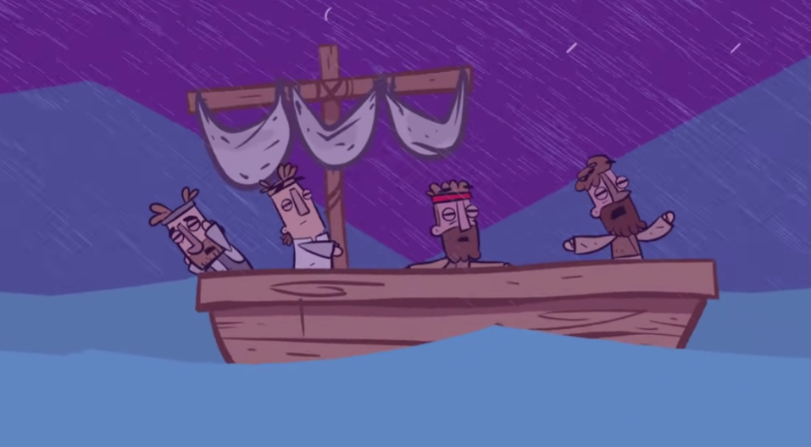
Most stories have a storm (a problem) . . .
A Stormy Problem
But every storm (problem) also
has a purpose

Slide 4


A Stormy Problem
Every storm has . . .
positive or negative purposes

Slide 5
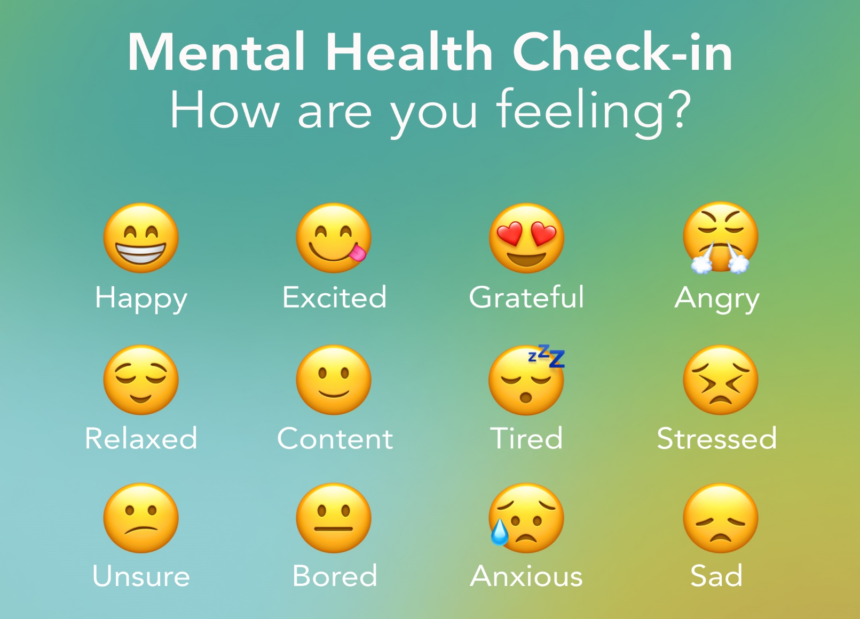
A Stormy Problem

Slide 6
A Stormy Problem
What should we do if we experience a stormy problem?

Slide 7
A Stormy Problem
Keep Going

Slide 8
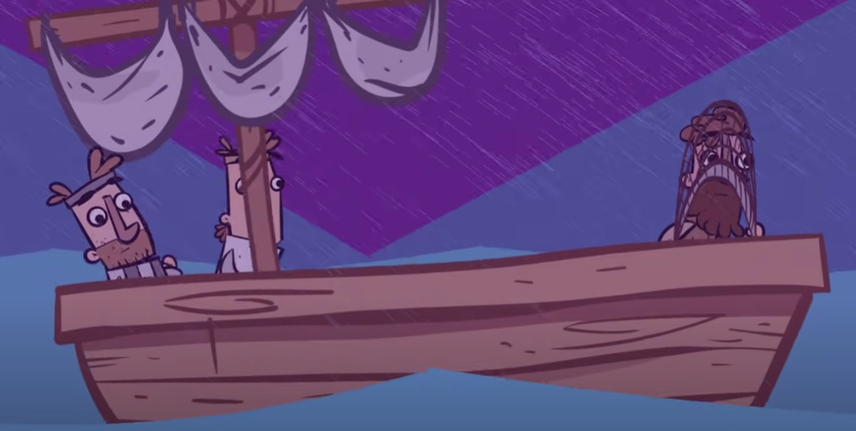
A Stormy Problem
Take Courage

Slide 9
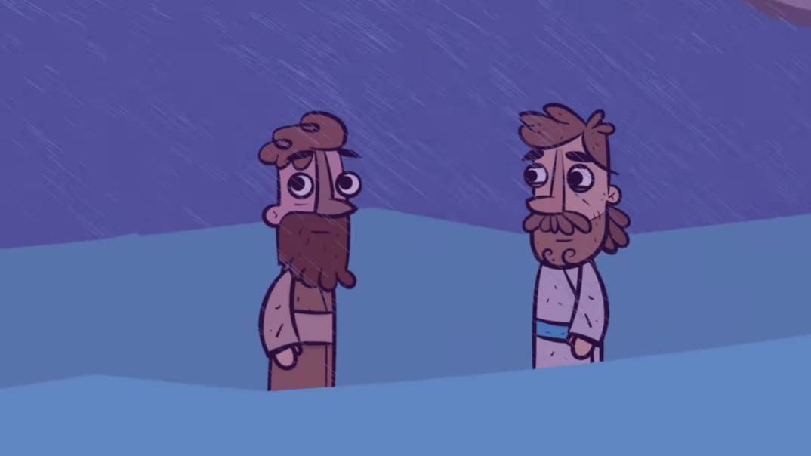
A Stormy Problem
Step Out

Slide 10
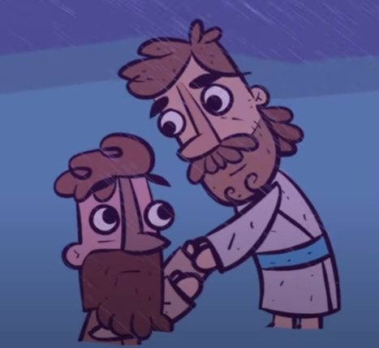
A Stormy Problem
Ask for Help

Slide 11
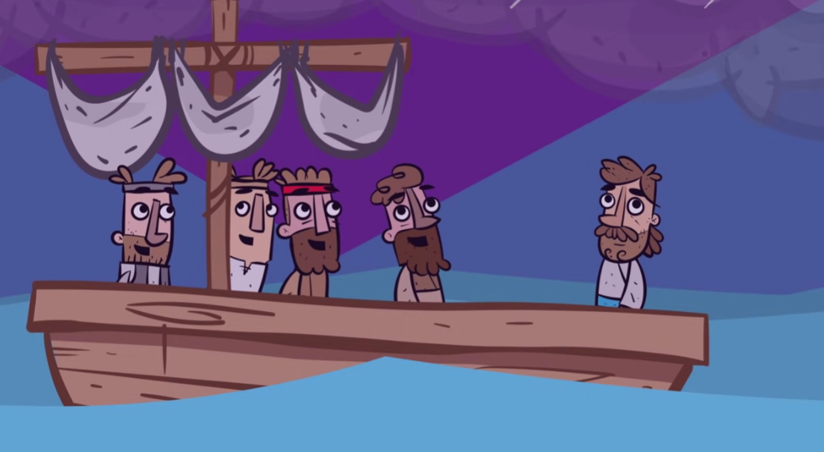
A Stormy Problem
Keep Calm

Slide 12
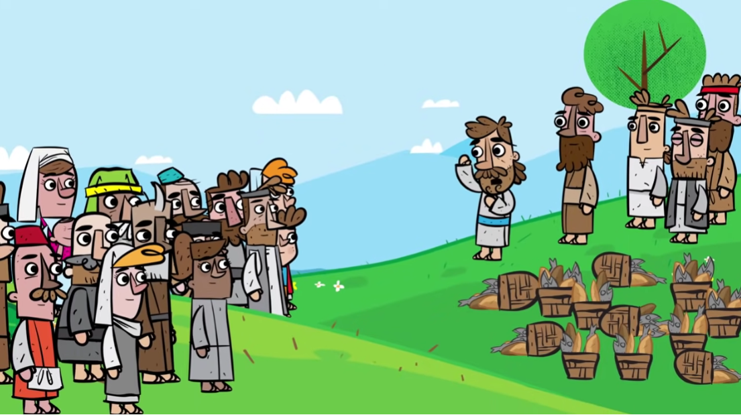
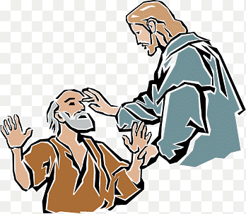
A Stormy Problem
The storm was sandwiched between two miracles, but the disciples didn’t know that.
They just needed to get to the other side of their problem.

