Slide 1

Source: Wikipedia

Slide 2
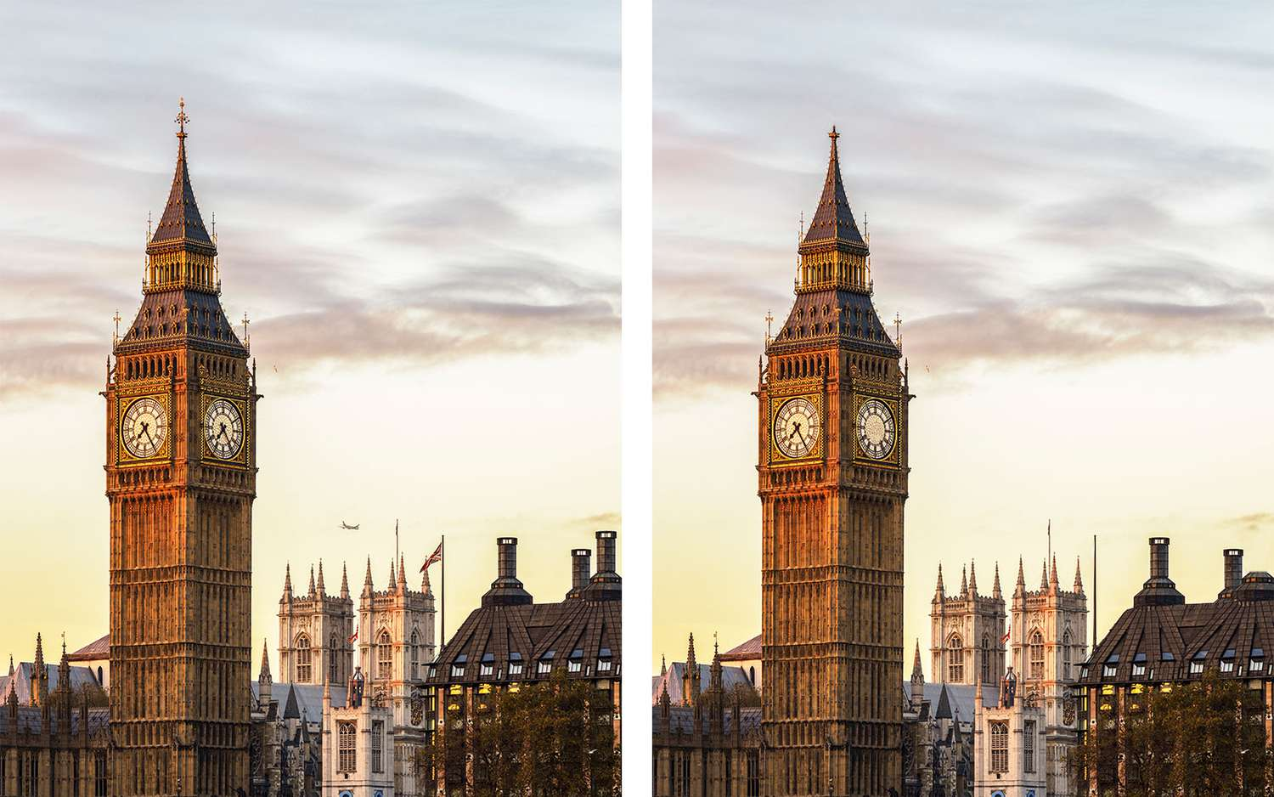

Slide 3
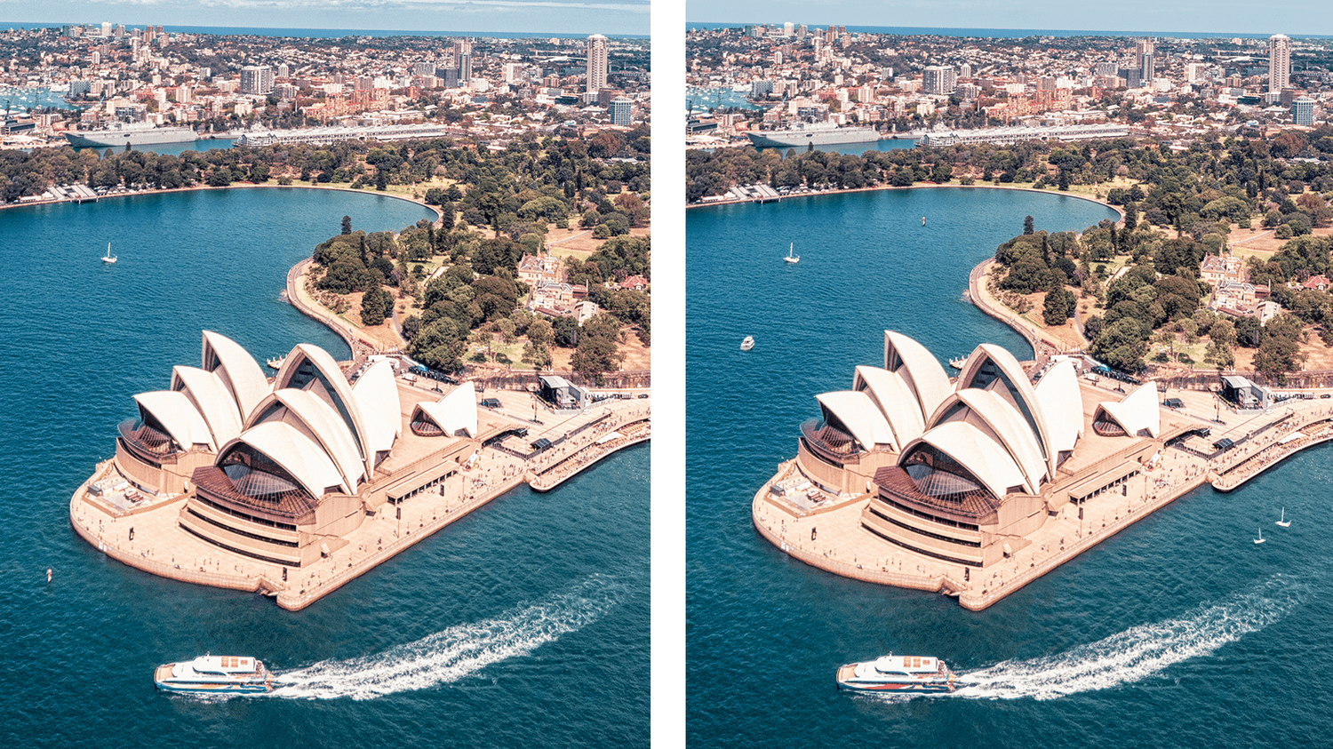

Slide 4

Source: The Lumo Project

Slide 5

Source: The Lumo Project

