Slide 1

Take one step at a time . . .
Step by step, we can reach our goals.

Slide 2

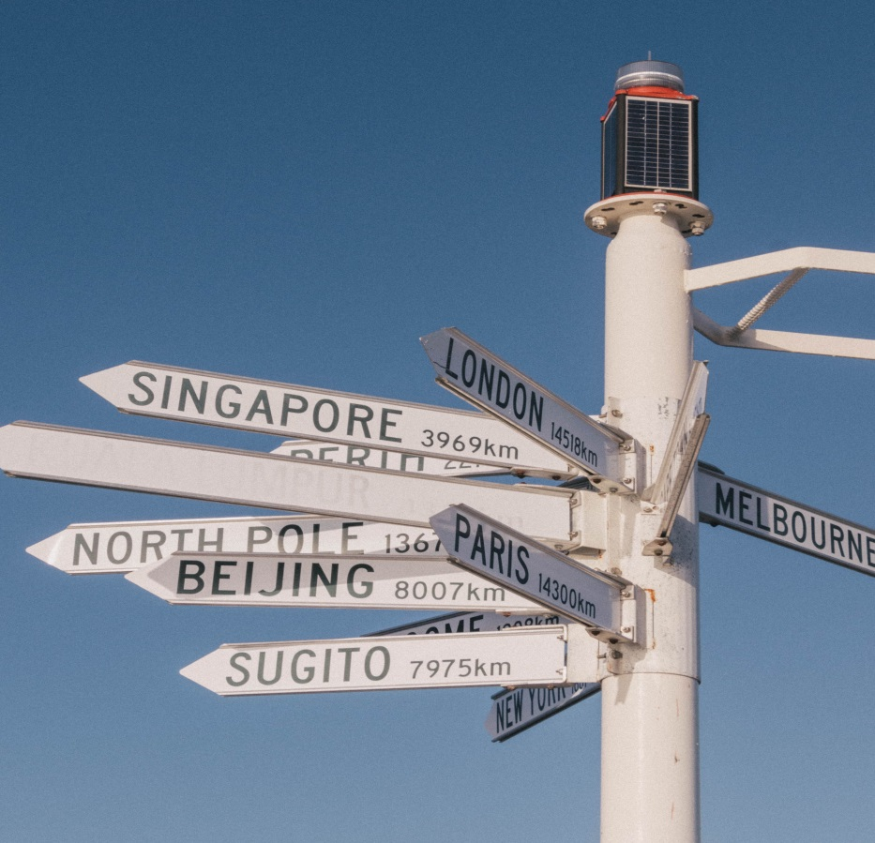
Which way?

Slide 3
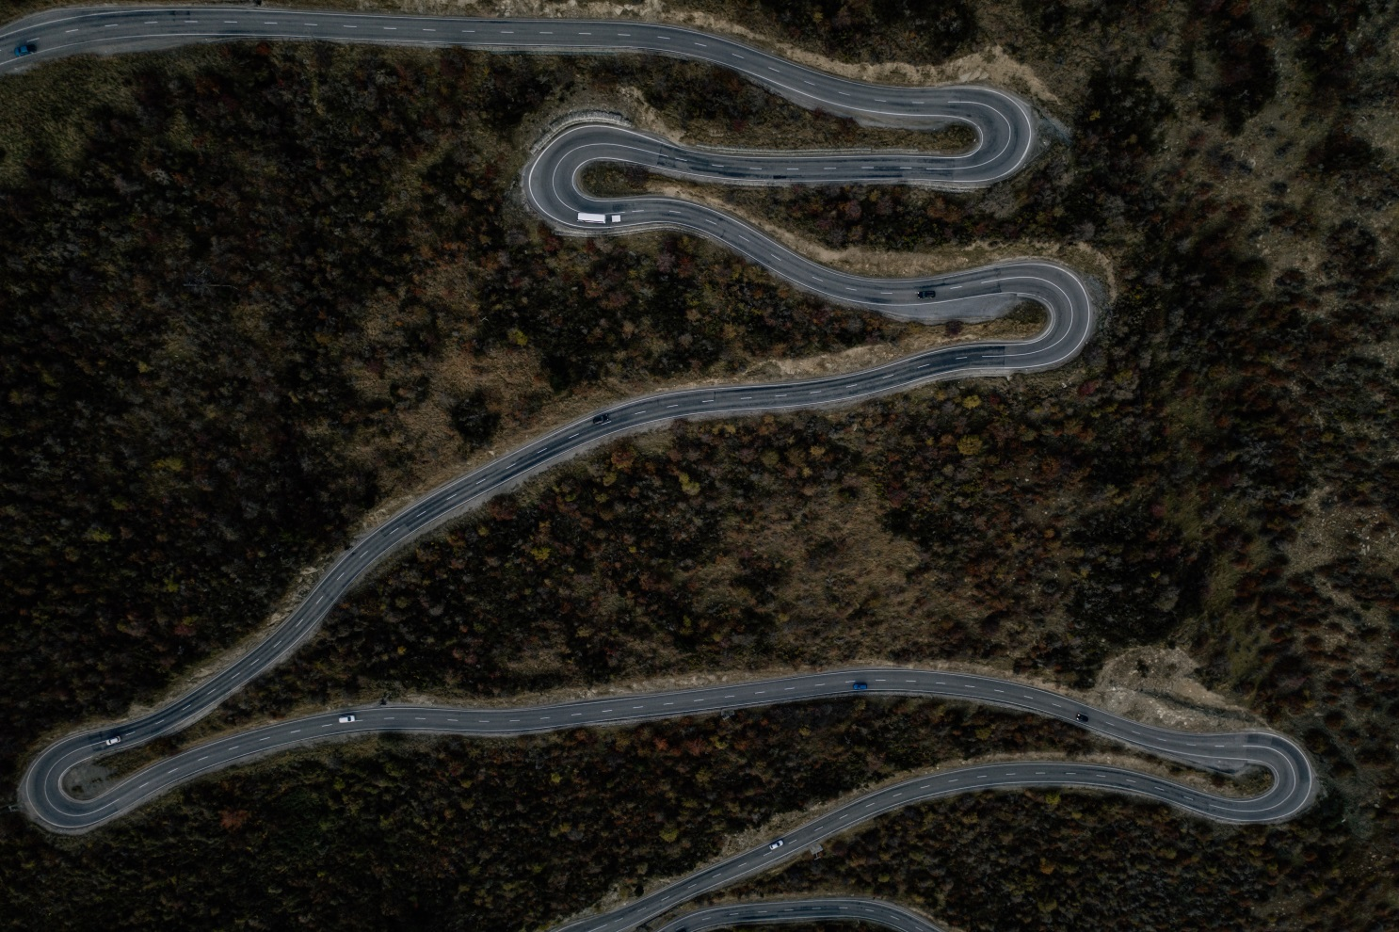
A road in Otago, New Zealand
Whichever path we take, our journey is unlikely to be a straight road. There will be setbacks, delays, detours and sideways moves!

