Slide 1
Welcome!

Slide 2

Taking one step at a time . . .
Step by step, we can reach our goals.

Slide 3
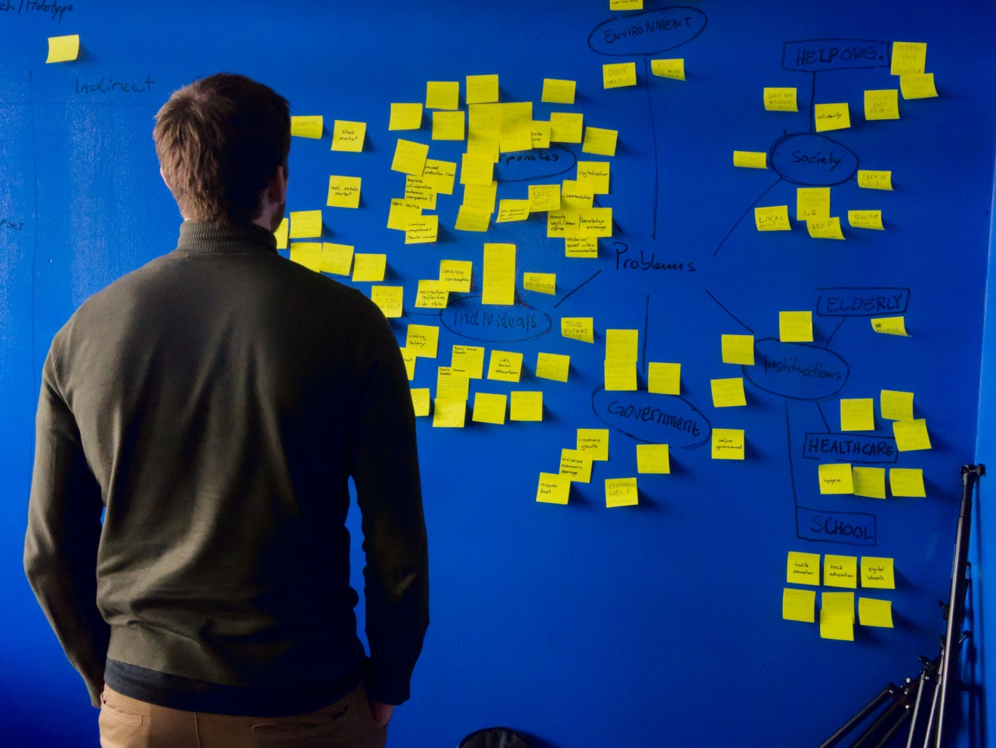
Mind maps
Start at the centre with a topic, and then branch outwards with any idea that springs to mind.

Slide 4
‘More haste, less speed!’

Slide 5


Which way?

Slide 6
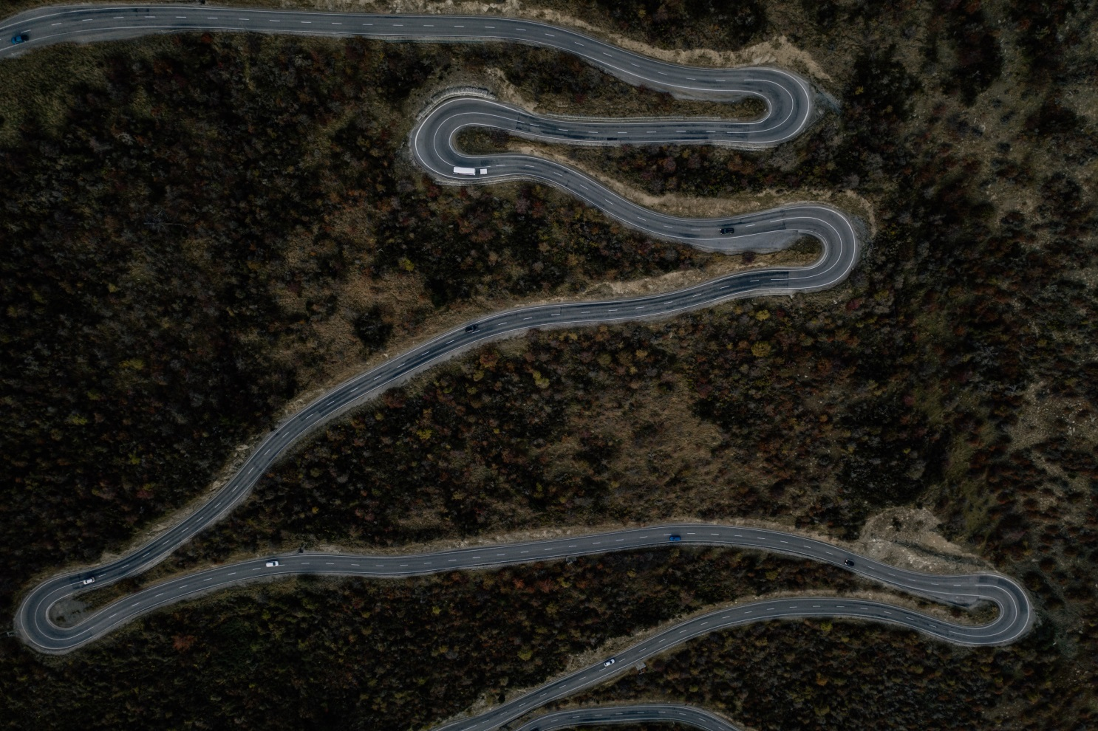
A road in Otago, New Zealand
Whichever path we take, our journey is unlikely to be a straight road. There will be setbacks, delays, detours and sideways moves!

