Slide 1

Welcome

Slide 2


Slide 3



Slide 4
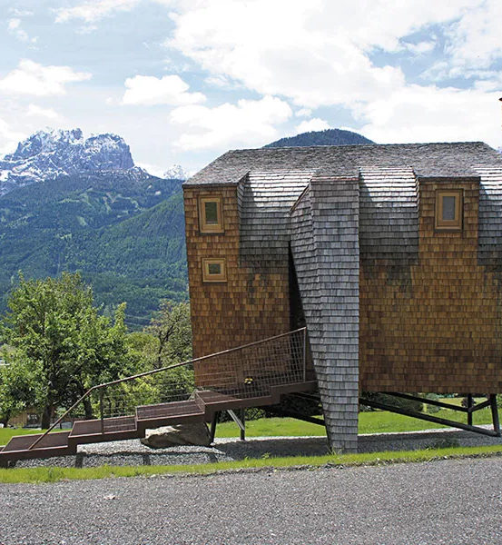


Slide 5
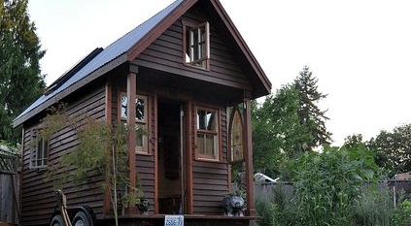

Slide 6
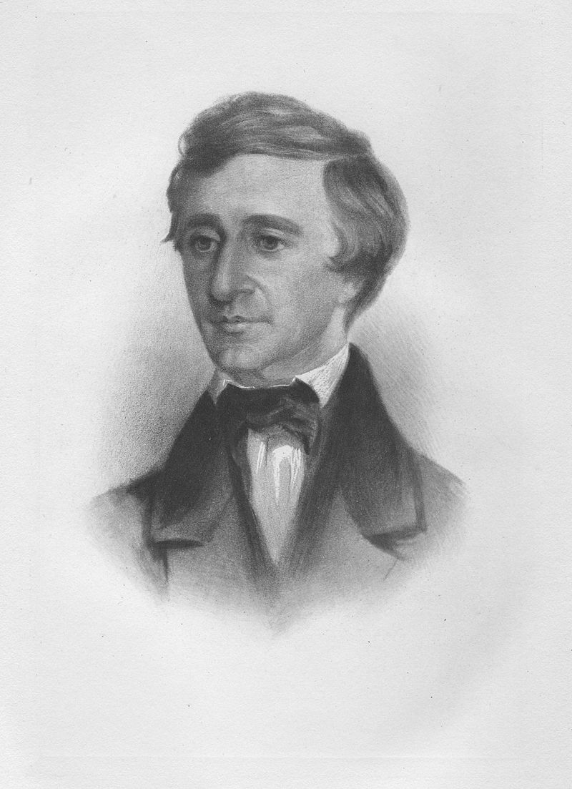
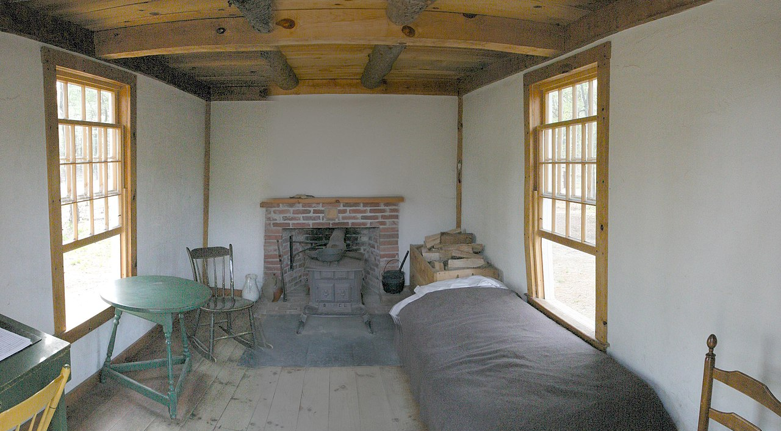
‘I make myself rich by making my wants few.’ Henry David Thoreau

