Slide 1
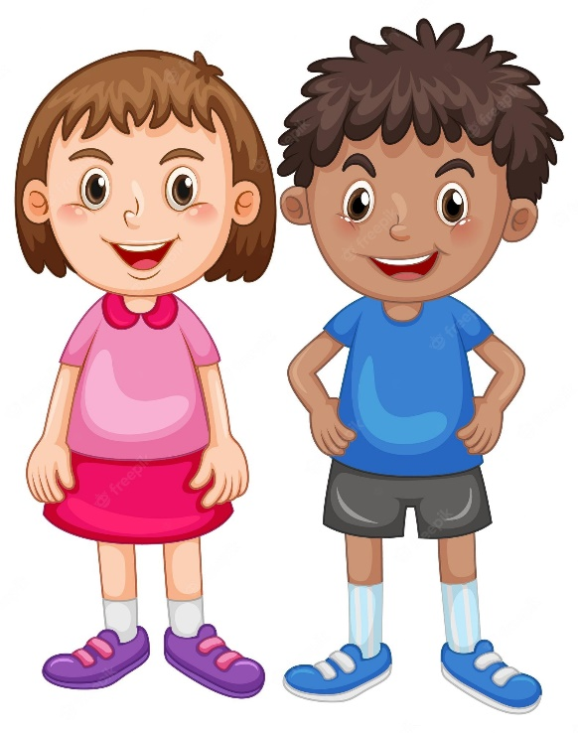

Change the Label
Have you ever labelled yourself?
creative
sporty

Slide 2
Change the Label
Are the labels below positive or negative?
creative
sporty

Slide 3
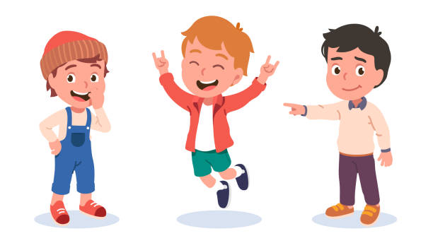
Change the Label
Have you ever labelled others in a positive way ?

Slide 4
Change the Label
stubborn
difficult
defiant
rude
impatient
bossy

Slide 5
Change the Label
How can we change a label?

Slide 6
Change the Label
persistent
difficult
spirited
stubborn
rude
defiant
honest
bold
bossy
impatient
authoritative
eager

Slide 7

Change the Label

