Slide 1
A Pit of Problems
What is a pit?

Slide 2
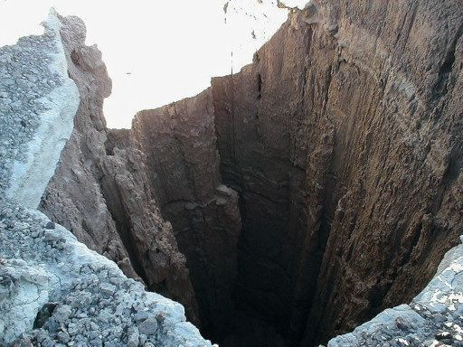

A Pit of Problems
What is a pit?

Slide 3
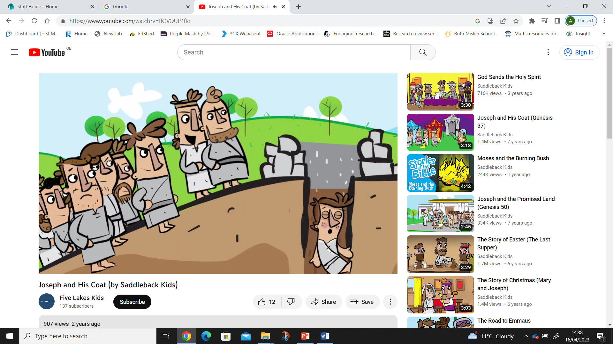
A Pit of Problems

Slide 4
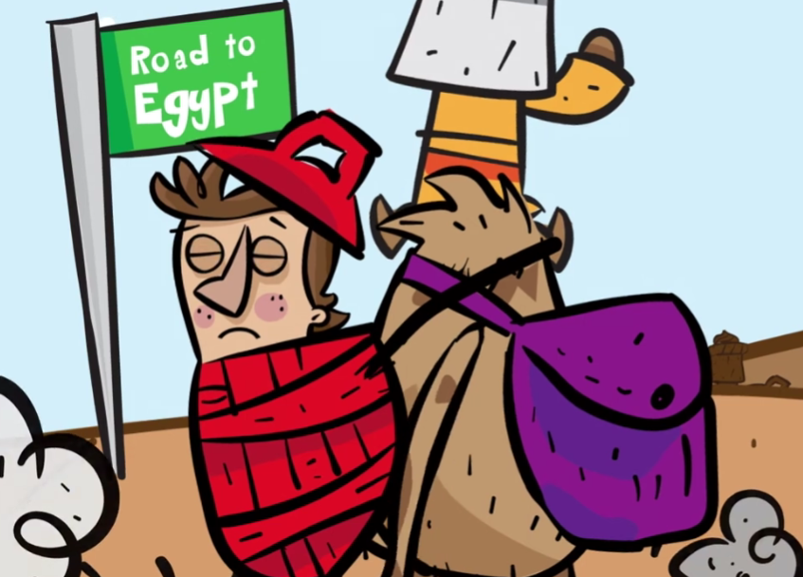
A Pit of Problems

Slide 5
A Pit of Problems

Slide 6
A Pit of Problems
Anxiety
Loneliness
Learning times tables
Cyberbullying
Homework
Tests/SATs
Bullying at school
Sporting activities
Friendships
Anger/upset

Slide 7
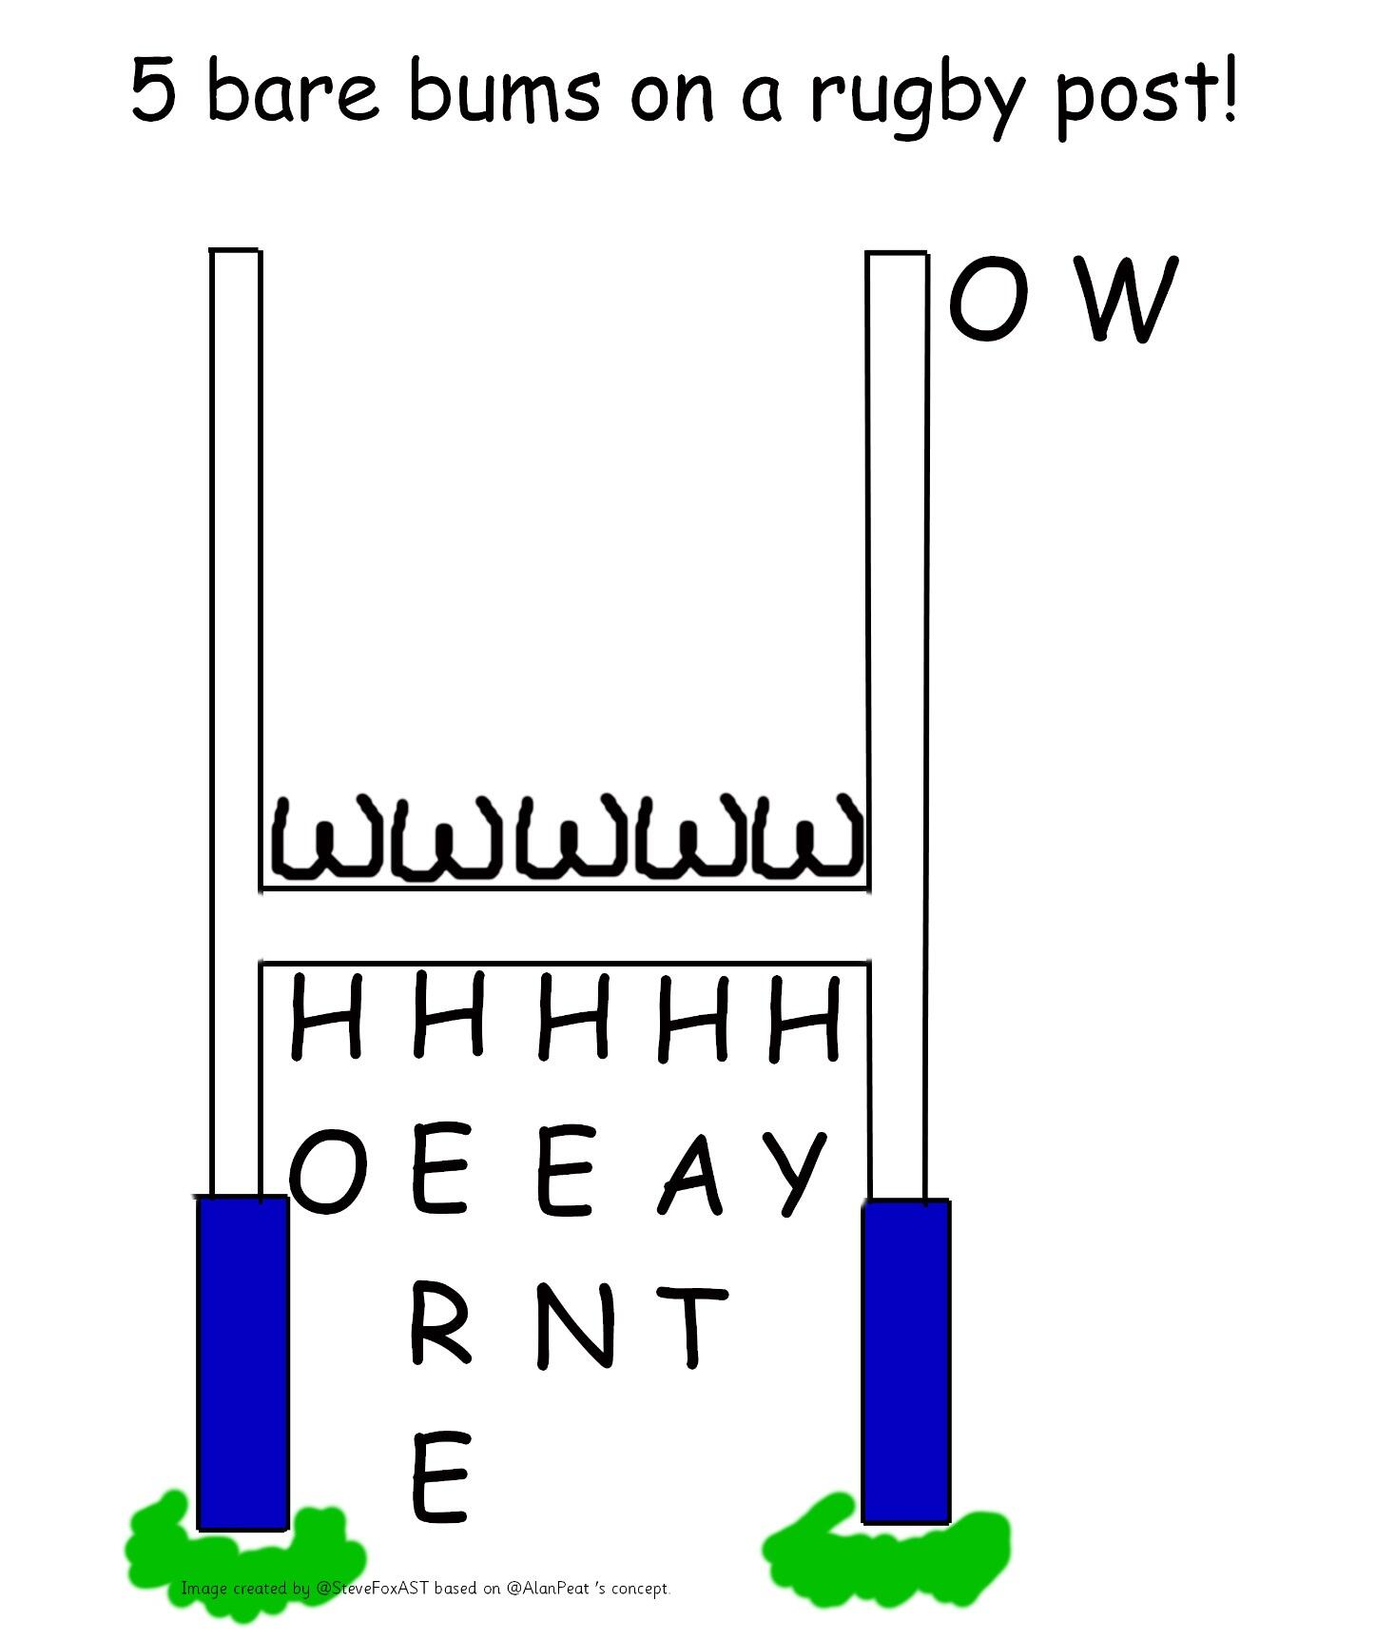
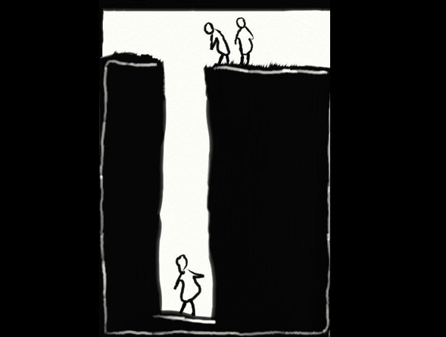
A Pit of Problems
Ask a question

Slide 8
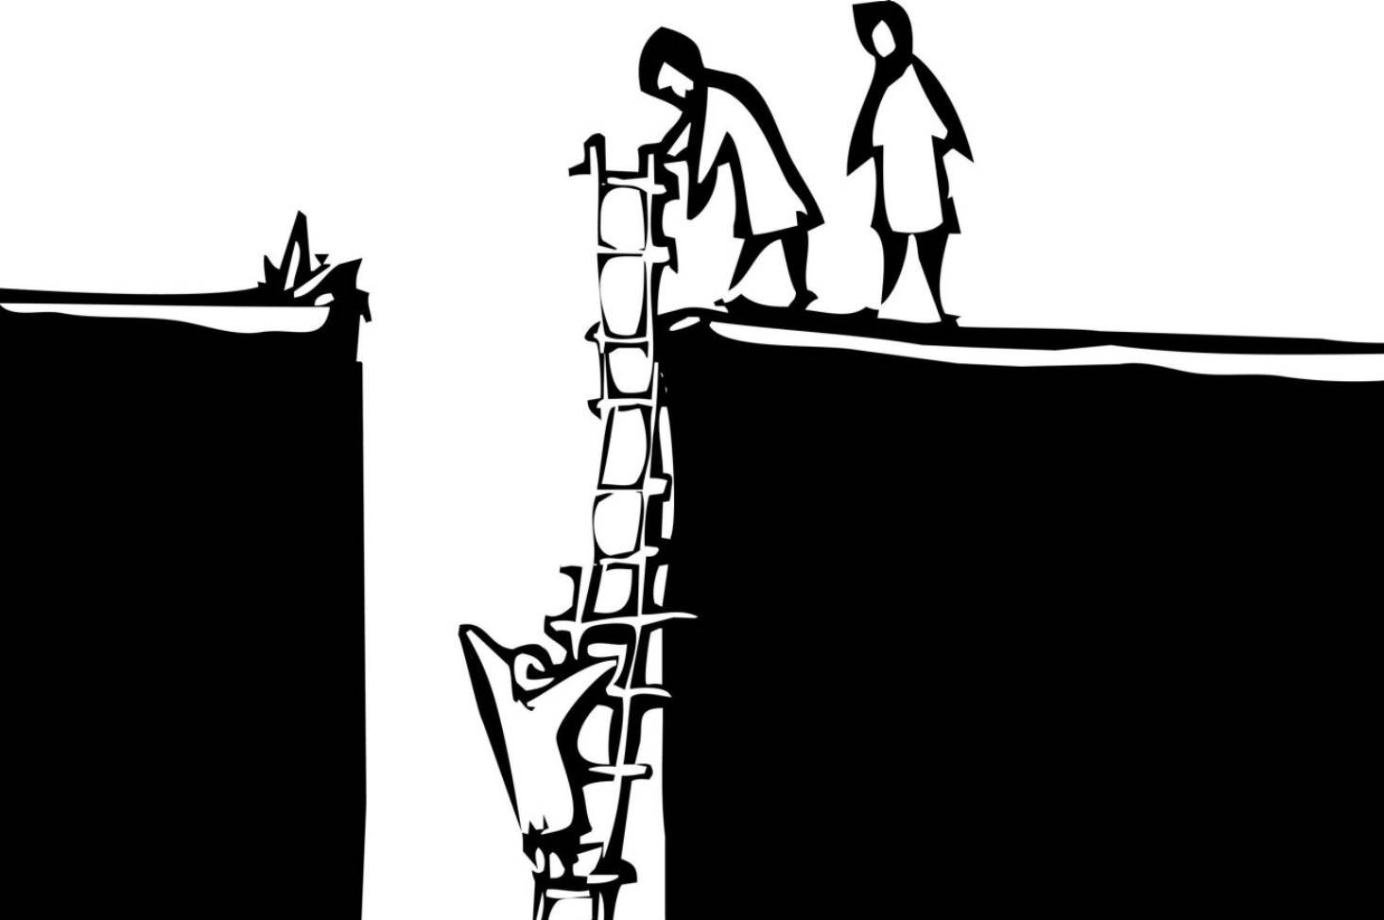
A Pit of Problems
Ask a question
Make time for reflection

Slide 9
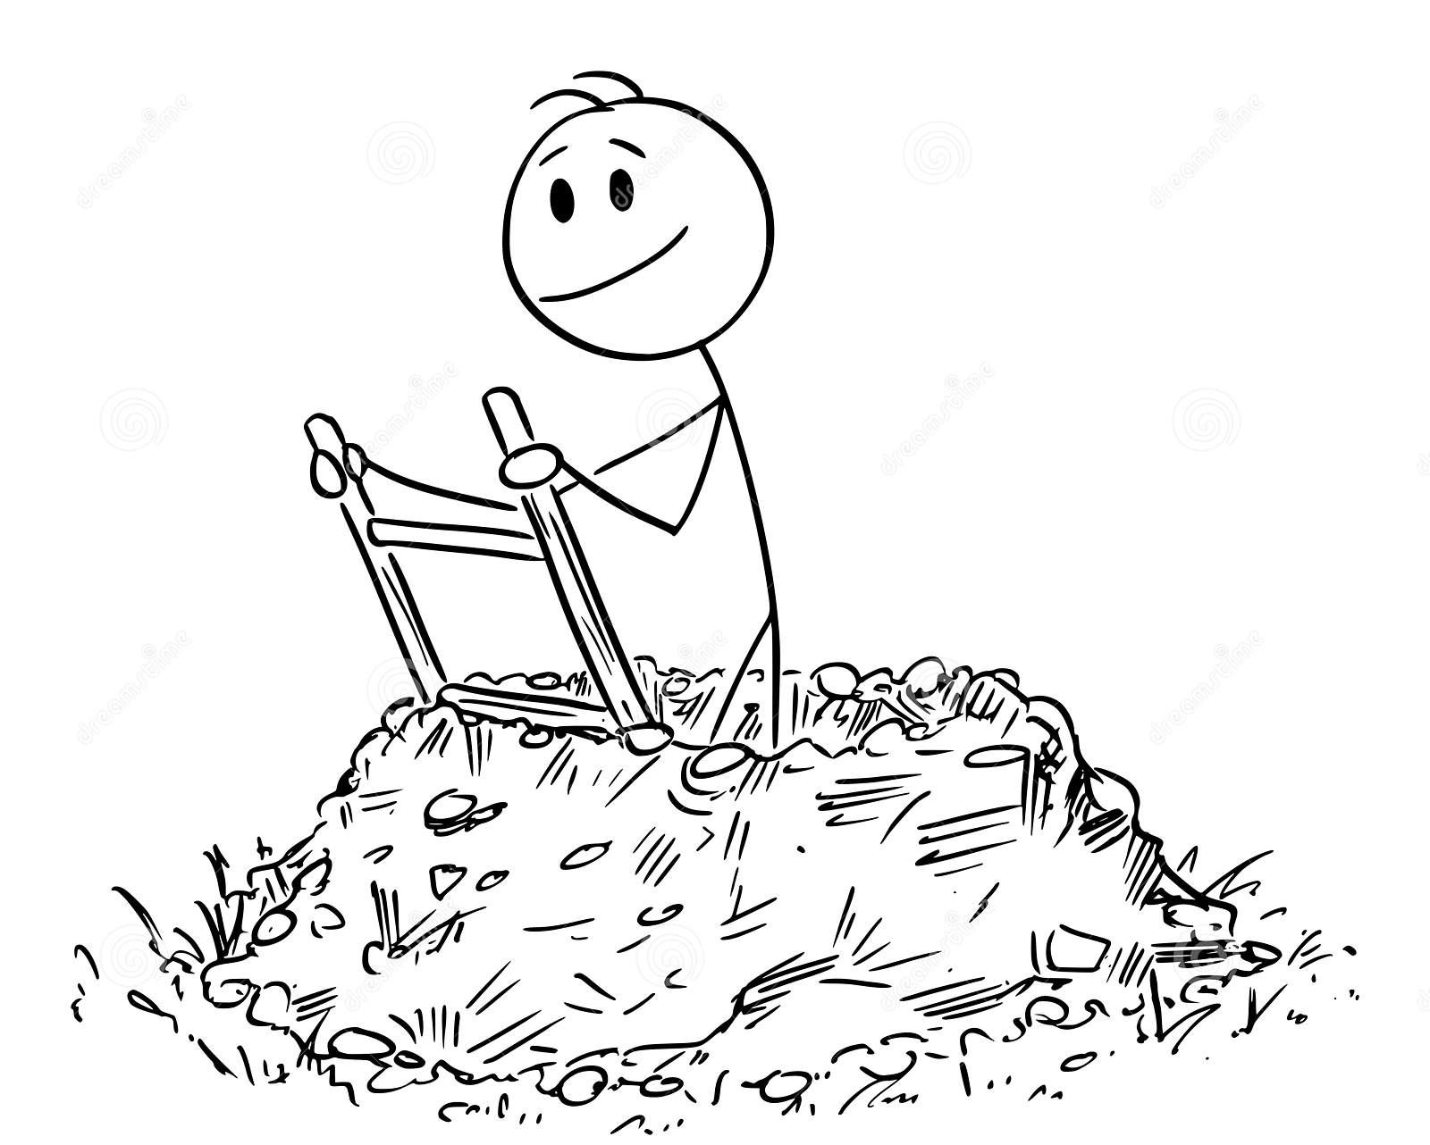
A Pit of Problems
Ask a question
Make time for reflection
Finally, take action!

