Slide 1

Welcome

Slide 2


Slide 3



Slide 4
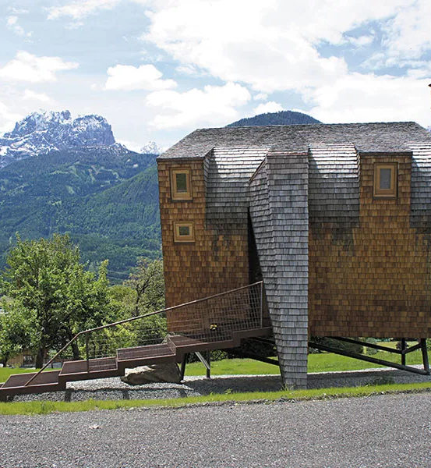


Slide 5
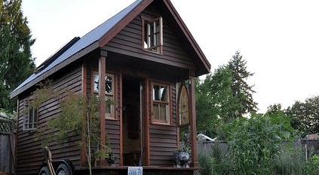

Slide 6
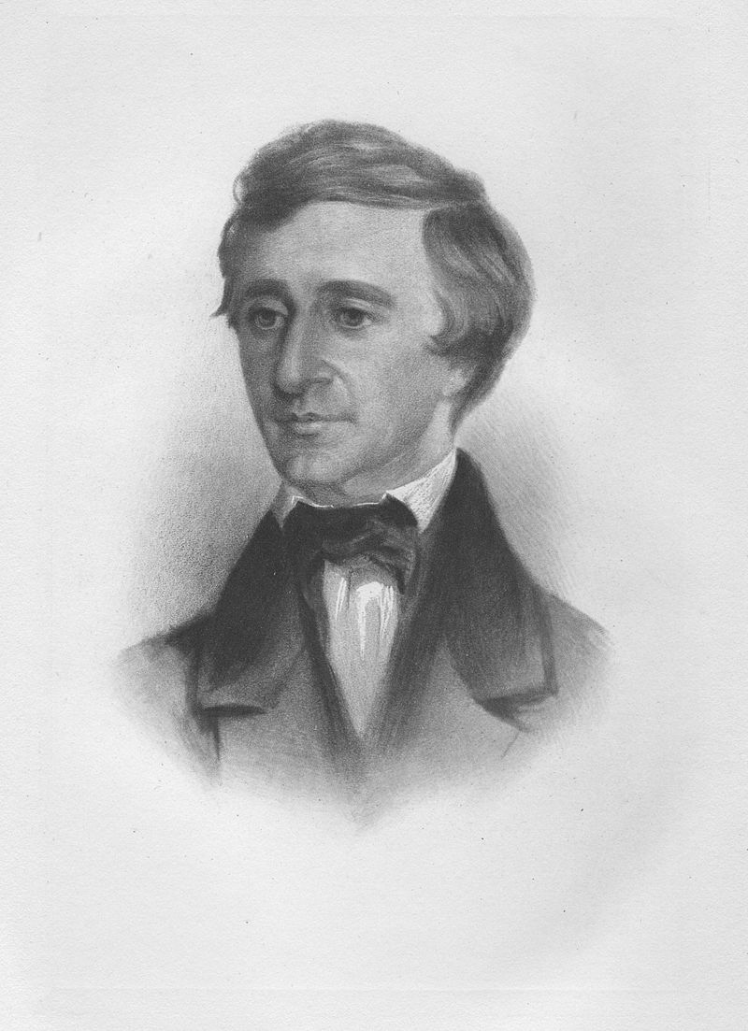
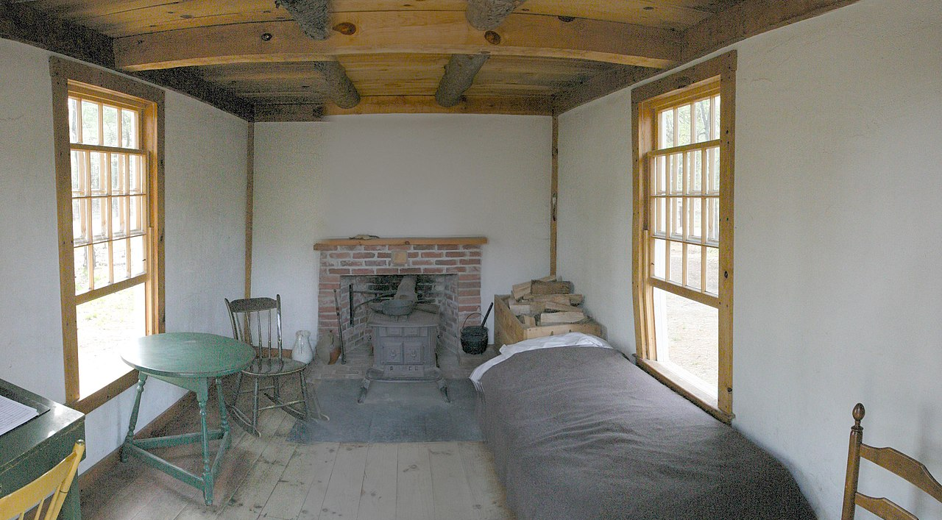
“I make myself rich by making my wants few” Henry David Thoreau

