Slide 1
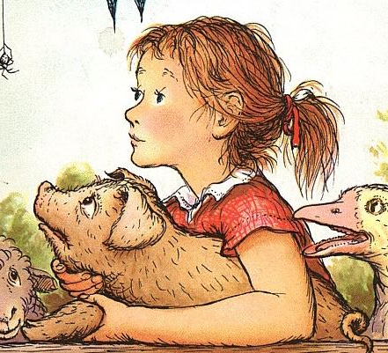

Charlotte’s Web

Slide 2
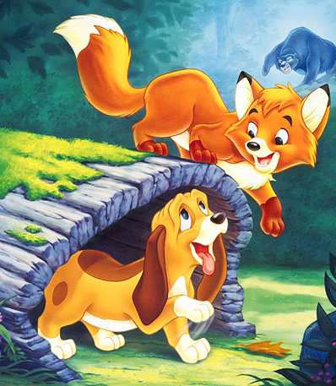
The Fox and the Hound

Slide 3

Zog

Slide 4
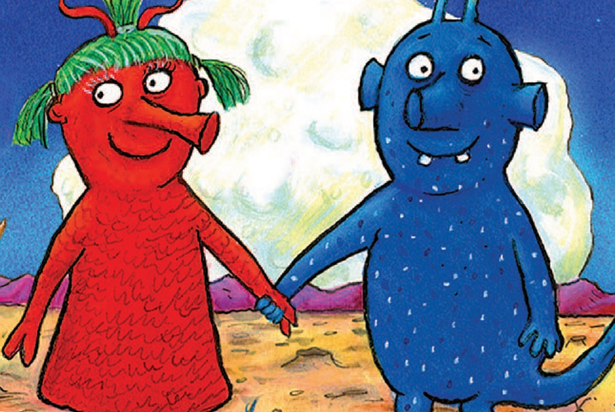

The Smeds and the Smoos

