Slide 1
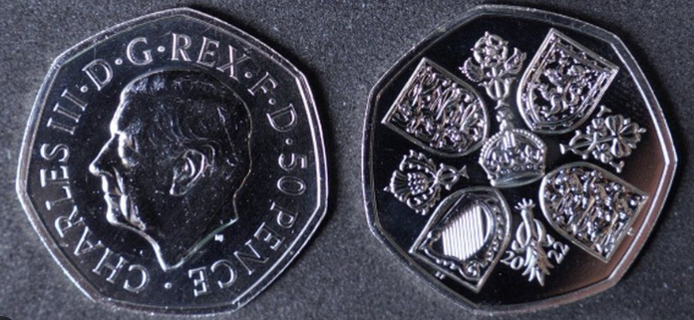
How would you describe a coin?

Slide 2
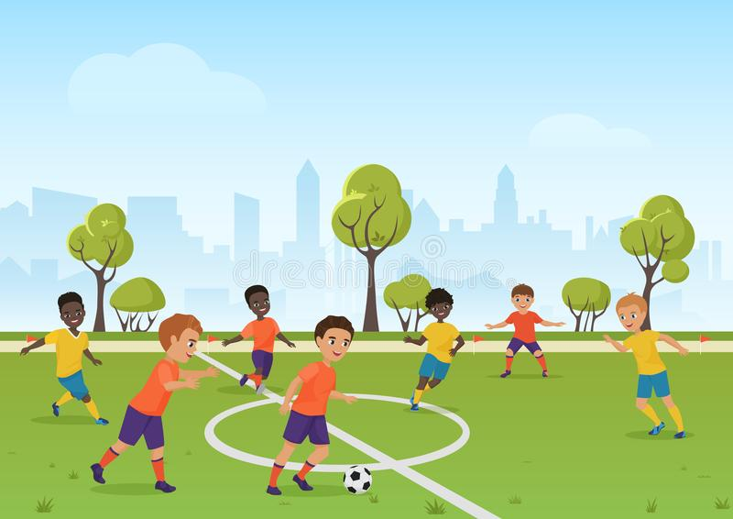
How would you describe a football match?

Slide 3
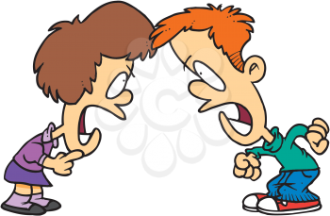
How would you describe an argument?

Slide 4
How are all three connected?

Slide 5

Do we have two sides to our behaviour?

Slide 6
Our behaviour
Optimistic vs Pessimistic
Trusting vs Envious

Slide 7

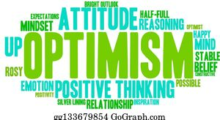



Optimistic vs Pessimistic

Slide 8


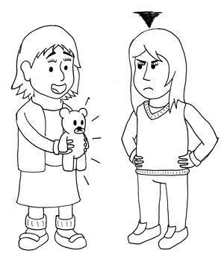
Trusting vs Envious

