Slide 1
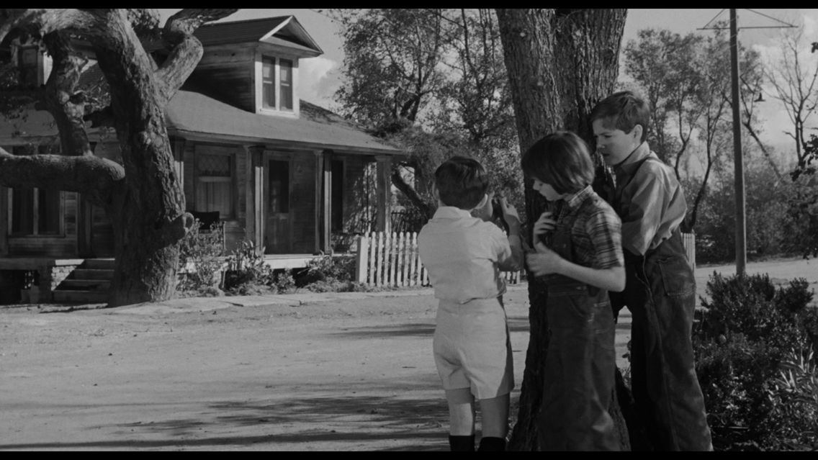
To Kill a Mockingbird by Harper Lee

Slide 2

The Boy in the Striped Pyjamas by John Boyne

Slide 3

A Man Called Ove by Fredrik Backman

