Slide 1
Welcome

Slide 2


Slide 3


Slide 4


Slide 5


Slide 6
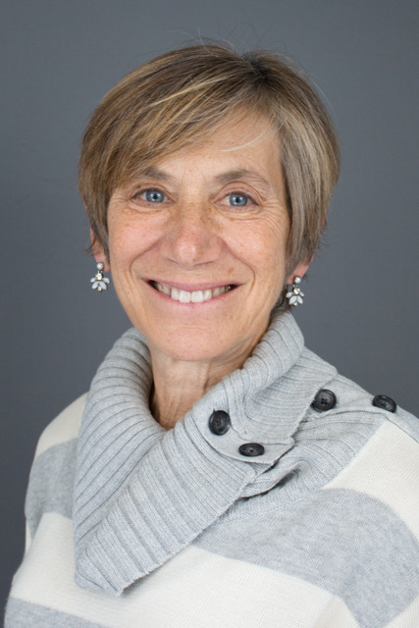

Slide 7

A purposeful life
The individual must be actively engaged
The individual must be engaged in a somewhat successful project
The project must have positive value

Slide 8


