Slide 1


Slide 2
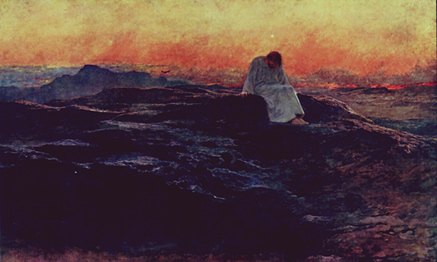

Slide 3
Pause for thought
When in your daily routine do you have space to stop and be still and quiet?
What is it that you need to stop doing to find opportunity for quiet stillness and peace?
Can you call to mind a particular location that will be a helpful ‘quiet place’ for you?

